Slide 1
Decimals and measures
Convert between standard units of mass
Independent Task
Mathematics

Slide 2
Question 1
Grams | Kilograms
817
276
 | 0.254
 | 0.72
156
 | 0.874
 | 0.6234
305
 | 0.3
Complete the table converting between grams and kilograms.

Slide 3
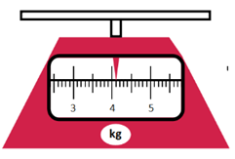
Question 2
An eight week old puppy is put on the scales.
Six months later, the puppy weighs 8.7 kg more.
What is the mass of the puppy now in grams?

Slide 4
Question 3
A pirate finds some gold bars. He needs to know how many grams of gold he has in order to sell.
He weighs one third of the bars.
What is the total mass of the bars in grams?

Slide 5
Question 4
I have been tracking the weight of my new kitten, Apricat.
At the end of week one, Apricat had gained 380 g.
At the end of the second week, he gained 0.09 kg.
At the end of the third week, he had gained 0.27 kg.
Apricat now weighs 2.01 kg.
What was his weight at the beginning in grams?

