Slide 1
Maths
Mr Bond
Please note this downloadable resource contains colour font and images

Slide 2
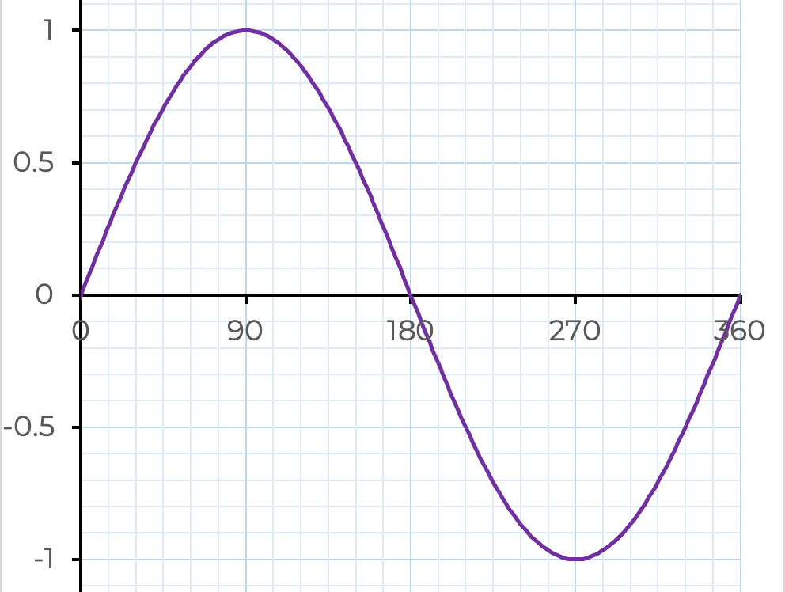
‹#›

Slide 3
Answers

Slide 4
‹#›

