Slide 1
Identifying fractions of shape with different numerators
Mathematics
Miss Sabzvari

Slide 2
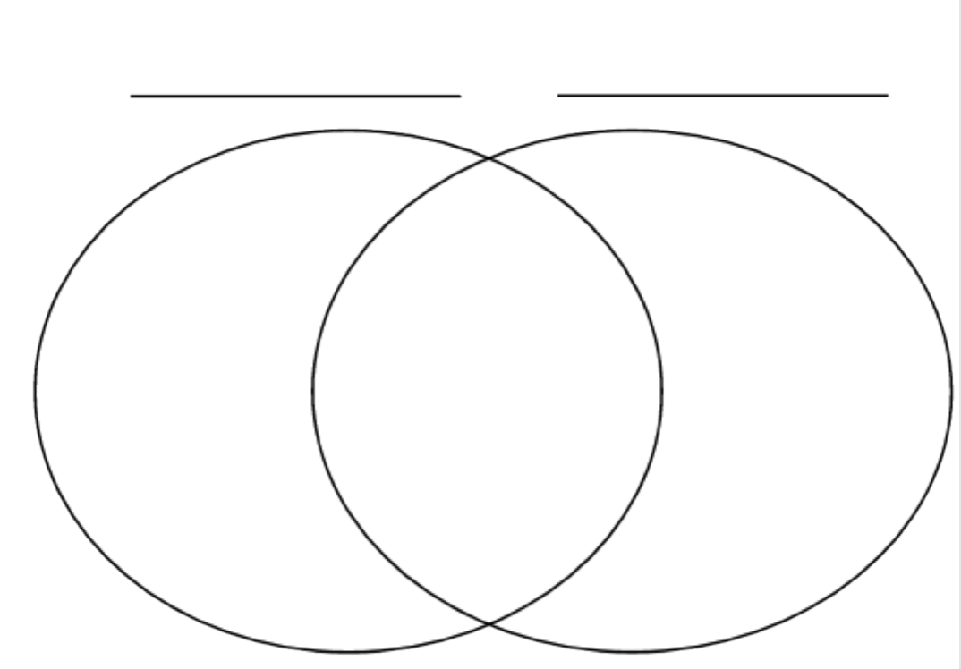
Independent Task
-Identify the fraction.
-Sort the fractions onto the Venn diagram.
numerator >1
denominator >2

