Slide 1
Solve algebraic fraction equations involving addition or subtraction
Maths
Miss Davies

Slide 2
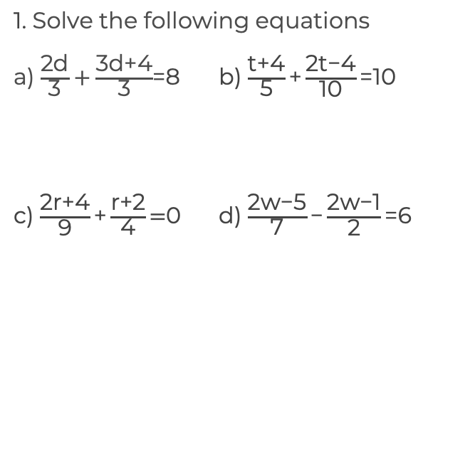
Solve algebraic fraction equations
‹#›

Slide 3
Answers

Slide 4
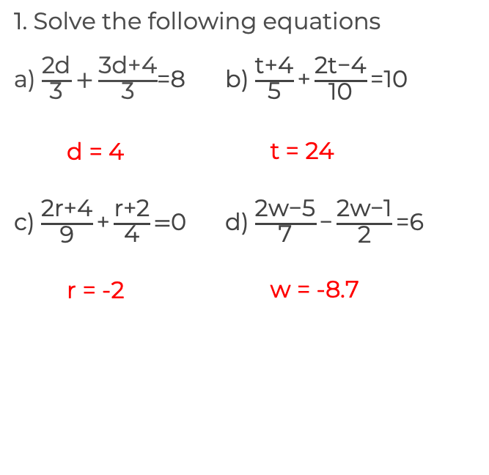
Solve algebraic fraction equations
d = -0.6
h = 1 or 5
t = -3.5 or 1
‹#›

