Slide 1
Solve problems involving the use of percentages for comparison.
Independent Task
Mathematics
Miss Parsons

Slide 2
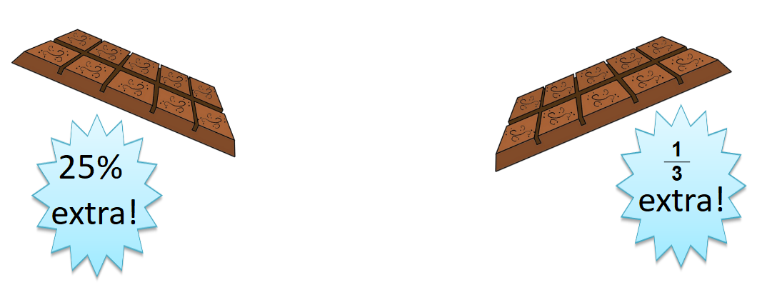
Question 1
A regular bar of chocolate weighs 300 g. It is on offer in two different shops.
Which offer has more chocolate? How do you know?
Notes:
Lesson Agenda:

Slide 3
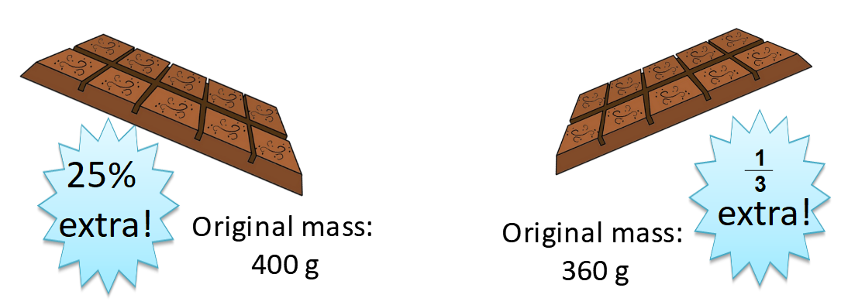
Question 2
Two bars of chocolate are on offer.
Which offers more chocolate? How do you know?
Notes:
Lesson Agenda:

Slide 4
Question 3
Laura scored 75% on a grammar test. There were 96 marks. Mo sat a different test with 80 marks. He got correct.
Who got more correct answers? Convince me.
4
5
Notes:
Lesson Agenda:

