Slide 1
Draw Graphs of Simple Cubic Functions Using Tables of Values
Maths
Miss Davies

Slide 2
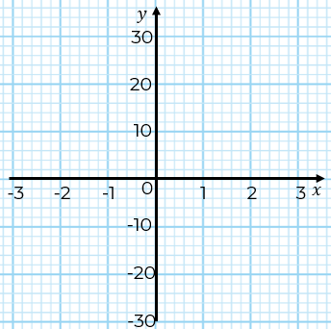
Draw graphs of simple cubic functions
 | -3 | -2 | -1 | 0 | 1 | 2 | 3
 | -3 | -2 | -1 | 0 | 1 | 2 | 3
‹#›

Slide 3
Draw graphs of simple cubic functions
 | -3 | -2 | -1 | 0 | 1 | 2 | 3
 | -3 | -2 | -1 | 0 | 1 | 2 | 3
‹#›

Slide 4
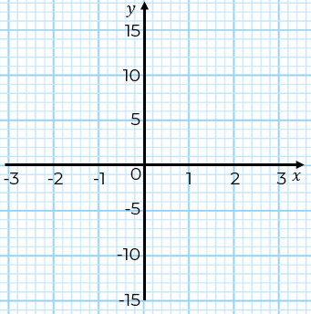
Draw graphs of simple cubic functions
 | -3 | -2 | -1 | 0 | 1 | 2 | 3
‹#›

Slide 5
Answers

Slide 6
Draw graphs of simple cubic functions
 | -3 | -2 | -1 | 0 | 1 | 2 | 3
 | -3 | -2 | -1 | 0 | 1 | 2 | 3
-27
-8
-1
0
1
8
27
27
8
1
0
-1
-8
-27
x
x
x
x
x
x
x
x
x
x
x
x
x
x
‹#›

Slide 7
Draw graphs of simple cubic functions
x
E.G They both pass through the origin and have
the same absolute values. The graph is reflected on the x-axis
x
x
x
x
x
 | -3 | -2 | -1 | 0 | 1 | 2 | 3
x
x
x
x
-25
-6
1
2
3
10
29
x
x
x
 | -3 | -2 | -1 | 0 | 1 | 2 | 3
x
-29
-10
-3
-2
-1
6
25
E.G The curve is the same shape they cross y-axis at different points.
‹#›

Slide 8
Draw graphs of simple cubic functions
 | -3 | -2 | -1 | 0 | 1 | 2 | 3
-15
0
3
0
-3
0
15
x
x
x
x
x
x
x
‹#›

