Slide 1
Identifying suitable bar models to represent word problems
Mathematics
Miss Mitchell

Slide 2
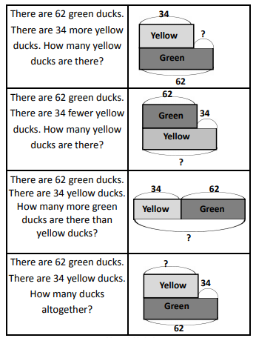
Question 1
Once you have matched the bar models to the word problems, can you solve the them?

