Slide 1
Lesson 5: DIVs and Classes
KS4 HTML and CSS
Computing
Ben Garside
Materials from the Teach Computing Curriculum created by the National Centre for Computing Education

Slide 2
Task 1 - DIVs
Click on the following link and explore the files (index.html and style.css) to help answer the questions below:
oaknat.uk/comp-html-l5-start
Where can you see the word “favourite” used other than inside the headings
Go to style.css and change the value of the background-color property to “red”. Run your code and describe what has happens to which parts of the page.
Why do you think DIVs are and what impact do you think they have had to the appearance to the site?

Slide 3
Task 1 – CSS cheat sheet 1
CSS property | Value example
background-color | green; red; blue; black; yellow; white; LightBlue; LightCoral; LightGreen; LightPink; LightGrey; oaknat.uk/comp-css-colors
color | (as above)
text-align | left; right; center;
font-family | Arial; Helvetica; Times New Roman; Verdana; oaknat.uk/comp-css-websafe-fonts
font-size | 20px;

Slide 4
Task 1 – CSS cheat sheet 2
CSS property | Value example
height | 100px;
width | 100px;
Margin (the space outside the box; this affects all margins – if you want specific ones, choose margin-top, margin-bottom, margin-left, or margin-right instead) | 10px;
Padding (the space inside the box) | 10px;
Border oaknat.uk/comp-css-border | 1px solid black;

Slide 5
Task 2 – DIVs and Inner DIVs
Go to the following repl.it and complete the tasks below:
https://repl.it/@NCCE/KS4-HTML-Lesson-5-DIV-and-ID-activity-Oak#index.html
Go to style.css and add the code on the right hand side (run your code to see what has happened)
Go to index.html and add another DIV to create the same effect on for “My favourite artists”
Use your cheat sheet to make the subheadings align to the centre.
.subheading{
background-color: rgb(229, 230, 215);
color: black;
border: 2px solid black;
margin: 5px;
padding:10px;
}

Slide 6
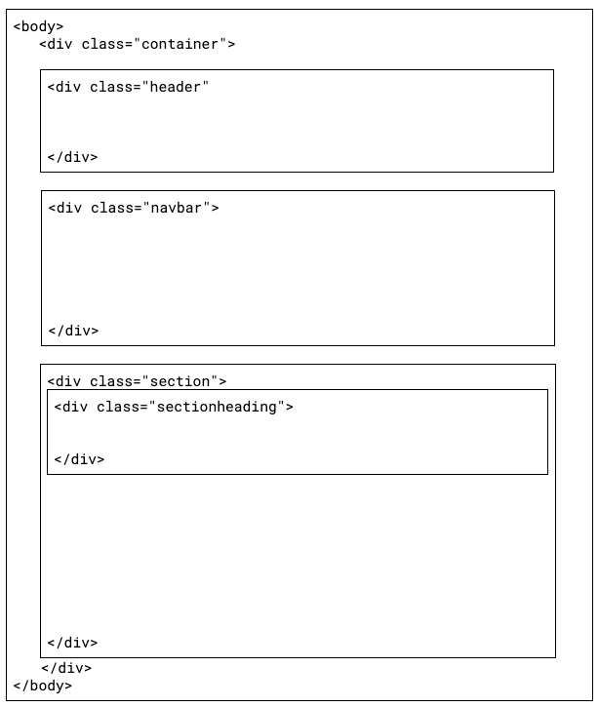
Task 3 - Adding DIV tags to your Laser tag website
Reopen your laser tag website on repl.it and apply DIV tags so that you can achieve different styles for the sections, heading and subheadings on your pages.
You should aim to achieve a similar appearance across all pages.
Use the previous activity and the cheat sheet from task 1 to help you

