Slide 1
Mathematics
Downloadable resource -
Solving simultaneous equation algebraically
Ms Bridgett

Slide 2
 |  |  | 12
 |  |  | 9
 |  |  | 10
In each table, the symbol represents a number.
The sum of each row is given.
Find the value of the symbols.
Which is easier and which is more difficult? Can you explain why?
 |  |  | 12
 |  |  | 9
 |  |  | 8

Slide 3
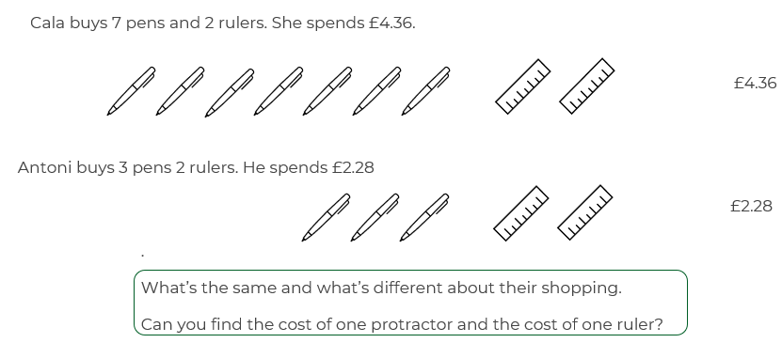
Can you write and solve this using algebra?
Let p=the cost of a pen and let q=the cost of a ruler.
Which method do you prefer?
Can you think of a situation where the algebra might be a better method to use?

Slide 4
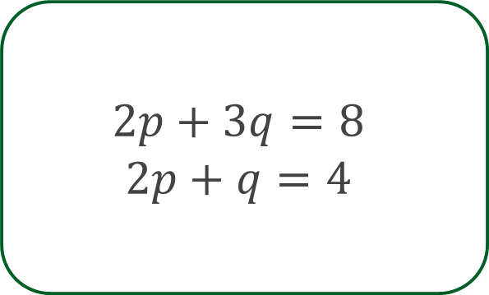
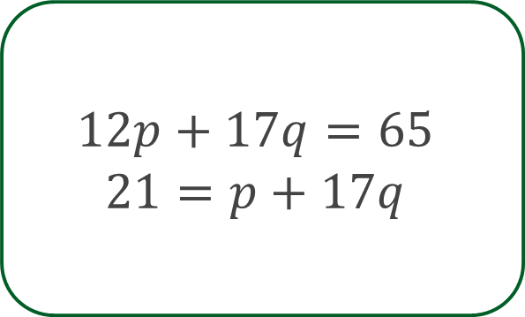
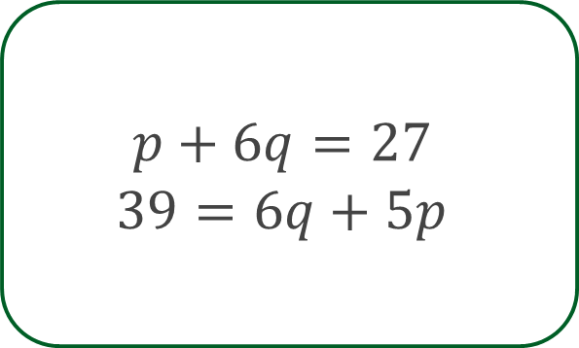
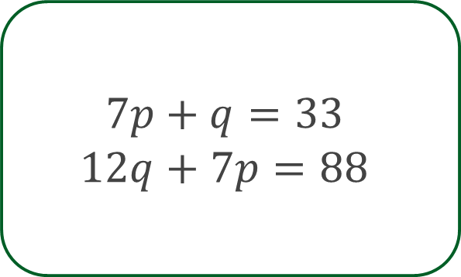
Solve the pairs of simultaneous equations.
Check your solutions using substitution.

Slide 5
Place 1, 2 and 3 into the boxes to create a pair of simultaneous equations.
For example:
How many different pairs of equations are there?
How many pairs of solutions are there? Are they all possible to solve? Can you explain why?
Which solutions are integers and which aren’t?
What else do you notice?

