Slide 1
Recalling the 3 times table
Independent Task
Mathematics
Miss Brinkworth

Slide 2
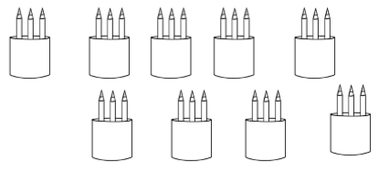
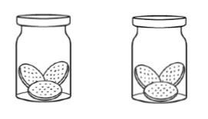
Part A match each question to the picture and answer it
2 x 3 =
= 10 x 3
9 x 3 =
= 7 x 3
Source: Mathematics Mastery
Notes:
400 - 20 = 380
312 - 80 = 232
578 - 90 = 488

Slide 3
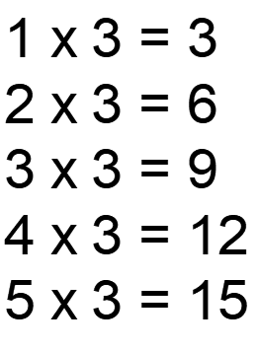
Part B Fill in the missing numbers here
2) Draw arrows to continue the 3 times table
3) Spot the odd one out of these numbers
15 9 21 30 13 33 6

