Slide 1
Solving adfected quadratic equations
Mathematics
Mr Coward

Slide 2
Try this
Find as many possible pairs of side lengths for each rectangle.
Area = 6 units squared
Area = 0 units squared
What do you notice?
Notes:
Answers

Slide 3
Independent task
1) Solve the following equations
Notes:
These paths are of a movements going clockwise and anti clockwise from C. It might be a bit surprising to Ss that the totals aren’t equal. The other interesting thing is that the 6 bearings can be paired to make 6 sums of 360. Ss might be prompted to notice which pairs make 360 which is somewhat interesting too

Slide 4
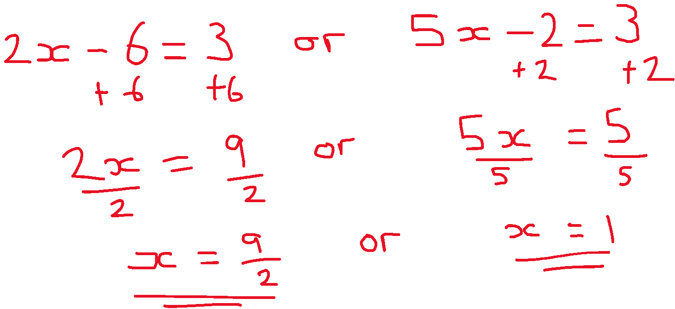
Independent task
2) What has gone wrong?
3) The below shows a quintic equation, to the power 5.
How do you know it will have a power of 5?
Find all the solutions of the quantic.
This quantic has five unique solutions, create a quantic with less than 5 solutions
Notes:
These paths are of a movements going clockwise and anti clockwise from C. It might be a bit surprising to Ss that the totals aren’t equal. The other interesting thing is that the 6 bearings can be paired to make 6 sums of 360. Ss might be prompted to notice which pairs make 360 which is somewhat interesting too

Slide 5
Explore
Zaki says this bracket will have two unique solutions because the brackets are different, show Zaki is incorrect.
Notes:
Students may notice that 5/6 and 3/4 can also be compared by denominating by 12ths

