Slide 1
Properties and combustion of alcohols
GCSE Chemistry - Chemistry - Key Stage 4
Organic chemistry
Dr Patel

Slide 2
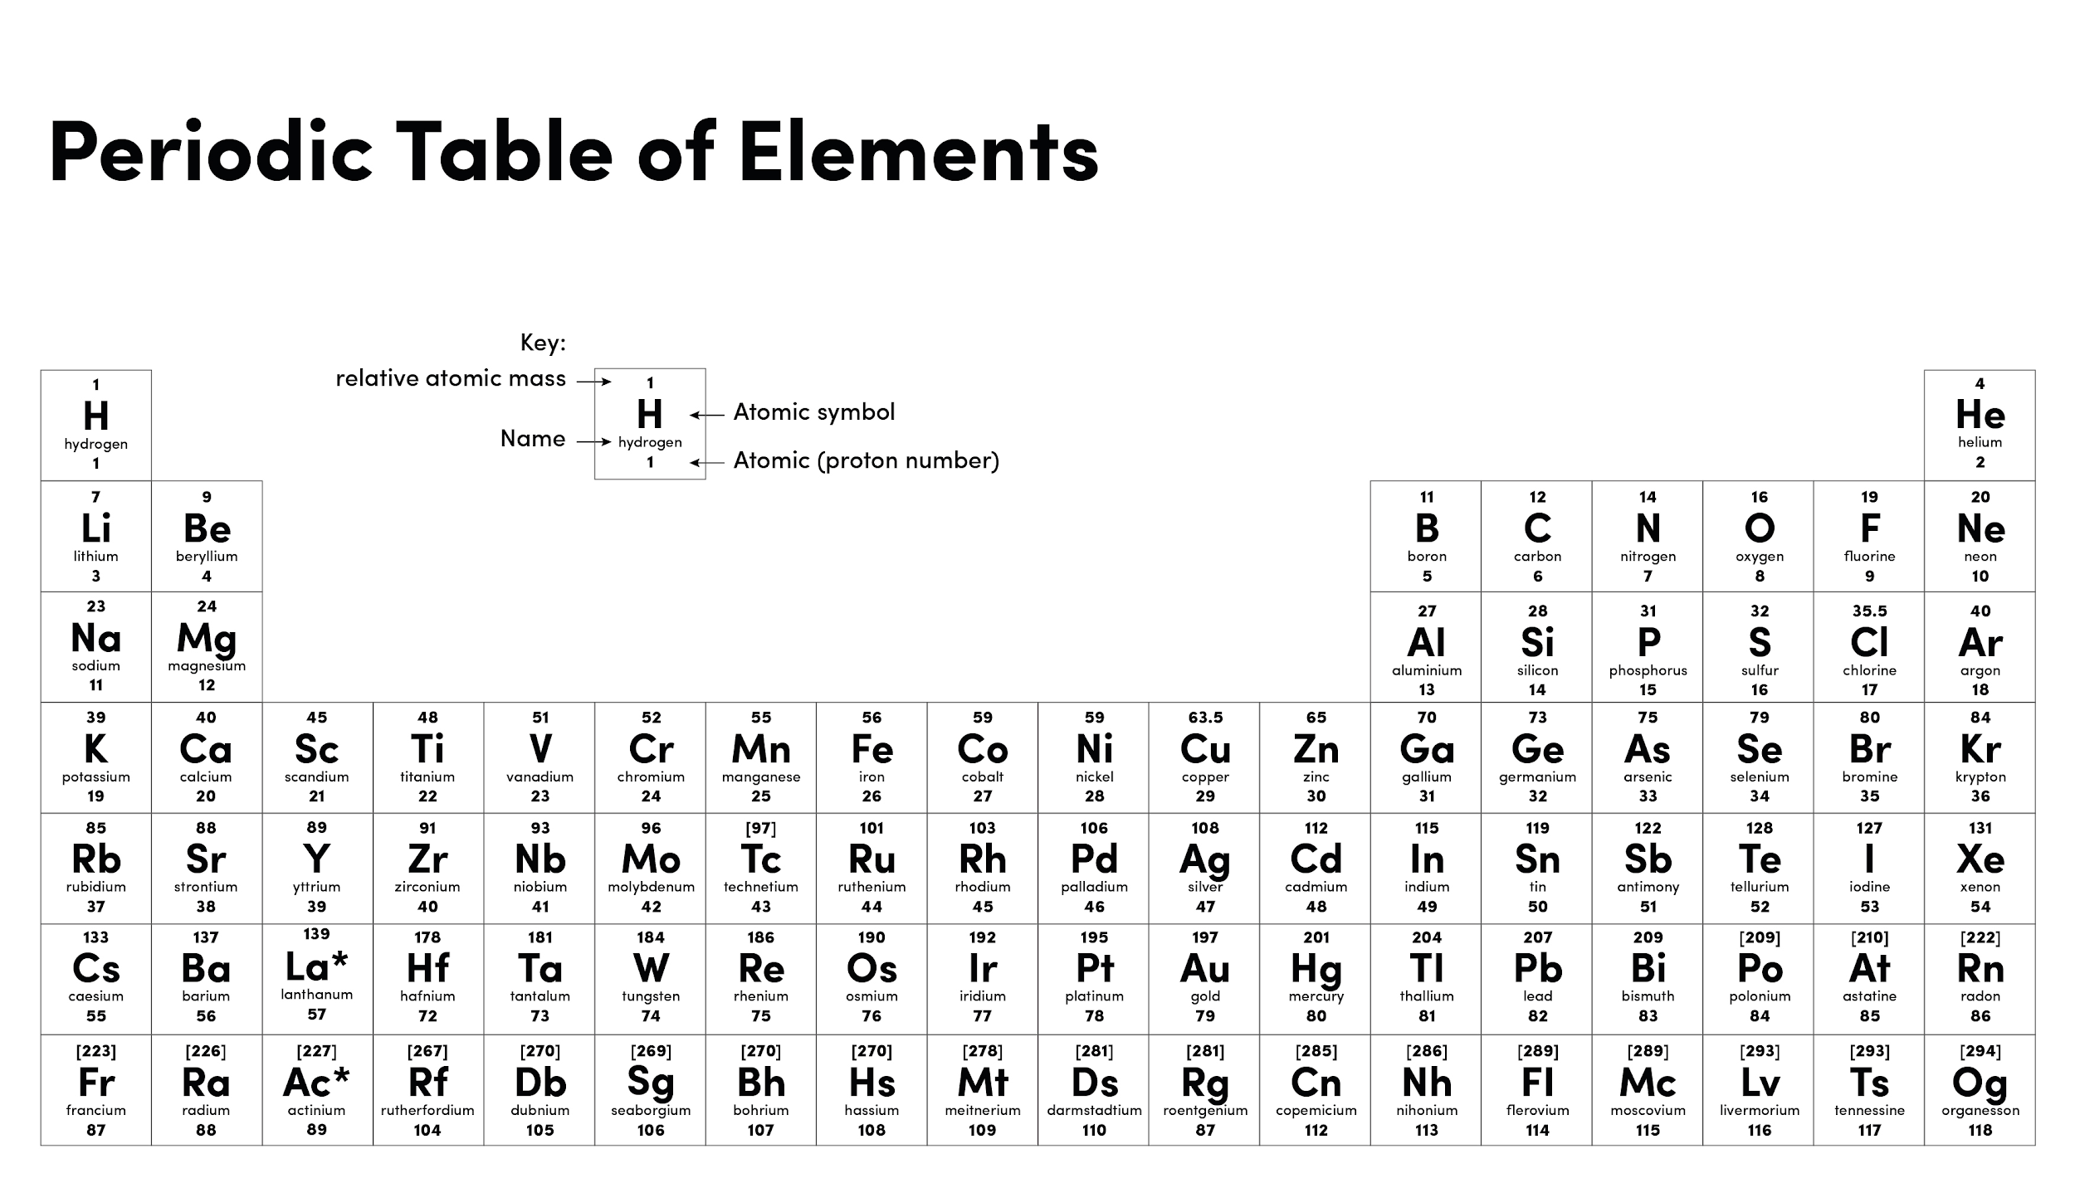
Source of image: Oak

Slide 3
Independent task
Property | Test | Observation
Solubility | Does the alcohol dissolve when added to water?
pH | What is the pH of the alcohols when tested with universal indicator?
Reaction with sodium | Reaction with sodium metal
Flammability | Did the alcohol set alight easily when a lit splint was held near it

Slide 4
Independent task
Method step | Reason
Use a measuring cylinder to measure out 100cm³ cold water into the conical flask
Take the starting temperature of the water
Measure the mass of the spirit burner with methanol in, including the cap

Slide 5
Independent task
Method step | Reason
Place a spirit burner underneath the flask and light the wick
When the temperature has increased by 10°C, extinguish the burner using the cap

Slide 6
Independent task
Method step | Reason
Reweigh the spirit burner and calculate the mass lost
Repeat all steps using a different alcohol in the burner

Slide 7
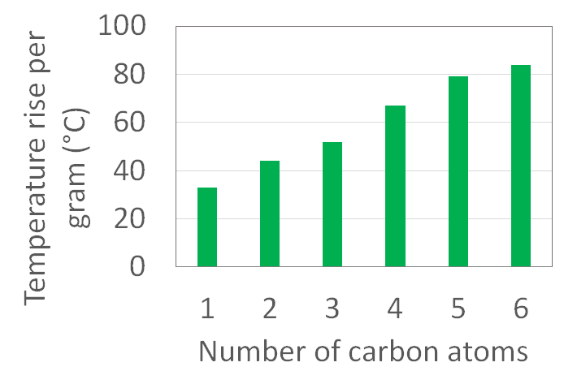
Independent task
Describe the results:
As the number of carbon atoms __________, the temperature rise per gram _________. This shows the alcohols with _______ energy releases ________ energy.

