Slide 1
Review 3
GCSE Chemistry - Chemistry - Key Stage 4
Organic chemistry
Dr Patel

Slide 2
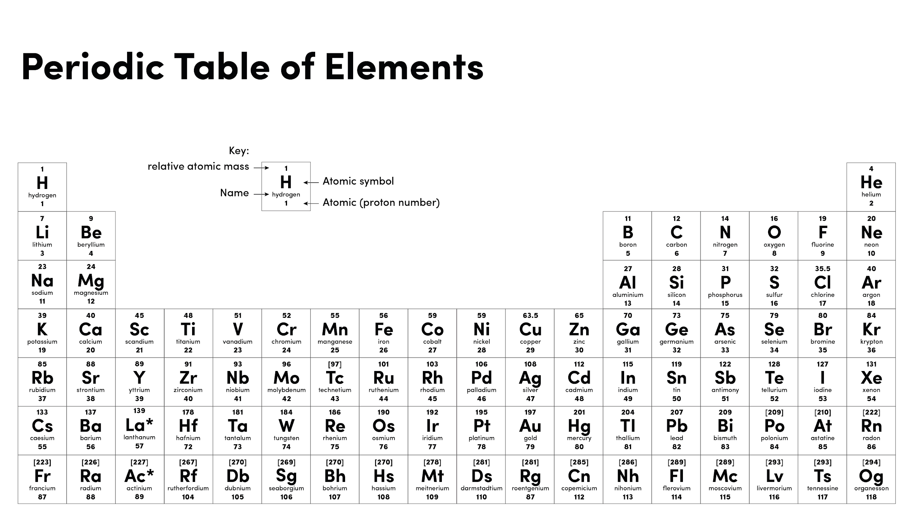
Source of image: Oak

Slide 3
Alkanes and alkenes
Hydrocarbon - contains carbon and hydrogen only
‘Meth’ (1 carbon), ‘Eth’ (2 carbons) ‘Prop’ (3 carbons), ‘But’ (4 carbons)
Homologous series - a family of molecules that contain the same functional group
Functional group - a group of atoms or bonds that determine the chemical/reactive properties of a molecule
Saturated - no double bonds
Unsaturated - contains at least one double bond
Alkanes: saturated, C_{n}H_{2n+2}
Alkenes: unsaturated, C=C functional group, C_{n}H_{2n+2}

Slide 4
Alcohols and carboxylic acids
Alcohols: solvents and fuels, OH functional group, name ends in -ol, C_{n}H_{2n+1}OH
Sodium + alcohol → sodium ethoxide + hydrogen
Carboxylic acids:
COOH functional group
Methanoic, ethanoic, propanoic and butanoic acid
Weak acids (partially ionise)
Metal carbonate + carboxylic acid → salt + water + carbon dioxide
Metal + carboxylic acid → salt + hydrogen
Alcohol + carboxylic acid → ester + water

Slide 5
Polymers
Repeating unit
Monomer - a small molecule that can react with another to form a long chained polymer
Polymerisation - many monomers join together to form a long chain
Addition polymerisation - monomers are alkenes (C=C), one product, no double bond in repeating unit.
Condensation polymerisation - monomers contain two functional groups, small molecule released (e.g. water of HCl).
H
H
C
C
H
H
n
Polymer (polyethene)
HOOC
COOH
HO
OH

Slide 6
Independent task
Do:
Start with the key facts you don’t know!
Use images
Use colour
Use keywords
Keep it concise
Be precise
Make them neat
Use them!
Don’t
Use full sentences
Rush
Create at least 5 flashcards using the key facts shown at the start of today’s lesson. You must choose 5 facts you’d forgotten or find it difficult to remember.

Slide 7
Independent practice
Incorrect statement | Correct statement
Amino acids are the monomers that make up DNA.
When a metal carbonate reacts with a carboxylic acid, hydrogen gas is produced.
When a carboxylic acid and an alcohol react, they produce salt and water.

Slide 8
Independent practice
Poor statement | Correct statement
When a group 1 metal reacts with water, it produces salt and water
Carboxylic acids are weak acids because they turn universal indicator yellow-orange
H
H
H
H
C
C
C
H
H
H

Slide 9
Write each statement next to the correct command word
State
Give a scientific reason as you why something occurs
Describe
Describe the similarities and differences between things
Explain
Consider evidence for and against and make a judgement
Compare
Give a simple answer. No explanation needed.
Evaluate
Recall some facts, events or process in an accurate way

Slide 10
Independent Practice
H
H
State the functional group that is present in all carboxylic acids
Describe the structure of ethene (see diagram)
Explain why carbon monoxide is produced during the incomplete combustion of alkanes.
C
C
H
H
Notes:
There turn.

Slide 11
Alcohol | Both | Water

Slide 12
Independent Practice
Compare the reaction of sodium with ethanol and water.
Notes:
There turn.

