Slide 1
Mathematics
Applying decimals and percentages to area multiplication
Downloadable Resource
Mr Langton

Slide 2
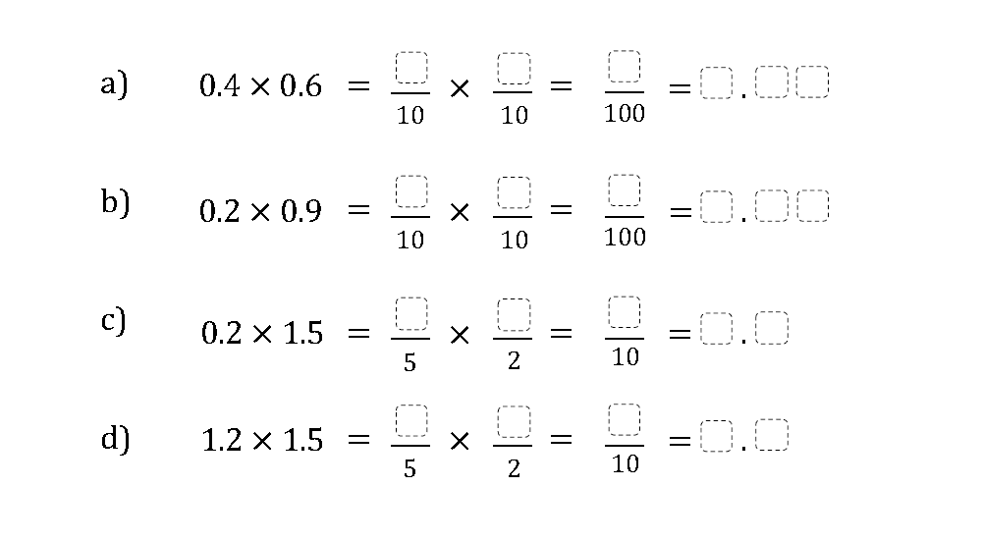
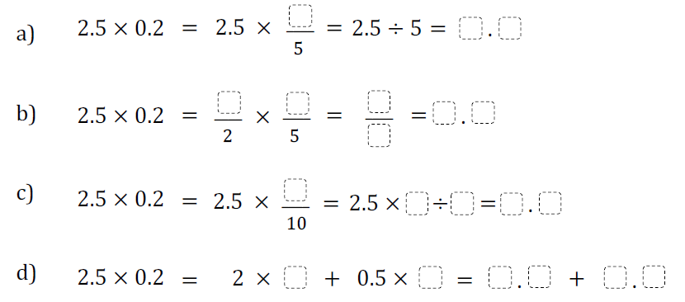
Applying decimals and percentages to area multiplication
Show the representation as a fraction calculation:
Show the representation as a decimal calculation:
Solve both of your calculations:

