Slide 1
Enlargement by an integer scale factor Lesson 1 of 8
Downloadable Resource
Mathematics
Miss Kidd-Rossiter

Slide 2
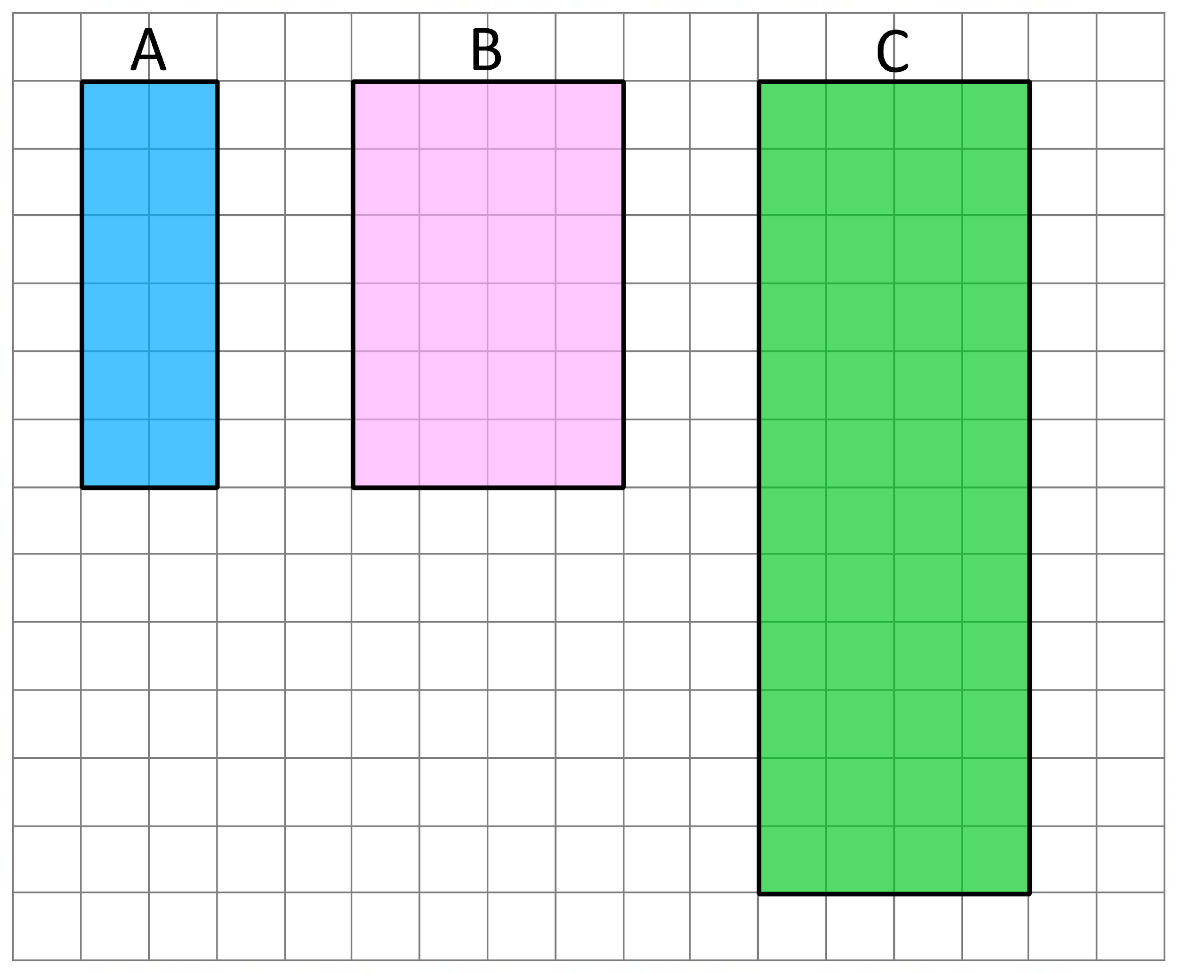
Try this
What’s the same and what’s different?
Support on next slide

Slide 3
Try this
What’s the same and what’s different?
Hint - what’s the same/different about the:
Angles
Side lengths

Slide 4
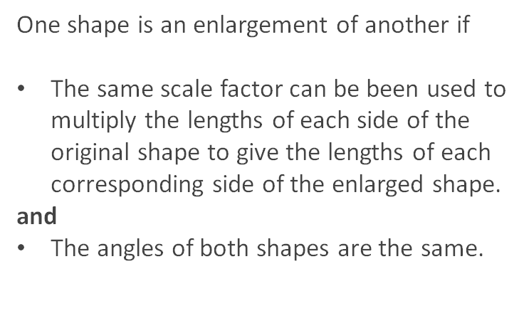
Connect
Notes:
One shape is an enlargement of another if
The same scale factor can be been used to multiply the lengths of each side of the original shape to give the lengths of each corresponding side of the enlarged shape.
and
(b)The angles of both shapes are the same.

Slide 5
Connect
Notes:
One shape is an enlargement of another if
The same scale factor can be been used to multiply the lengths of each side of the original shape to give the lengths of each corresponding side of the enlarged shape.
and
(b)The angles of both shapes are the same.

Slide 6
Independent task
The below shapes have been enlarged. What scale factor have they been enlarged by?
A is the object, B is the image
A is the object, C is the image
A is the object, D is the image
B is the object, C is the image
A
B
C
D

Slide 7
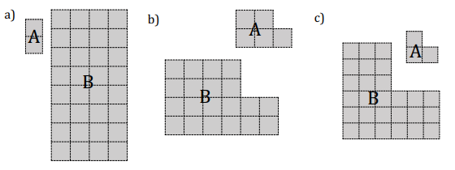
Independent task
State the scale factor of enlargement for each of the following transformations from A to B.
Find the perimeters of each of the shapes in Q2. What do you notice?

Slide 8
Independent task
Explain why Z is not an enlargement of Y
 | Y |  |  |  | Z

Slide 9
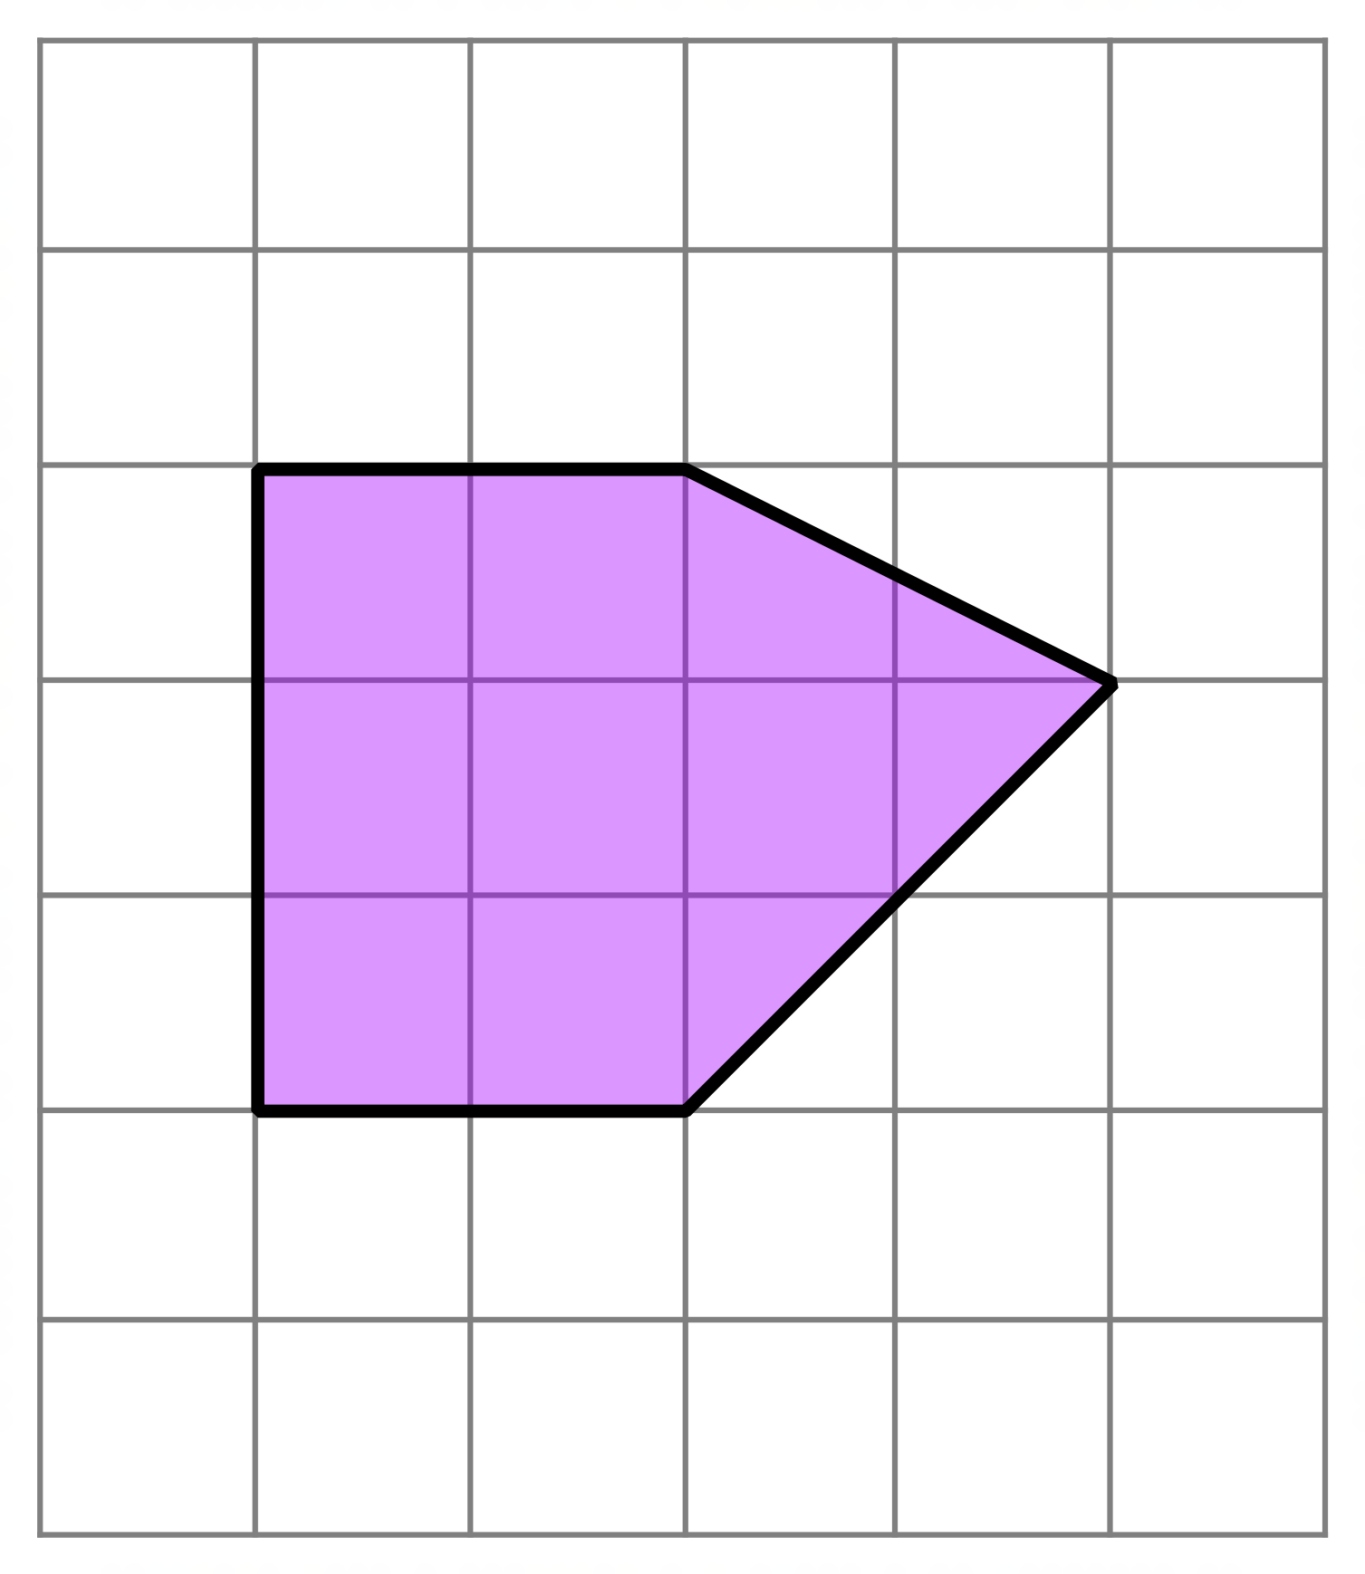
Explore
Draw a copy of the purple pentagon onto squared paper
Draw enlargements of the pentagon with the following scale factors:
scale factor 2? scale factor 3? scale factor 4?
scale factor n?
What is the area of the enlarged shape?
What do you notice?

