Slide 1
Exploring the value of a 3-digit number in more than one way
Lesson 3 of 5
Mathematics
Miss Jones

Slide 2
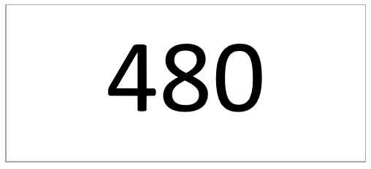
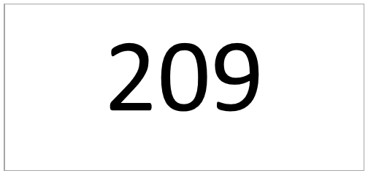
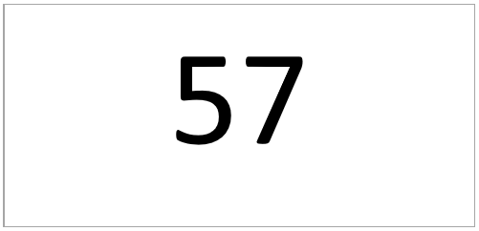
Record two different ways of representing the numbers below.
You can draw the dienes or write the numbers.
An example has been done for the number 480.

