Slide 1
Independent Living Unit 5 - World of Work
Oak Specialist
Applying Learning

Slide 2
Unit 5- World of Work
Lesson 1 - The benefits of work
Lesson 2 - Different types of work
Why do we work? This lesson explores what’s good about getting a job.
Not all jobs are the same. This lesson looks at understanding what a job family is and the different types of tasks that can be done.
Option 3
Lesson 4 - Routes into employment
Lesson 3 - Vocational profiling
Option 4
What is a vocational profile and how can it help you?
What are the different ways to get a job. Which route is right for you?
Lesson 5 - Getting a job
Lesson 6 - Workplace behaviour
Option 3
Option 4
Where should you look for jobs? Understanding Interviews and reasonable adjustments
How is work different to school or college? What rules are the same and what ones are different?
Notes:
Depending on how many lessons for each unit, there could be a 2nd page for lesson 5…etc

Slide 3
Lesson 6 - Workplace behaviour

Slide 4
Teacher notes- Lesson 6
-Learning intention:
To know some of the behaviour expectations in a workplace setting
Understand what to do when they have trouble meeting the required expectations
Types of behaviour (Social, Unsocial, Anti-Social)
Workplace expectations - the rules and conduct
Planning for challenges
Resources:
Pen and paper
Notes:
In this lesson it will be important to get across to the student that when we talk about ‘behaviour’ this is not always negative. It is just as important if not more important that we think about displaying positive behaviour. Students with additional needs will have challenges that are unique to themselves so it will be important they they are able to predict what some of these might be and how to plan for them.

Slide 5
Lesson Activity Stages
This lesson will be taught in 3 parts:
Types of behaviour
The rules of work
Predicting and planning for challenges
Notes:
Share with the student the purpose of the lesson and the things you will be doing together

Slide 6
Part 1: Types of behaviour
It is important to think about our behaviour in a workplace. Many things will be the same as what people expect of you in a school, college or at home but some are different.
Our ‘behaviour’ can be grouped into three types:
Social
Unsocial
Anti-social
Notes:
The next slide will explain the three groups

Slide 7
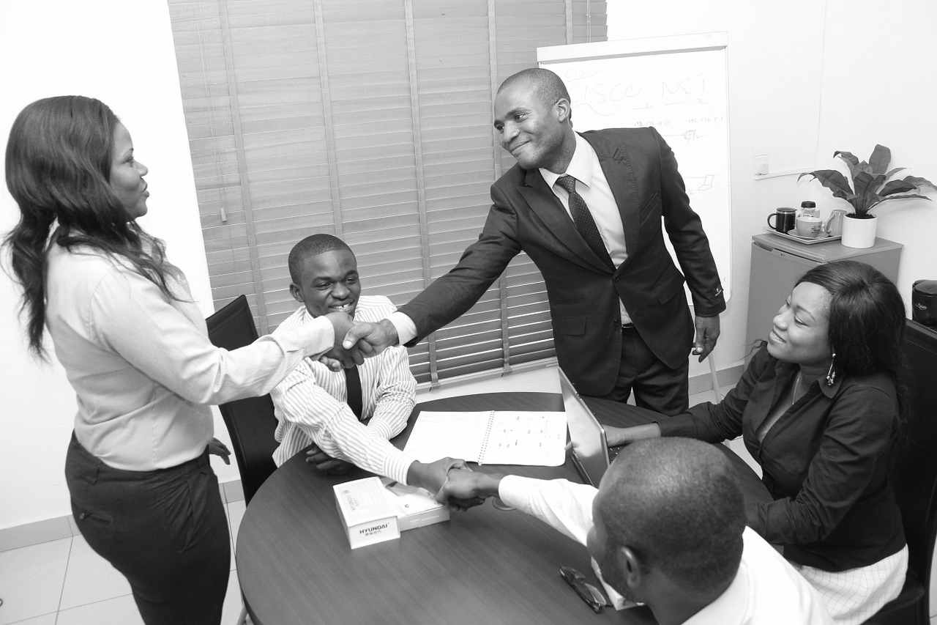
Types of behaviour
Social
Calm, interactive (you communicate well) and are productive (you do the tasks you have been asked to do).
You are able to complete your job without any problems and people are happy to work alongside you.
Notes:
Teaching point: it is important to distinguish for the student the different between ‘socially acceptable behaviour’ and ‘socialising’ the term ‘social behaviour’ is referring to socially acceptable behaviour, ie. positive behaviour displayed to others. It does not mean you have to always be mixing with others in an informal way.

Slide 8
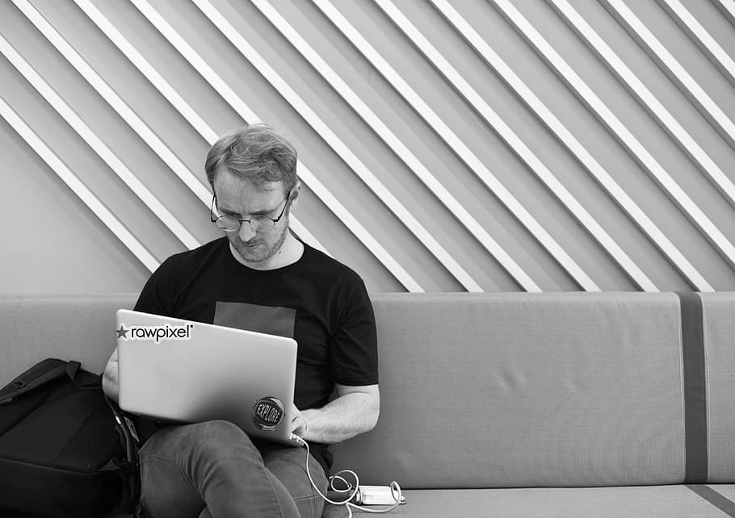
Types of behaviour
2. Unsocial
You are controlled and productive but you may struggle to interact and communicate well with others around you, but your actions are not disruptive.
Notes:
Teaching point: this is not necessarily a negative behaviour. However it will be important to explore with the individual student any behaviour that they deem unsocial as if this is frequently repeated it may become anti-social.

Slide 9
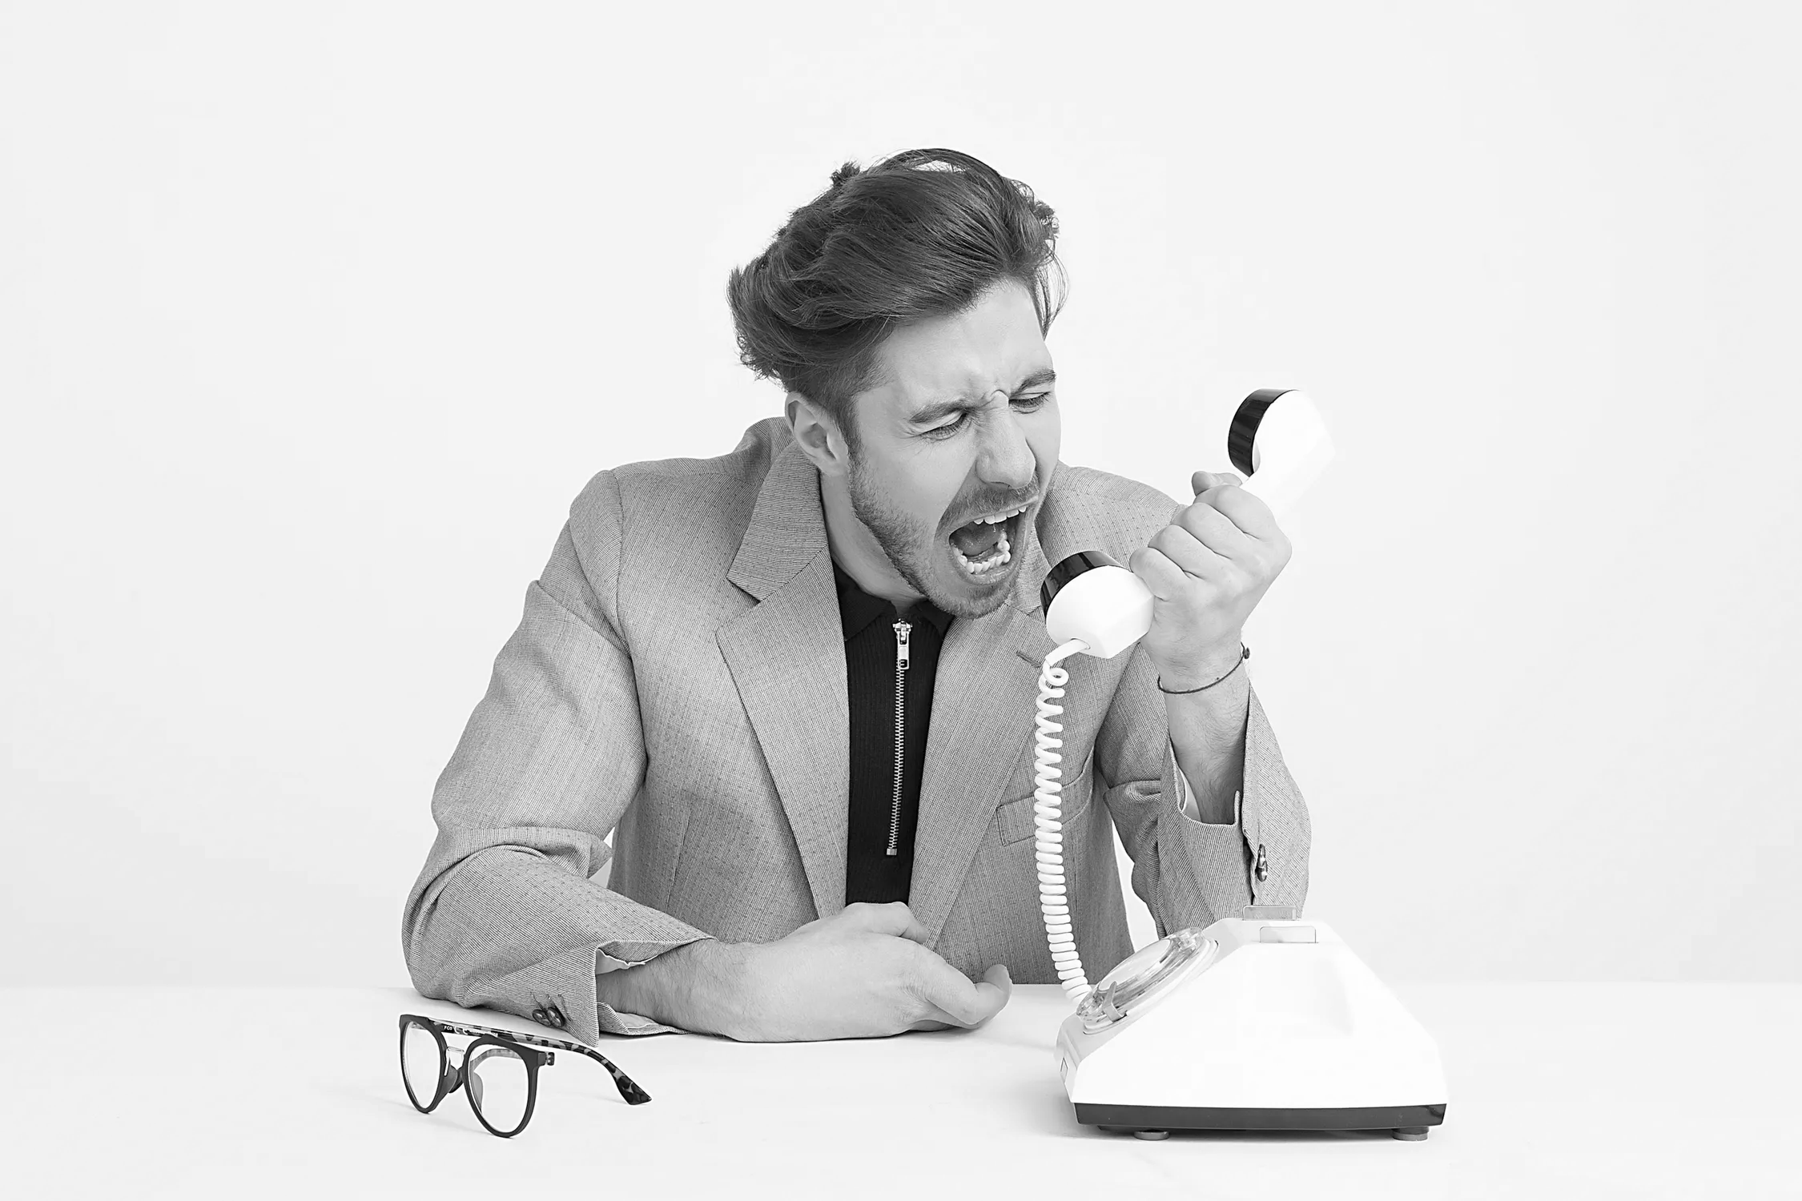
Types of behaviour
3. Anti-social
You display behaviour that challenges, upsets or disrupts others (staff and customers).
Notes:
Teaching point: sensitively ask the student to recall a time when they have felt they have displayed anti-social behaviour

Slide 10
Types of behaviour
On the next three slides you will see some examples of people displaying different types of behaviour.
With your teaching partner discuss whether you think it is an example of social, unsocial or anti-social behaviour.
Can you explain why this type of behaviour would be appropriate or inappropriate in the workplace?

Slide 11
Types of behaviour
Example 1:
You arrive at work feeling stressed because you are late. You decide you need to have your morning cup of coffee, without talking to anyone you head to the staff kitchen. When the manager tells you that you are late and you haven’t read an important email you throw your coffee at your manager.
Social? Unsocial? Anti-Social?
Notes:
Encourage conversation around each example. E.g. would you ever do that? Is that positive or negative? What might have happened/you be feeling to behave that way?

Slide 12
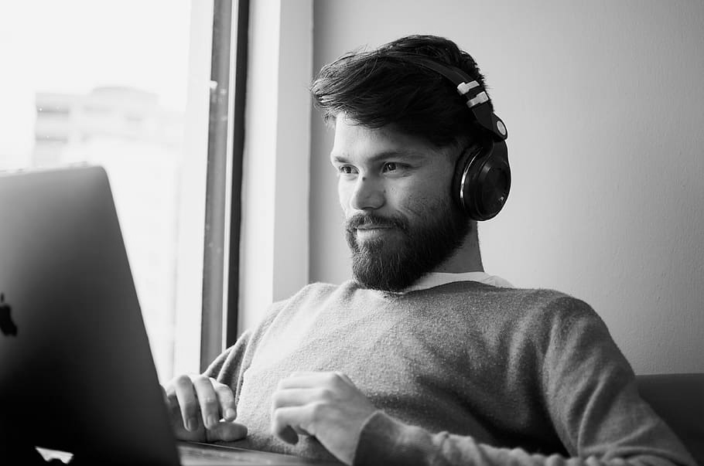
Types of behaviour
Example 2:
You arrive at work feeling sad because your favourite pet died last night. You sign in but you do not say hello to the security guard like you normally do. You head to your desk and put your headphones in and start to check your emails. You forget about the team meeting.
Social? Unsocial? Anti-Social?
Notes:
Encourage conversation around each example. E.g. would you ever do that? Is that positive or negative? What might have happened/you be feeling to behave that way?

Slide 13
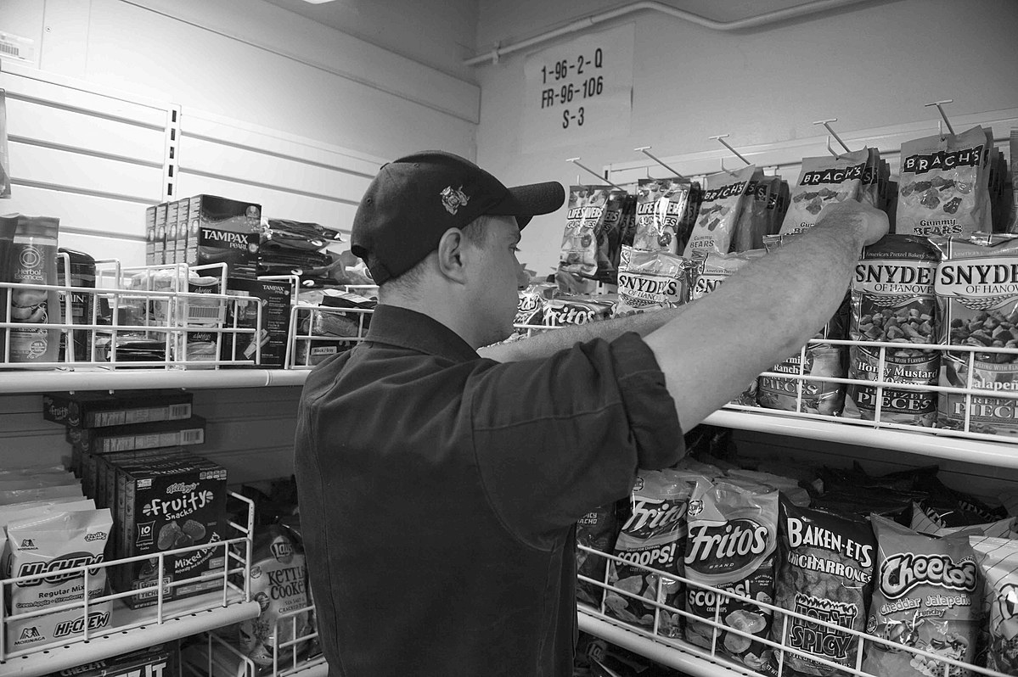
Types of behaviour
Example 3:
You arrive at work early, make yourself a cup of tea in the staff kitchen. You have a quick chat with a colleague (staff you work with) about a TV show and then head out onto the shop floor to restock the shelves.
Social? Unsocial? Anti-Social?
Notes:
Encourage conversation around each example. E.g. would you ever do that? Is that positive or negative? What might have happened/you be feeling to behave that way?

Slide 14
Types of behaviour
How did you do? Check your answers.
Behaviour | Example | Comment
Social | Arrive early, make a cup of tea and have a quick chat, then head off to restock the shelves. | You communicate with staff, have good time keeping and complete your task.
Unsocial | Sad because your pet died, sign in but don’t say hello. Put your headphones on, check emails but forget the team meeting. | This is OK as your behaviour has not negatively impacted on others. We all forget things sometimes, but if this regularly happens then this would be a problem.
Anti-Social | You arrive late and stressed but still make a drink, when challenged by your manager you throw coffee at them. | This is unacceptable behaviour, however you might be feeling. This will lead to serious consequences and may mean you lose your job.
Notes:
Teaching point: Does the student agree with the type of behaviour given to each example. If not can they suggest why?

Slide 15
Part 2: The rules of work
A workplace comes with rules which can be separated into two groups.
Instructions: something you MUST do - for example not to use your mobile phone in-front of customers.
Conduct: the positive social behaviour that should be displayed
Instructions can be quite simple to follow, whilst conduct does not always come with examples which can make it difficult to understand.
Notes:
Teaching point: Conduct is an extremely challenging concept for someone with additional needs or learning difficulty to understand. Explain to the student that conduct, simply put, is an example of positive behaviour.

Slide 16
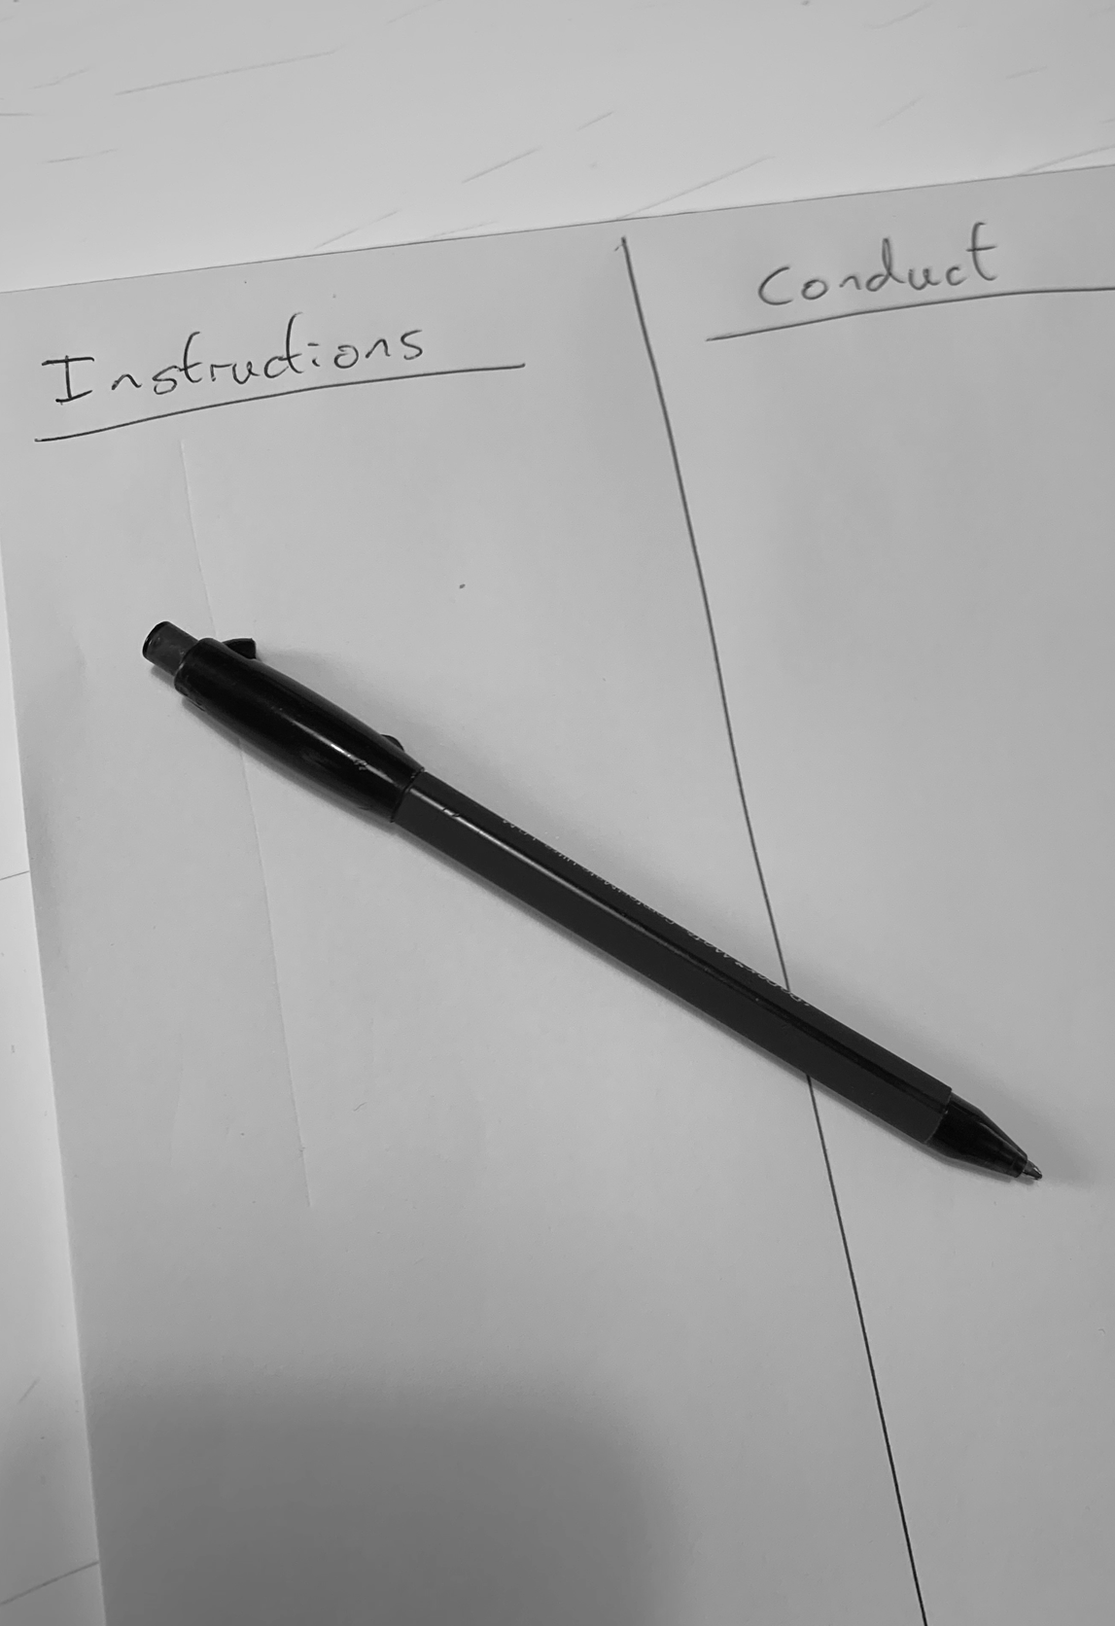
The rules of work
On a piece of paper draw a line down the middle and add the word ‘Instruction’ at the top of one half and ‘conduct’ at the top of the other half.
On the next slide are examples of different workplace rules. Can you sort them into the two columns on your paper into instructions and conduct?
Image teachers own
Notes:
Teaching point: Conduct is an extremely challenging concept for someone with additional needs or learning difficulty to understand. Explain to the student that conduct, simply put, is an example of positive behaviour.

Slide 17
The rules of work
Report a safety issue to a manager immediately
Instructions or conduct?
Wear an ID badge
Treat each other with respect and dignity
Be polite when talking to others
Sign in at reception
Take time to understand the needs of the customer
Behave honestly and in the best interests of the business
Present yourself to others as professional and ready to help
Always wear a hard hat on the construction site
Write emails in font size 14
Notes:
Teaching point: check the student understands the example before asking them to decide if it is an instruction or conduct

Slide 18
The rules of work
How did you do? Check your answers
Instructions | Conduct
Wear an ID Badge | Be polite when talking to others
Sign in at reception | Behave honestly and in the best interests of the business
Write emails in font size 14 | Treat others with respect and dignity
Always wear a hard hat on the construction site | Take time to understand the needs of the customer
Report a safety issue to a manager immediately | Present yourself to others as professional and ready to help
Notes:
Teaching point: check for any misplaced examples in their own work, discuss any they are still unsure about.

Slide 19
The rules of work
There are some rules that aren’t written down. This is because they are generally agreed social standards for work, home and the community.
Some of these are:
Have good personal hygiene
Maintain personal space with colleagues and customers
Respect for property (no stealing)
Listen when someone is speaking to you
Respond when asked a question
Notes:
Teaching point: Discuss that some rules might not be written down, but that doesn’t mean it isn’t a rule. If they are ever unsure they should ask a trusted adult.

Slide 20
Part 3: Predicting and planning for challenges
In part 1 and 2 we have seen how positive social behaviour is the expected behaviour for a workplace, whilst unsocial behaviour may be acceptable on occasions but anti-social behaviour is not ok.
However, we all feel overwhelmed sometimes and when we are, we find it more challenging to display positive social behaviour.
Therefore it is important that we have a plan to manage our feelings and actions so that our behaviour does not become anti-social.
Notes:
Teaching point: for this exercise to be most effective encourage the student to draw upon previous personal experiences

Slide 21
Example plan
What might happen | Feeling | Possible anti-social action | Plan for positive social action
The manager speaks to me about not completing all my tasks on time | Low, annoyed, upset | Start shouting at the manager. Walk off | Listen, but don’t make eye contact as makes me feel uncomfortable. Thank the manager for their feedback and arrange for a time to talk again.
A customer brings in a dog | Scared | Shout, hit out towards the dog and customer | Call another colleague to speak to the customer, move away to a safe space such as the stockroom.
Long term plan to address regular difficulties
People to help me: Speak to my Job Coach. Set up a weekly check in with my mentor/workplace buddy. Tell my colleagues in advance about my fear of dogs. Things I need to be able to do: Practice active listening and listing the things I am good at so I don’t get myself down when I get some less positive feedback.

Slide 22
Predicting and planning for challenges
Have a go at creating your own plan. Draw out the table below, add as many rows as you need. If it helps make it visual.
What might happen | Feeling | Possible anti-social action | Plan for positive social action
Long term plan to address regular difficulties
People to help me: Things I need to be able to do:
Notes:
Teaching point: for this exercise to be most effective encourage the student to draw upon previous personal experiences

Slide 23
Independent Living
World of Work
Workplace behaviour
Make it easier
Make it harder
More ideas
Don’t use the phrase ‘unsocial’ and keep to positive and negative behaviours.
Identify 3 Instructions and 3 conduct behaviours that are the same wherever you are.
Identify 3 Instructions and 3 conduct behaviours that are different in the workplace.
Make it real - act out scenarios from the student’s plan.
Look at some businesses code of conduct and discuss the students understanding of what is written down.

Slide 24
Further Learning with Oak National
Independent Living:
Applying Learning- People who help us (Unit 4)
Applying Learning- Community safety (Unit 6)
External sites:
Use a search engine and type ‘code of conduct’ to find real examples of workplace rules and expectations

Slide 25
References
Slide 8- Man at desk, User 11472009, Freepik / Colleagues seminar, Needpix
Slide 9- Alone casual, Pxfuel
Slide 10- Man wearing brown suit jacket, Pexels
Slide 12- Spilt coffee, Piqsels
Slide 13- Man wearing headphones, Piqsels
Slide 14- MEDITERRANEAN SEA, U.S. Naval Forces, Wikimedia Commons

