Slide 1
Combined Science - Chemistry - Key Stage 4
Atomic Structure & the Periodic Table
Development of the atomic model
Dr Patel

Slide 2
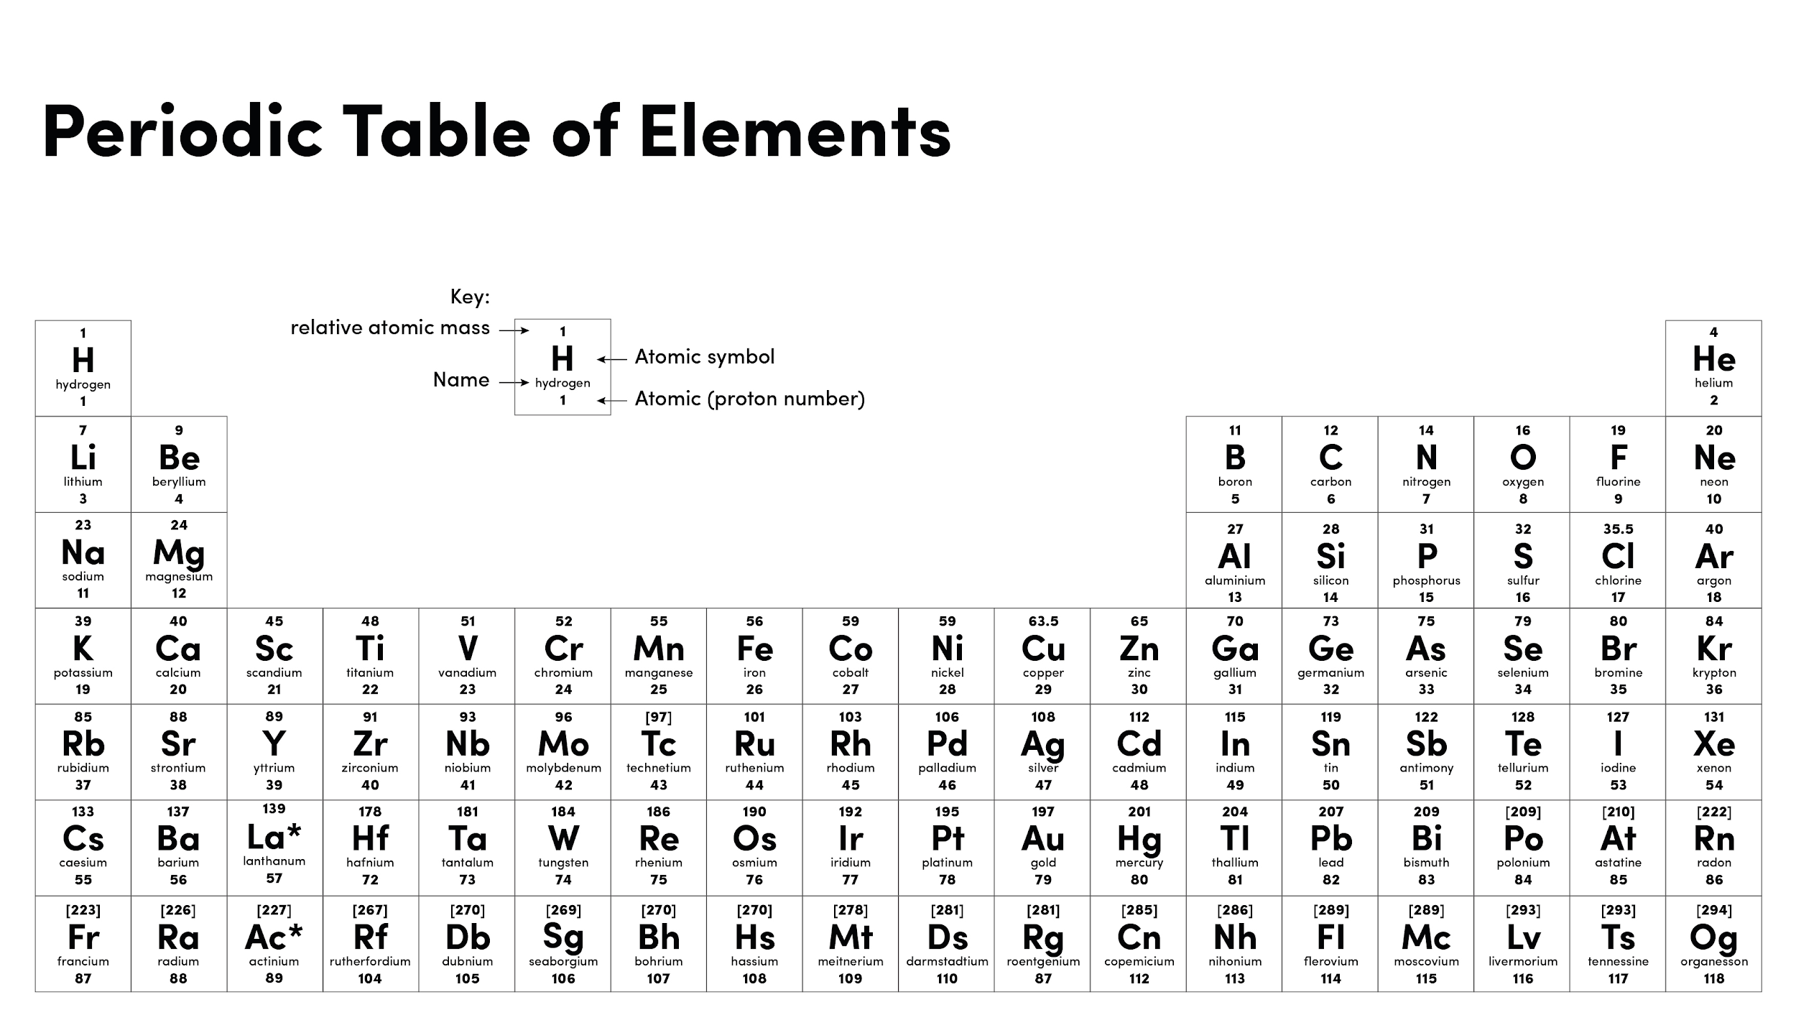

Slide 3
Warm up
Name the three subatomic particles shown in the diagram.
What is the charge of an electron?
What is the charge of a proton?
-
-
+
+
-
-
+
-
+
-
Source of image: Dr Patel

Slide 4
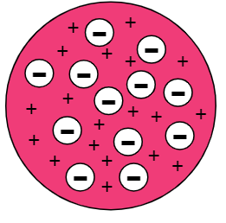
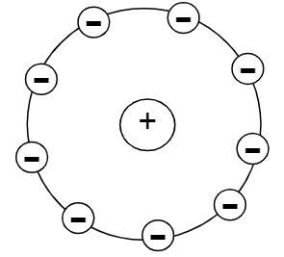
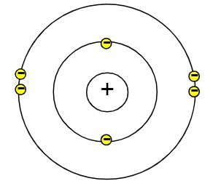
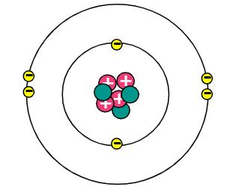
Plum pudding model
Tiny spheres
Nuclear model
Bohr’s model
Today’s model
Source of images: Dr Patel

Slide 5
Pause point
What is the name of each of these two models?
Which scientists developed each model?
What is similar about these two models?
What is different about these two models?

Slide 6
Independent task
A
B
C
D
E
Name models C and D
Which scientists models C and D?
What is similar about models C and D?
What is different between models C and D?
Which subatomic particle was discovered last, and who discovered it?
Clue: This particle is only present model E.

Slide 7
Exam style question
Compare the plum pudding model, and the nuclear models.
Support:
In the plum pudding model, the …..are arranged….whereas in the nuclear model, the….
Key words:
Nucleus, positive charge, electron, negative, fixed, random (or randomly)
Source of images: Dr Patel

