Slide 1
Describing a region [3 / 5]
Position and agreement of irregular adjectives
French
Monsieur Lowe

Slide 2
Phonétique

Slide 3
[gn]
ny
No hard Gs!

Slide 4
Spain
[gn]
Espagne

Slide 5
Spain
Logo
[gn]
montagne

Slide 6
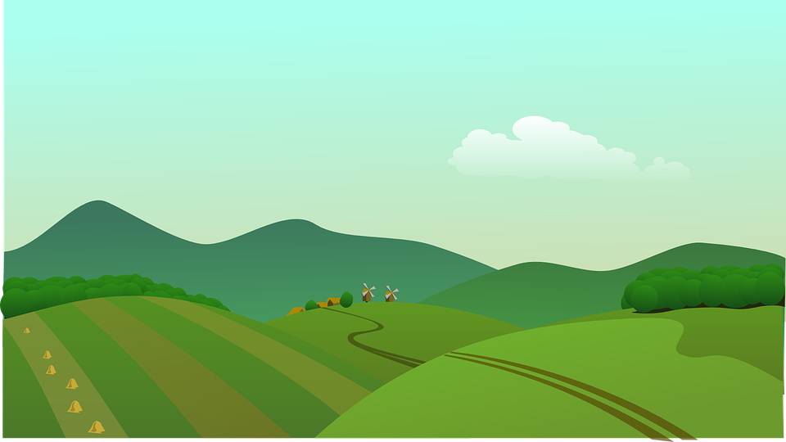
Spain
Logo
Landscape
[gn]
campagne

Slide 7
Spain
Logo
[gn]
More examples of the gn sound?

Slide 8
Spain
Logo
signe
champagne
champignon
mignon
l’araignée
l’agneau
gagner
oignon
sign
champagne
mushroom
cute
spider
lamb
to win/earn
onion

Slide 9
habiter | to live
vieux | old
ma région | my region
le musée | museum
le paysage | landscape
l’église | church
beau | beautiful
à la campagne | in the countryside
à la montagne | in the mountains
la ville | town

Slide 10
Grammaire Position and agreement
of irregular adjectives

Slide 11
beau
- beautiful (irregular adjective)
Adjectives need to agree with the noun they describe
beau
= beautiful
belle
= beautiful
Refers to masculine nouns
Refers to feminine nouns

Slide 12
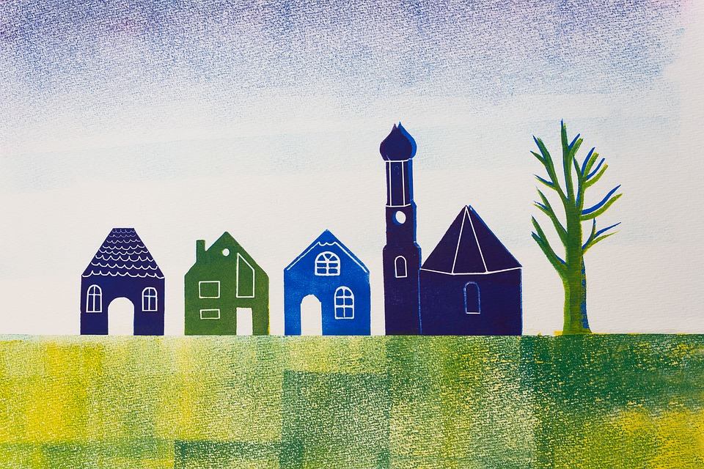
beau
- beautiful (irregular adjective)
Adjectives need to agree with the noun they describe
Use beau before a noun when describing something:
J’habite dans un beau village.
J’habite dans une belle ville.
I live in a beautiful village.
I live in a beautiful town.

Slide 13
beau
- beautiful (irregular adjective)
Adjectives need to agree with the noun they describe
Here are the plural forms:
Dans ma région, il y a deux beaux villages.
Dans ma région, il y a deux belles villes.
In my region there are two beautiful villages.
In my region there are two beautiful towns.

Slide 14
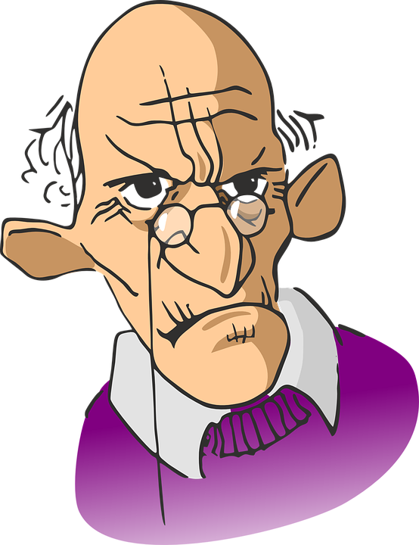
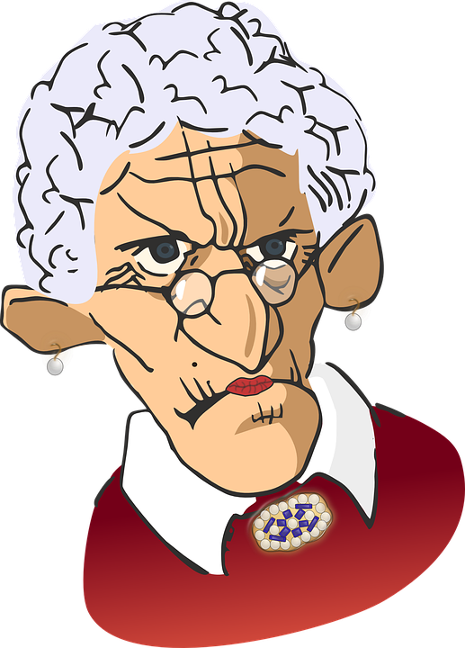
vieux
- old (irregular adjective)
Adjectives need to agree with the noun they describe
vieux
= old
vieille
= old
Refers to masculine objects
Refers to feminine objects

Slide 15
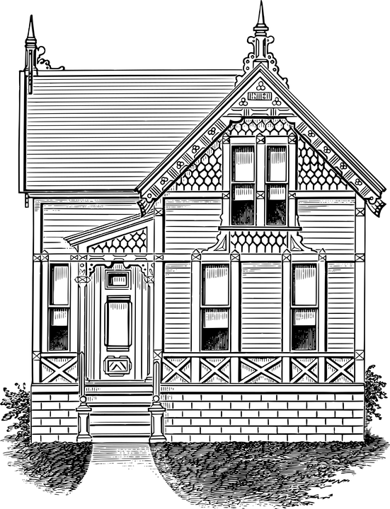
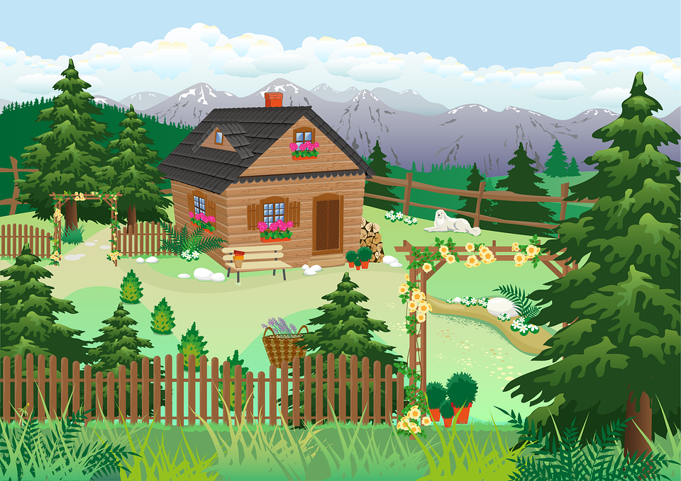
vieux
- old (irregular adjective)
Adjectives need to agree with the noun they describe
Use vieux before a noun when describing something:
J’habite dans un vieux chalet.
J’habite dans une vieille maison.
I live in an old cabin/chalet.
I live in an old house.

Slide 16
vieux
- old (irregular adjective)
Adjectives need to agree with the noun they describe
Here are the plural forms.
Dans mon village, Il y a deux vieux chalets.
Dans mon village, il y a deux vieilles maisons.
In my village there are two old chalets/cabins.
In my village there are two old houses.

Slide 17
Adjectives
DESCRIBE nouns
Masculine Singular
Feminine Singular
Masculine Plural
Feminine Plural
grand
grande
petite
belle
vieille
nouvelle
grands
grandes
petites
belles
vieilles
nouvelles
petit
petits
beau
beaux
vieux
vieux
nouveau
nouveaux
All of these adjectives go before the noun.
E.g. Dans ma ville, il y a une nouvelle boulangerie.

Slide 18
Describing a region
Adjectives describe
Adjectives must
Beautiful (m. and f.) =
Old (m. and f.) =
My town has =
My region has =
Nouns (things, objects, people)
agree and be masculine or feminine
beau (m.)/belle (f.)
vieux (m.)/vieille (f.)
Ma ville a
Ma région a

