Slide 1
Numeracy: Position and Direction - Applying Learning
Responding to ‘forwards’ and ‘backwards’
Lesson 3
Simon

Slide 2
Backwards
Backwards
Backwards

Slide 3
Forwards
Forwards
Forwards

Slide 4
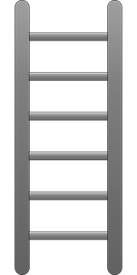
Snakes and Ladders
Start
Finish
Forward
Backward
Pictures from Pixabay

