Slide 1
Using the inverse operation to find missing numbers
Mathematics
Miss Brinkworth

Slide 2
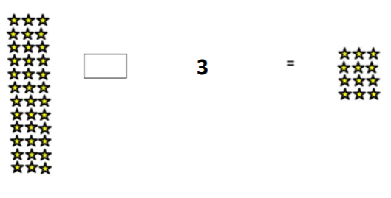
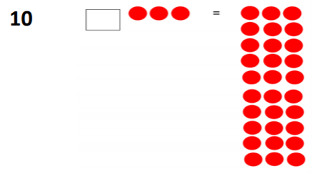
Part A: add x or ÷
2)
3) 27 ÷ = 3 4) x 3 = 30
5) 3 x = 33 6) ÷ 3 = 17
Notes:
Does the position/ order matter? Why not?

Slide 3
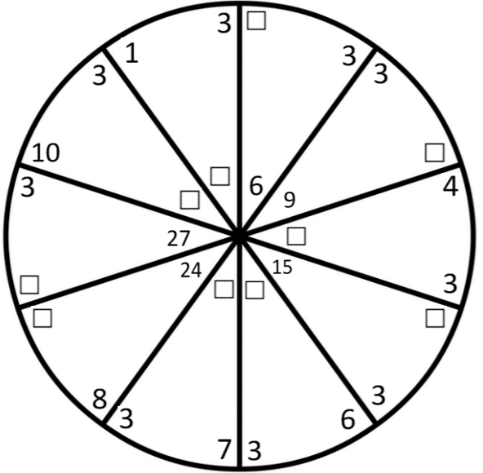
Part B:
Complete these
fact families
Notes:
Does the position/ order matter? Why not?

