Slide 1
Equal parts of a whole
Mathematics
Mr Coward

Slide 2
Try this
This is one chocolate bar.
What fraction of the chocolate bar is shaded in each of the pictures below?

Slide 3
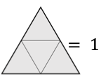
Independent task
1) If write a fraction to represent the value of the shaded section:

Slide 4
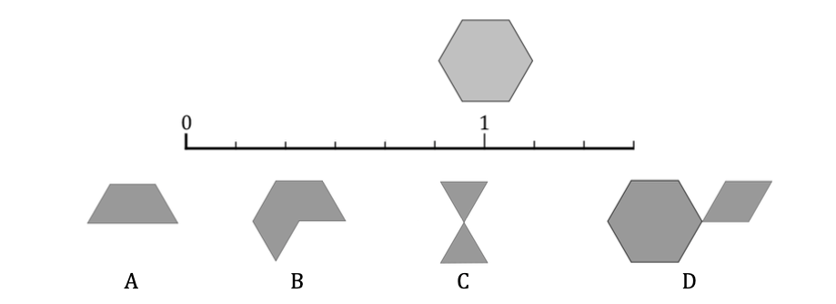
Independent task
2) Draw a copy of the number line and identify where the shapes should be placed:

Slide 5
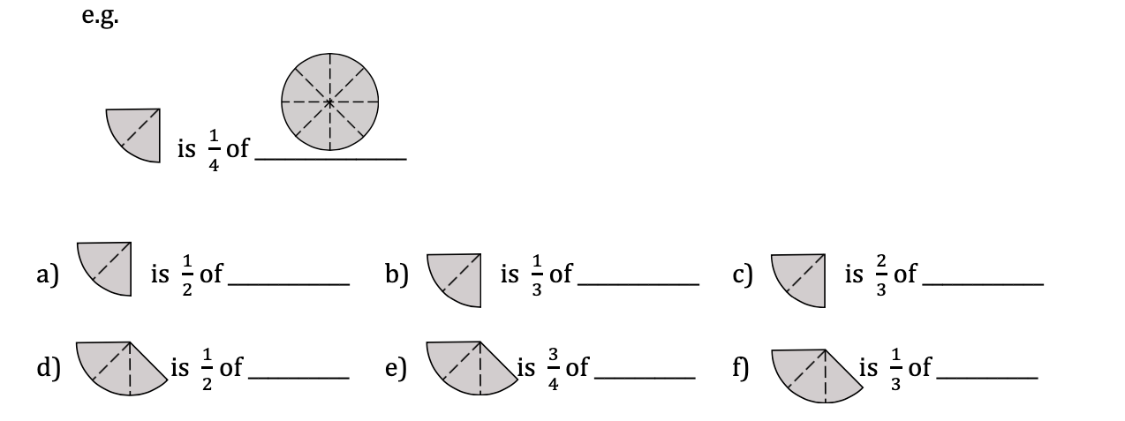
Independent task
3) Sketch a diagram to complete the statement:

Slide 6
Explore
Match the boxes, there should be four in each set..
One and one half
One and one third
Three quarters

