Slide 1
Atmospheric Pressure
Physics - Key Stage 4 - Forces
Mr Saville
Miss Whittick

Slide 2
Warm up - Independent Practice
What are the standard units of a force?
What are the standard units of pressure?
What are the standard units for gravitational field strength?
Convert 2000 g in to kilograms.
Convert 5 kN into newtons.
Convert 100 Pa into N/m².
Convert 1.3 kPa into pascals.
Convert 50 J into newton-metres.

Slide 3
Independent Practice
Describe the pressure change in the atmosphere due to height. (1)
As height increases….
Using the particle model of matter explain the change in pressure as height increases in the atmosphere. (3)
A plane window has an area of 0.06m². When the plane is at a certain altitude, the outside pressure of the atmosphere is 30 kPa and the cabin pressure is 75 kPa. Calculate the pressure exerted on the window. (hint: p = F / A) (4)
(Hints: Include density, volume, collisions)

Slide 4
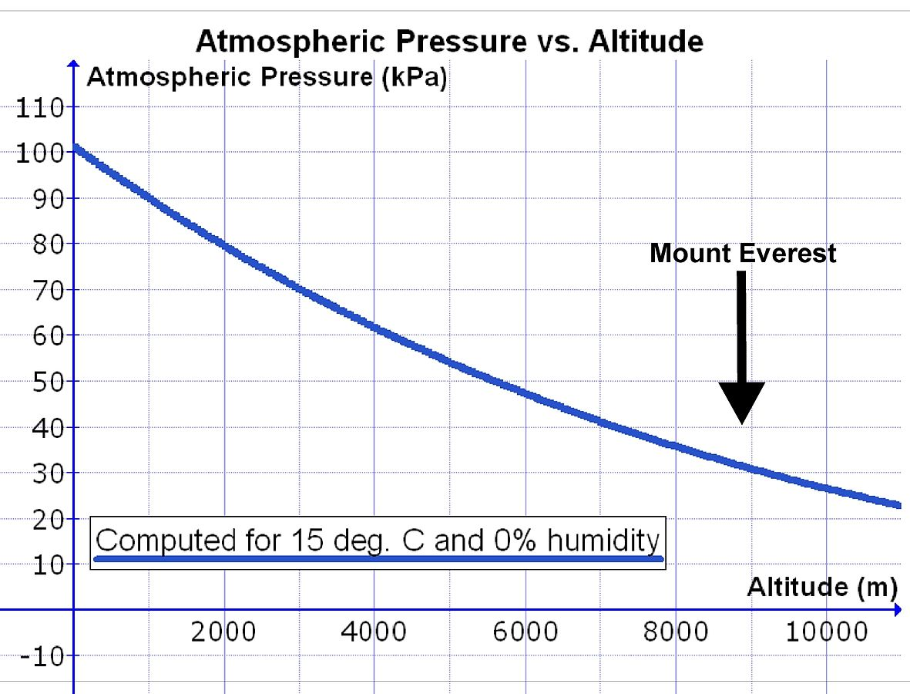
Exam Style Questions
Describe the pattern between atmospheric pressure and altitude.
At what approximate altitude is the atmospheric pressure 60 kPa?
In terms of atmospheric pressure, why it is dangerous to climb Mount Everest?
Image credit: Wikimedia Commons

