Slide 1
Solve Inequalities with Unknowns on Both Sides
Mr Lund
Maths
‹#›

Slide 2
Solve Inequalities with Unknowns on Both Sides
1. True or false?
2a – a + 5 = a + 5
3a – 3 + 2a + 4 = 5a + 6
2. Here is a bar model,
Which inequality does the bar model represent?
3. Solve.
2a < a + 5
3a ≤ 2a + 5
4a > 2a + 10
4. Simplify and solve.
t + 3t ≥ 20 + 2t
4t < – 20 + t + t
t
t
‘is less
than’
t
+ 5
3t < 5
2t > t + 5
2t < t + 5
‹#›

Slide 3
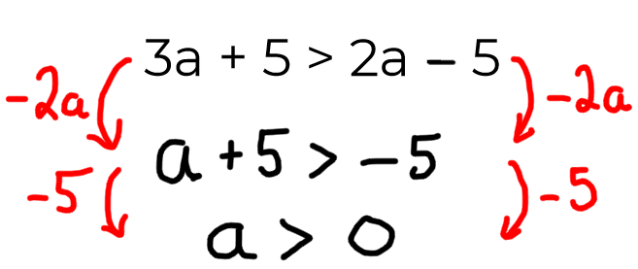
Solve Inequalities with Unknowns on Both Sides
5. Solve.
3y + 2 < 2y + 10
4a – 2 < 2a + 10
5t + 2 ≥ 2t – 10
6. Simplify and solve.
a) 5a + 2 > 2a + 10 + a
b) 3(t + 2) ≤ 2t + 10
7. Spot the mistake.
8. Represent the inequality
3y + 9 ≥ 2y + 8 on the number line.
‹#›

Slide 4
Answers
‹#›

Slide 5
Solve Inequalities with Unknowns on Both Sides
1. True or false?
2a – a + 5 = a + 5
3a – 3 + 2a + 4 = 5a + 6
2. Here is a bar model,
Which inequality does the bar model represent?
3. Solve.
2a < a + 5
3a ≤ 2a + 5
4a > 2a + 10
4. Simplify and solve.
t + 3t ≥ 20 + 2t
4t < – 20 + t + t
True
a < 5
a ≤ 5
False, 5a + 1
a > 5
t
t
‘is less
than’
t
+ 5
t ≥ 10
3t < 5
2t > t + 5
2t < t + 5
t < – 10
‹#›

Slide 6
Solve Inequalities with Unknowns on Both Sides
5. Solve.
3y + 2 < 2y + 10
4a – 2 < 2a + 10
5t + 2 ≥ 3t – 10
6. Simplify and solve.
a) 5a + 2 > 2a + 10 + a
b) 3(t + 2) ≤ 2t + 10
7. Spot the mistake.
8. Represent the inequality
3y + 9 ≥ 2y + 8 on the number line.
y < 8
a < 6
t ≥ – 4
It should be a > - 10
a > 4
t ≤ 4
‹#›

