Slide 1
To identify the properties of quadrilaterals
Worksheet
Maths
Miss Miles

Slide 2
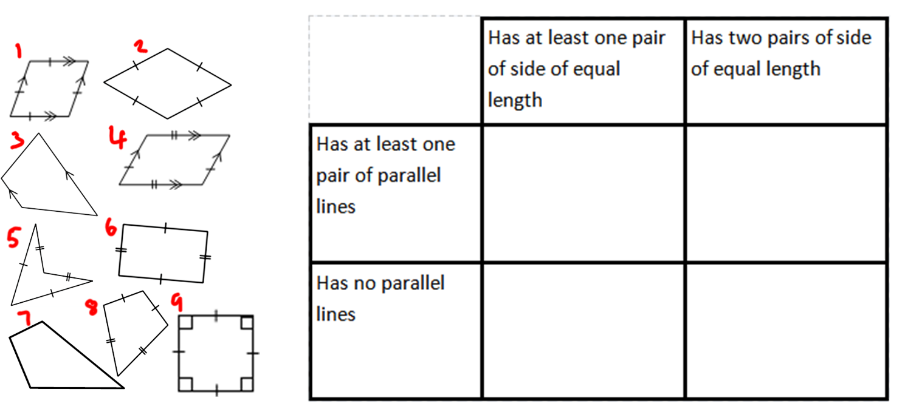
Independent Task
Notes:
Model how to fill in part of the table.

