Slide 1
Draw a tree diagram for dependent events
Mr Chan
Maths

Slide 2
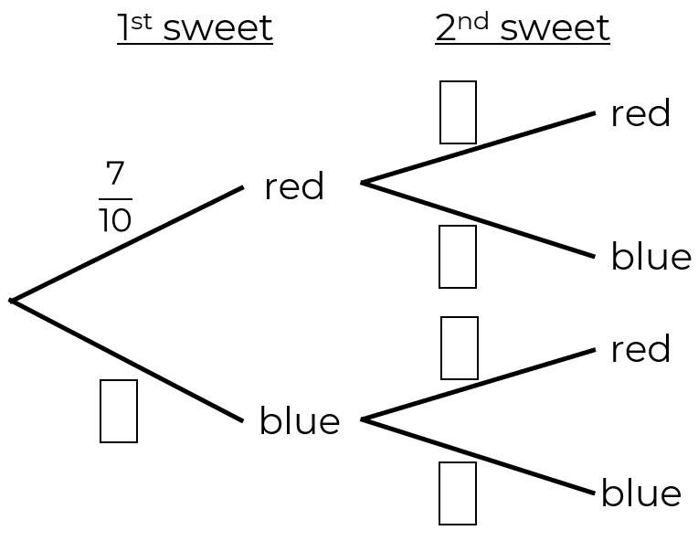
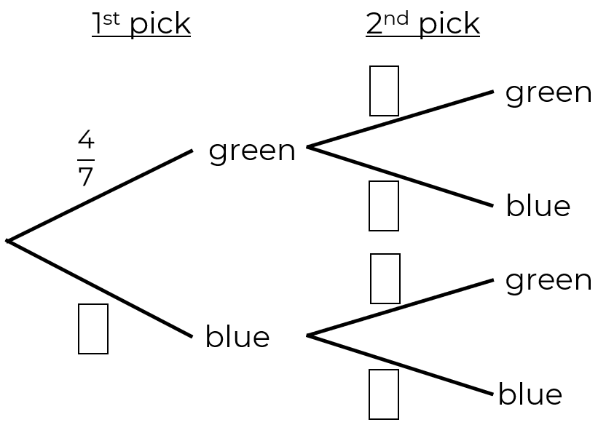
Draw a tree diagram for dependent events
1. Jack has a bag with 7 red and 3 blue sweets. He takes a sweet at random and eats it. He then takes another.
Complete the tree diagram.
2. Amir has a bag with 4 green and 3 blue counters. He takes a counter and does not replace it. He then takes another counter.
Complete the tree diagram.

Slide 3
Draw a tree diagram for dependent events
3. Rosie has a bag of fruit containing 4 apples and 6 pears.
Rosie chooses a piece of fruit at random and eats it. She then takes another piece. Draw a tree diagram to show the possible results.
4. There are 8 pens in Paul’s pencil case. 5 of the pens are blue and the rest are red. Paul randomly takes two pens out of his pencil case.
Draw a tree diagram to show all the possible outcomes.

Slide 4
Answers

Slide 5
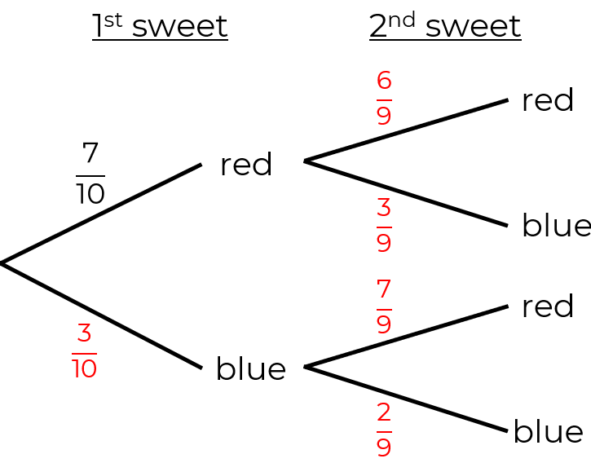
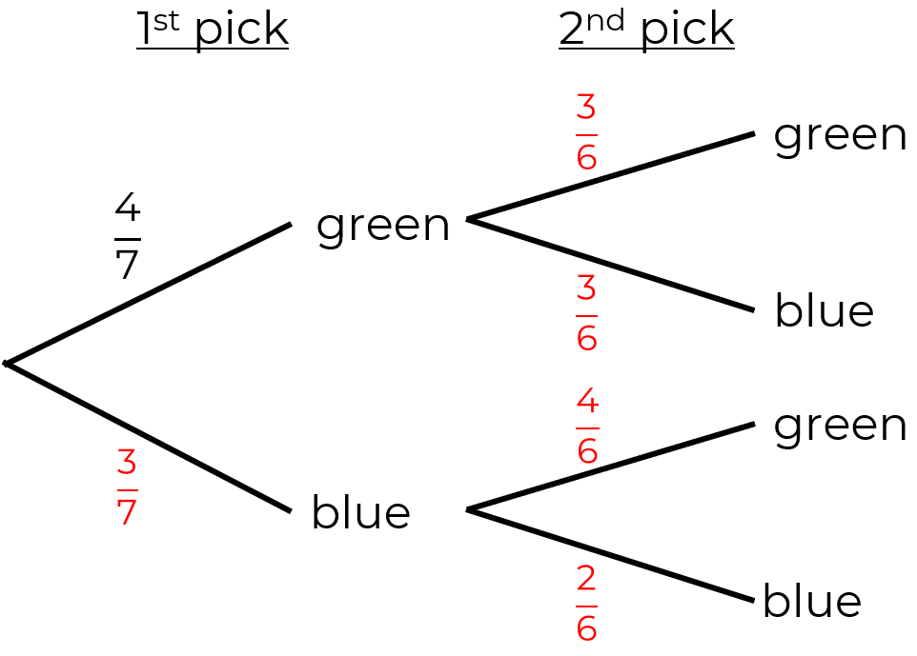
Draw a tree diagram for dependent events
1. Jack has a bag with 7 red and 3 blue sweets. He takes a sweet at random and eats it. He then takes another.
Complete the tree diagram.
2. Amir has a bag with 4 green and 3 blue counters. He takes a counter and does not replace it. He then takes another counter.
Complete the tree diagram.

Slide 6
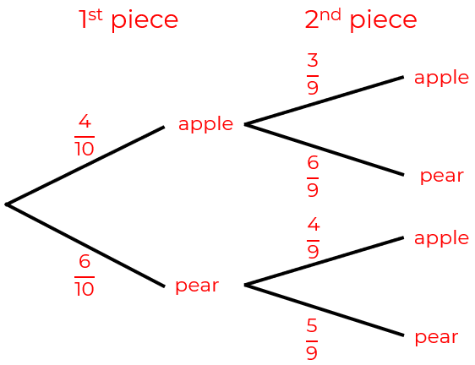
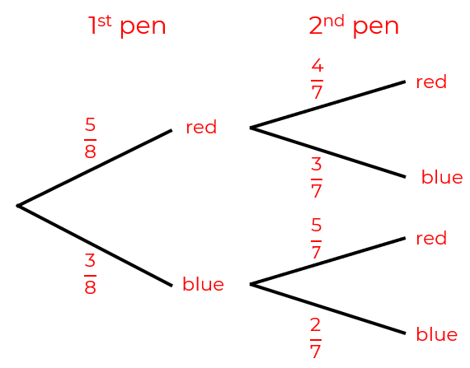
Draw a tree diagram for dependent events
3. Rosie has a bag of fruit containing 4 apples and 6 pears.
Rosie chooses a piece of fruit at random and eats it. She then takes another piece. Draw a tree diagram to show the possible results.
4. There are 8 pens in Paul’s pencil case. 5 of the pens are blue and the rest are red. Paul randomly takes two pens out of his pencil case.
Draw a tree diagram to show all the possible outcomes.

