Slide 1
Using multiples to divide
Worksheet
Mr Ward

Slide 2
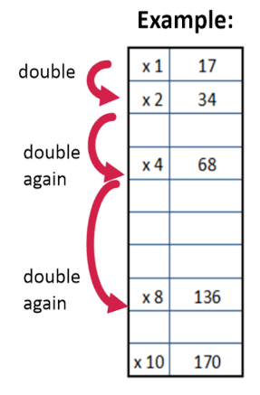
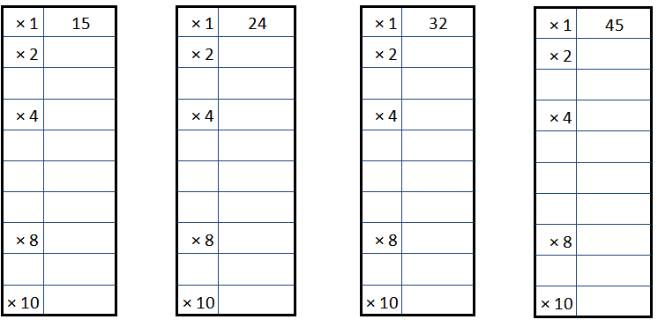
Warm up - Speedy multiples
Try timing yourself!

Slide 3
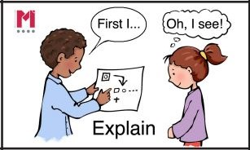
Talk Task - Using multiples to divide
Represent each problem with an area model and then partition and calculate each part.
Record the steps of the strategy on an empty number line

Slide 4
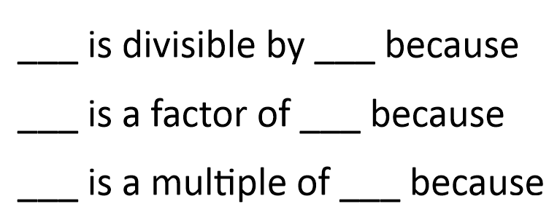
Independent Task - Hunt for multiples
Hunt out the multiples of 15, 24, 32 or 45.
Use the multiples grids from the Do Now task.
Sort the numbers and generate statements.
672 930 1035
1890 792 448
576 288 900
Sentence Stems

Slide 5
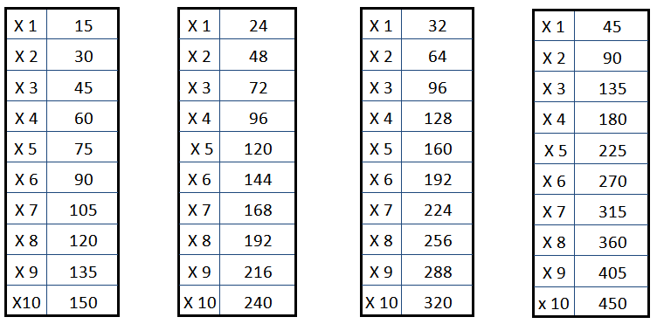

Slide 6
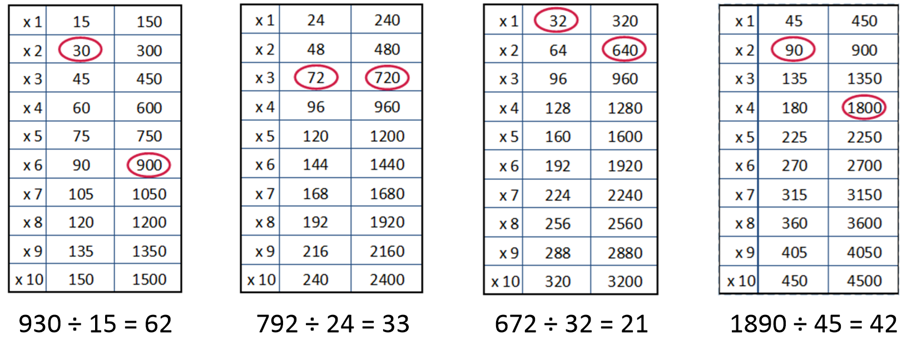
Challenge Slide
Look at the example statements generated using the facts
found within the tables.
What other numbers can you generate statements about?

