Slide 1
Mathematics
Calculating angles within a shape 3: composite shapes and parallel lines
Mr Kelsall

Slide 2
New learning: triangles
Can you draw one line in each quadrilateral, from one vertex to another vertex, to create two triangles? Can you draw your own examples

Slide 3
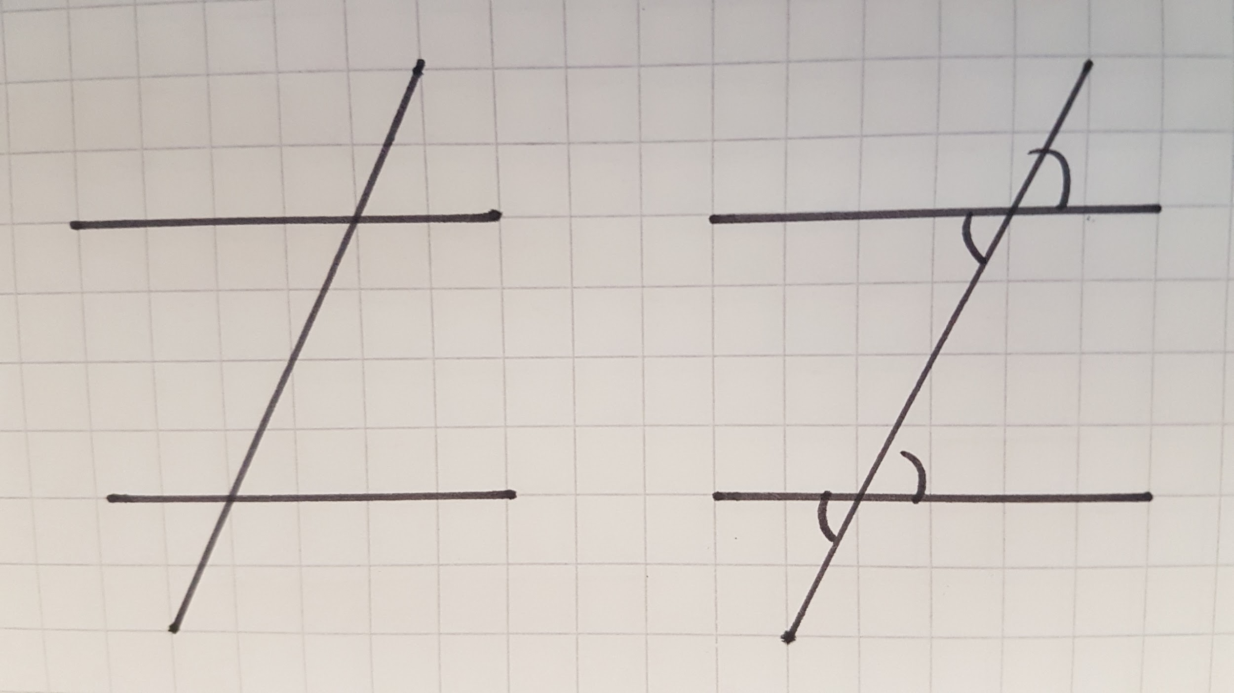
New learning: Parallel lines
What do you notice about the angles in these shapes? Can you explain your thoughts?

Slide 4
New learning: Parallel lines
What do you notice about the angles in these shapes? Can you explain your thoughts?

Slide 5
New learning: Parallel lines
In this shape, can you find quadrilaterals?
Explain their properties? Explain their angle size?
 | Angles | Sides
Square: | 4 RA | 4 equal PS
Rectangle | 4 RA | 2 pairs of PS
Rhombus | 2 pairs of equal A | 4 equal PS
Parallelogram | 2 pairs of equal A | 2 pairs of PS
Trapezium |  | 1+ pairs of PS

Slide 6
Independent task
Use your new learning to find the missing angles in these shapes
Source of all images : Mr Kelsall or Oak National Academy

