Slide 1
Independent Task
To recognise the value of different coins.
Maths
Mrs Bramble & Miss Sidhu

Slide 2
Independent Task

Slide 3
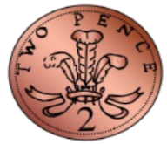
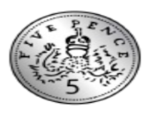
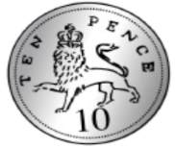
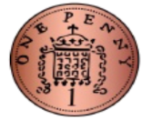
Independent Task
Can you place the coins in order from the greatest value to the least value?
Can you place the coins in order from the greatest value to the least value.

Slide 4
Answers
The highest value coin is the 10p as it needs 10 pennies to make the same value.
The 1p is the least in value as its value is 1 pence.

Slide 5
Answers

