Slide 1
To share a total equally between a set number of groups
Independent Task
Maths
Miss Charlton, Mrs Bramble and Miss Sidhu

Slide 2
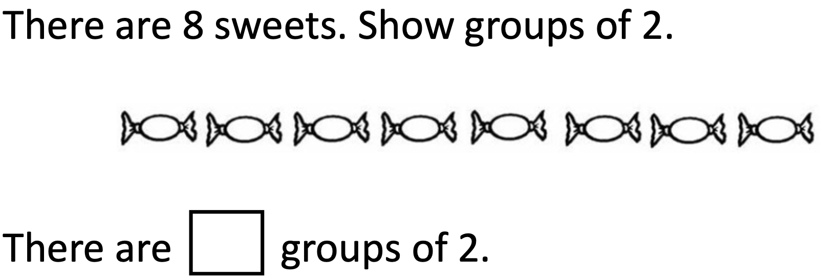
Independent Task 1

Slide 3
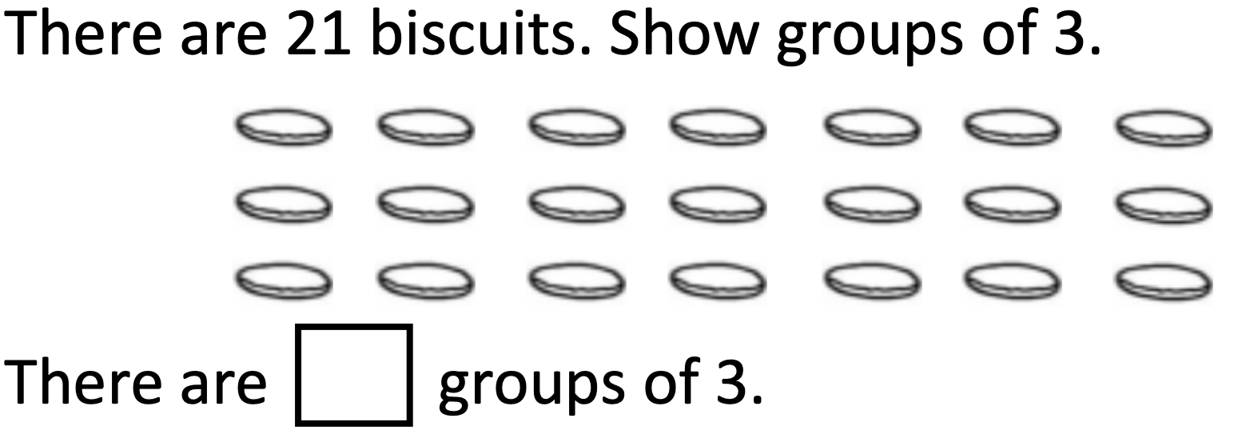
Independent Task 2

Slide 4
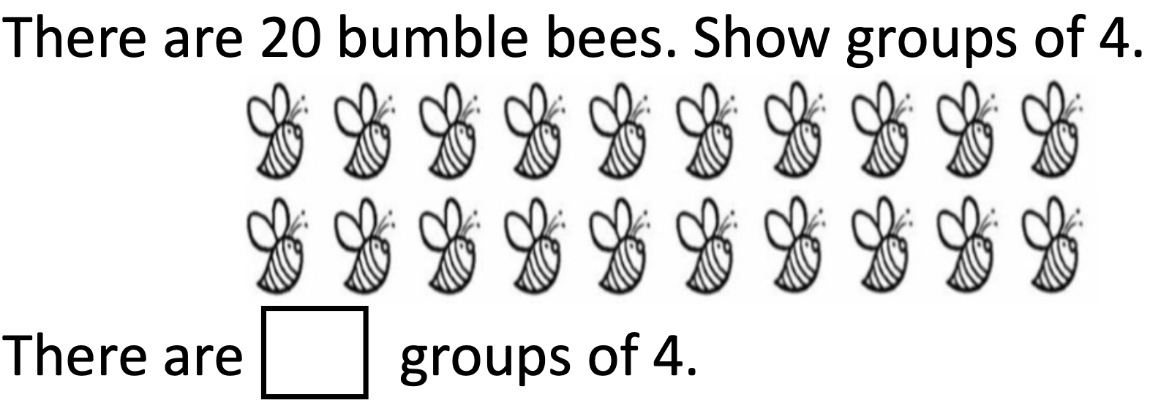
Independent Task 3

Slide 5
Independent Task 4

Slide 6
Answers 1
4

Slide 7
Answers 2
7

Slide 8
Independent Task 3
5

Slide 9
Independent Task 4
8

