Slide 1
Case study:
Marie Curie and Frederick Soddy
The Radioactive Scientists!
Combined Science - Chemistry - Key Stage 4
Atomic Structure & the Periodic Table
Dr Patel

Slide 2
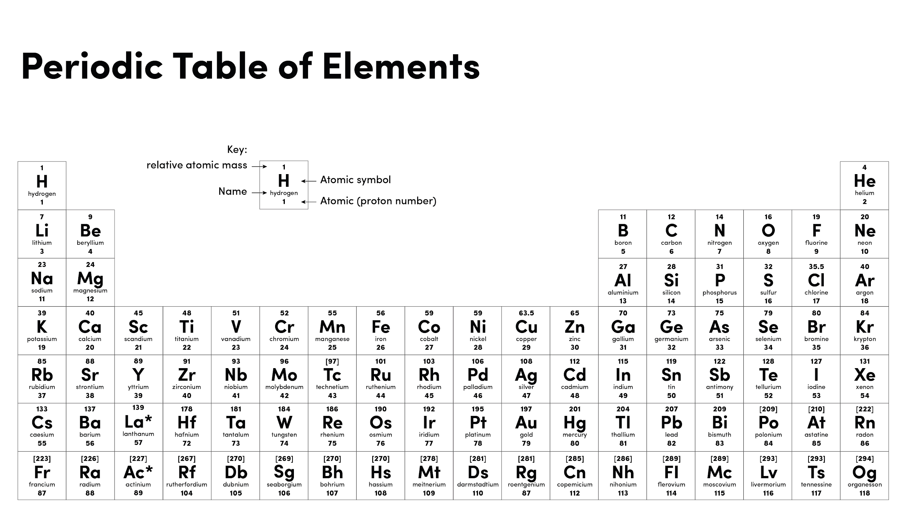
Image source Oak

Slide 3
Independent task
 | Marie Curie | Frederick Soddy
Scientific achievements
Number of Nobel prizes achieved
Other interesting facts

