Slide 1
Difference of Two Squares
Mathematics
Mrs Buckmire
Notes:
Pen and paper and encourage to pause

Slide 2
Try this
Expand and simplify
What do you notice?

Slide 3
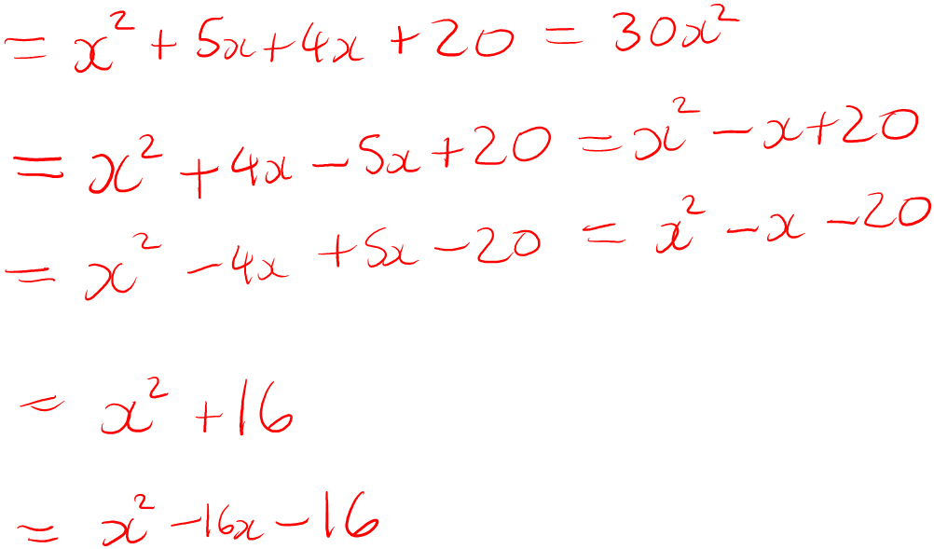
Independent task
Binh has completed some questions. Correct and explain her mistakes.
She has expanded and simplified the following expressions:

Slide 4
Explore
Xavier says….

