Slide 1
Independent Living Unit 6- Staying Safe
Oak Specialist
Applying Learning

Slide 2
Unit 6 - Staying Safe
Lesson 1 - Online Safety
Lesson 2 - Safety in the home
How can we stay safe online? What information should we share online?
What hazards are there at home? How can we minimise those hazards?
Lesson 3 - Community safety
Lesson 4 - Road safety
Who do we interact with during our day, and what do we share with them?
How can we make sure we are safe on the road? What precautions can we take?
Lesson 5 - Safety on transport
Lesson 6 - Safe relationships
Planning for safe travel on public transport.
Staying safe in close and intimate relationships.

Slide 3
Lesson 4 - Road Safety

Slide 4
Unit 6 lessons contain safety messages and discussions around potentially sensitive topics. Please ensure all lessons are delivered by a parent/carer or teacher.
Notes:
-Sharing info online
Diff online activity - games vs sending
Communicating online

Slide 5
Teacher notes - Lesson 4
Learning Intention: To know how to stay safe when crossing the road using different pedestrian crossings.
Look at images of different crossings and explain what to do in each scenario
Encourage learners to complete the ‘Can you cross the road?’ quiz looking at each of the images on the slides and saying if they can cross in each instance.
Look at the slide with cyclists and ask if learners can spot what else they need to look out for on the road.
Learners can write their own checklist for crossing the road.
You will need: Pen, sheets of paper.

Slide 6
Road safety
Staying Safe
Applying Learning
Notes:
Lesson 1 starting screen. Repeat for each lesson

Slide 7
Lesson Activity Stages
Different crossings
Road crossing quiz
Look out for cyclists
Crossing checklist
Notes:
Talk through each of the activity stages, clearly stating what happens first, second and last.
-Can you cross quiz! - photos of different crossings and lights on crossings - always say they need to stop first, as sometimes cars may not stop. Police cars, fire engines and ambulance may need to pass quickly - so don’t cross when you hear or see them.

Slide 8
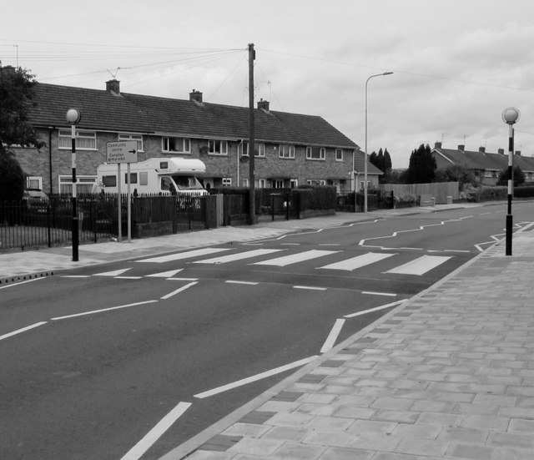
Zebra Crossing
Wait for traffic to stop before crossing.
Walk straight across the road.
Do not cross on the zig zag lines.
Start on the red ‘bobbles’ and end on the red ‘bobbles’ the other side.
Notes:
Explain to learners that they should always wait for traffic to stop before they cross on a zebra crossing.

Slide 9
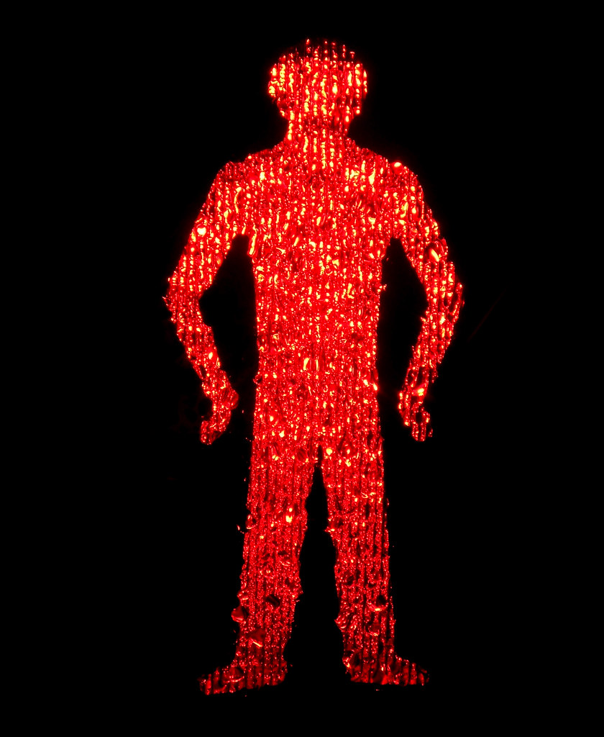
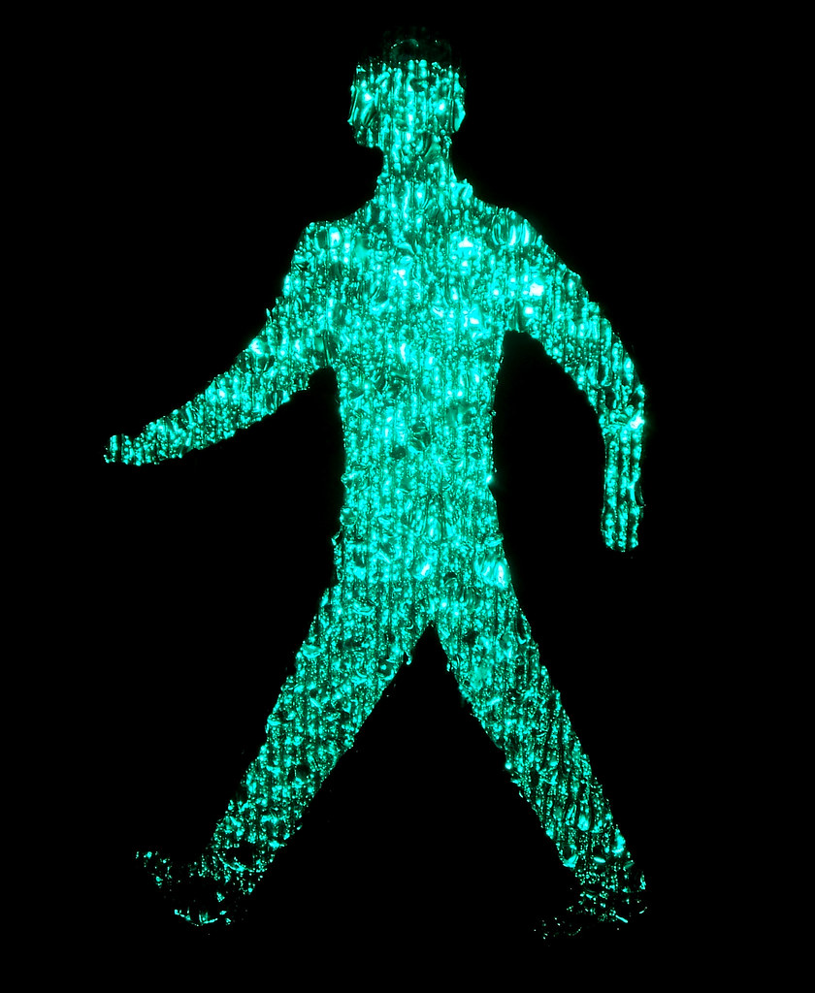
Pelican, Puffin and Toucan Crossings
Teacher notes:
Explain to learners that:
They need to press the button
Stand and wait when they see the red man
Look and listen. If there’s no traffic, bicycles or sirens they can cross if they see a green man.
Make sure they cross calmly and carefully, walking straight to the other side.
Notes:
Explain to learners that:
-They need to press the button
-Stand and wait when they see the red man
-Look and listen. If there’s no traffic, bicycles or sirens they can cross if they see a green man.
-Make sure they cross calmly and carefully, walking straight to the other side.

Slide 10
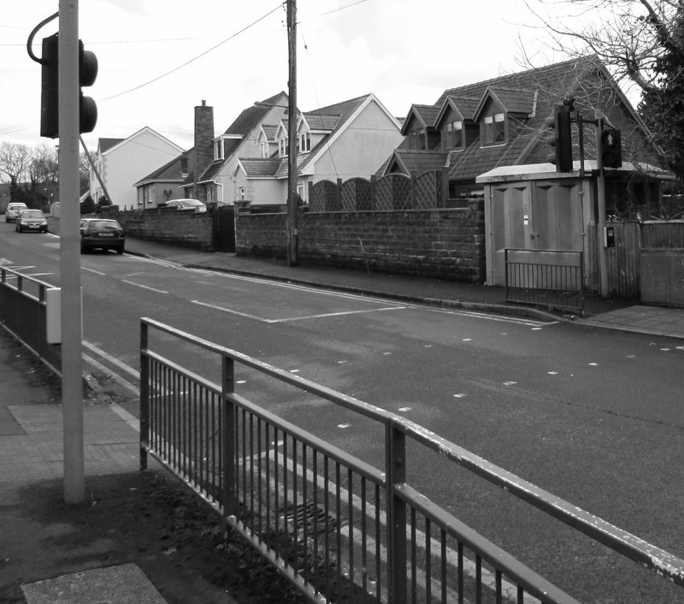
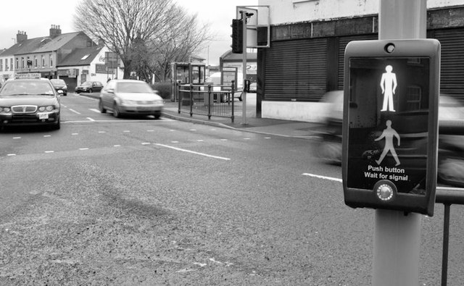
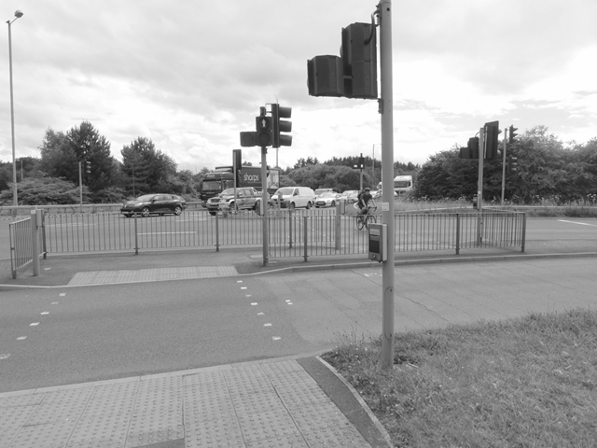
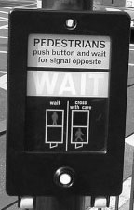
Pelican, Puffin and Toucan Crossings
Pelican Puffin Toucan - bikes cross too
Pelican Puffin Toucan

Slide 11
Teacher notes: Can you cross quiz
In the following slides are photos of different crossings and lights on crossings.
Always say to your learner that they need to stop first, as sometimes cars may not stop. Police cars, fire engines and ambulances may need to pass quickly, so don’t cross when you hear or see them.
Notes:
Can the learner say if they should cross or wait?

Slide 12
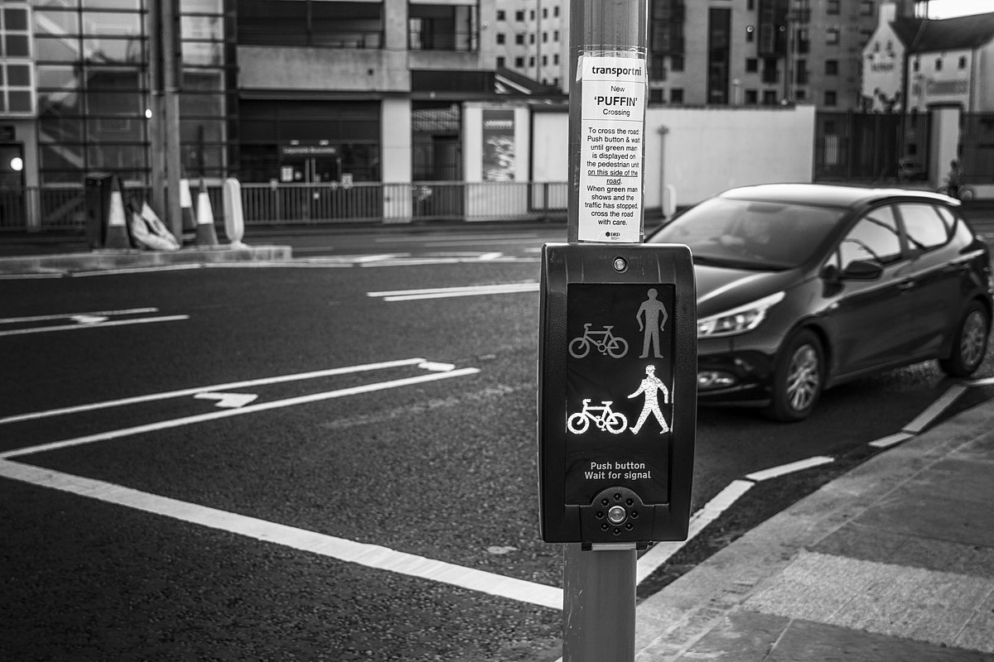
Road crossing quiz - cross or wait?
Notes:
Can the learner say if they should cross or wait?

Slide 13
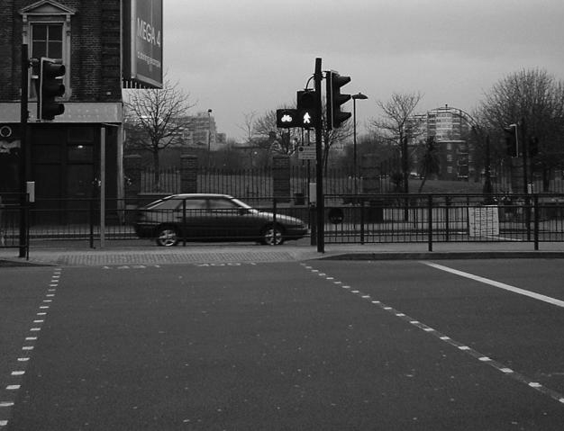
Road crossing quiz - cross or wait?
Notes:
Can the learner say if they should cross or wait?

Slide 14
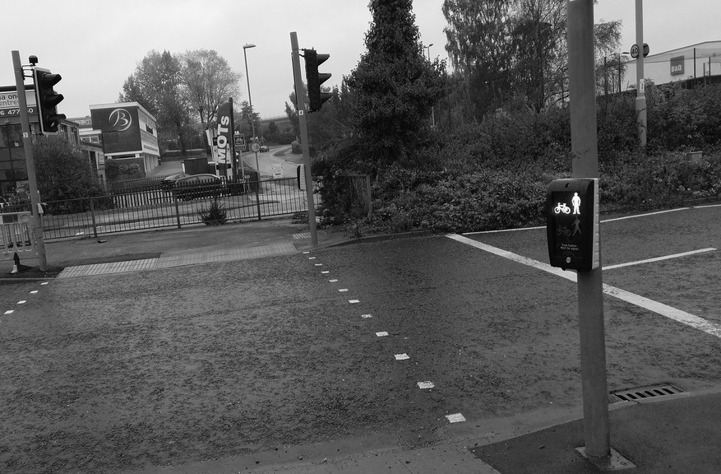
Road crossing quiz - cross or wait?
Notes:
Can the learner say if they should cross or wait?

Slide 15
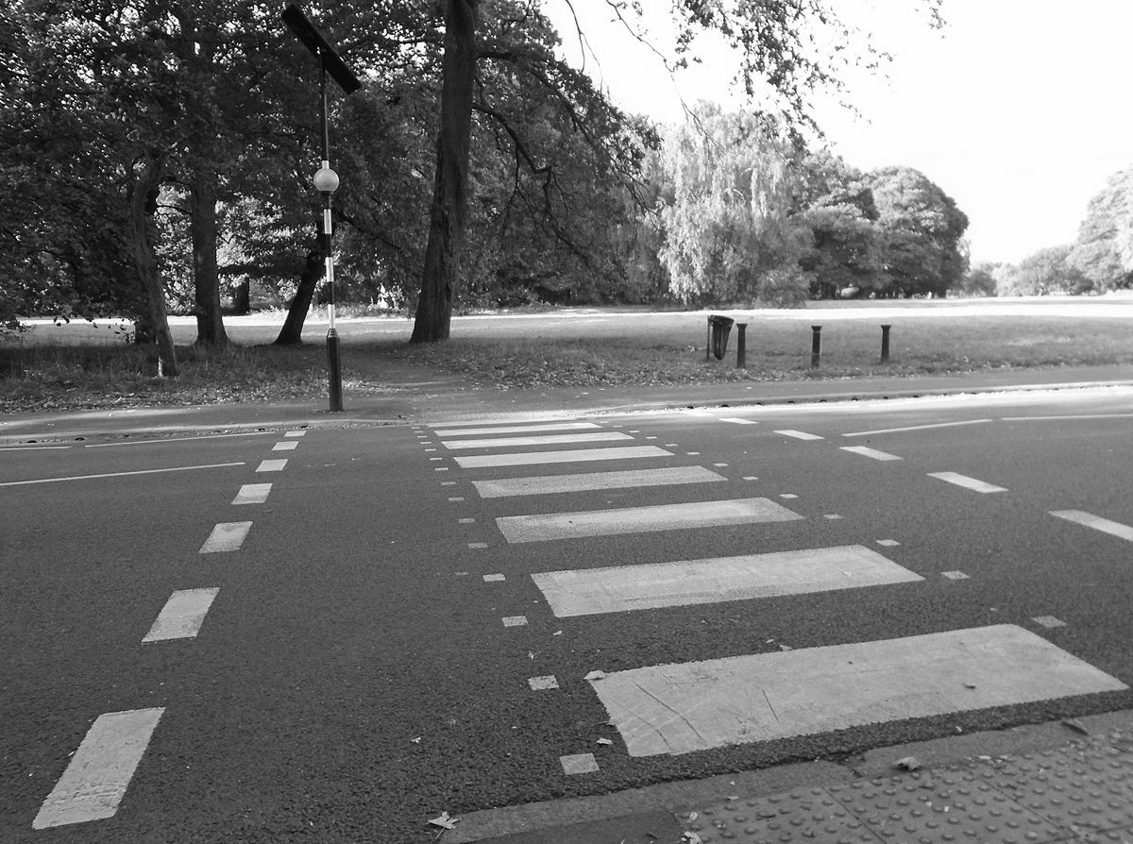
Road crossing quiz - Cross or wait?
Road crossing quiz - Cross or wait?
Notes:
Can the learner say if they should cross or wait?

Slide 16
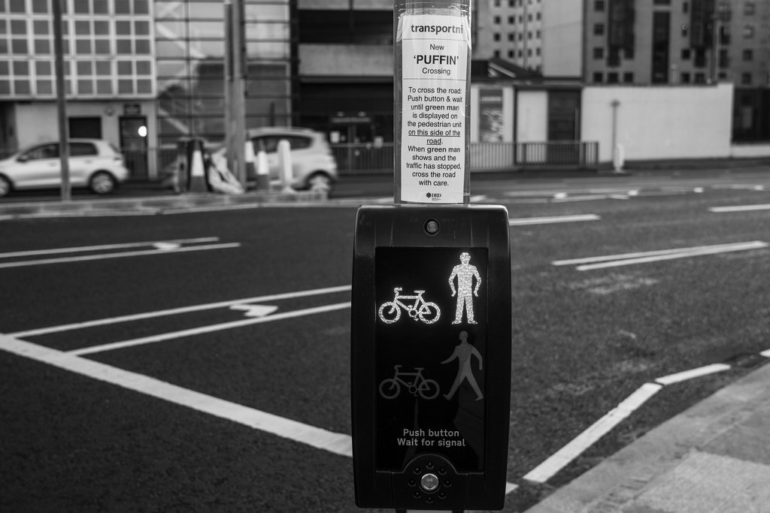
Road crossing quiz - cross or wait?
Notes:
Can the learner say if they should cross or wait?

Slide 17
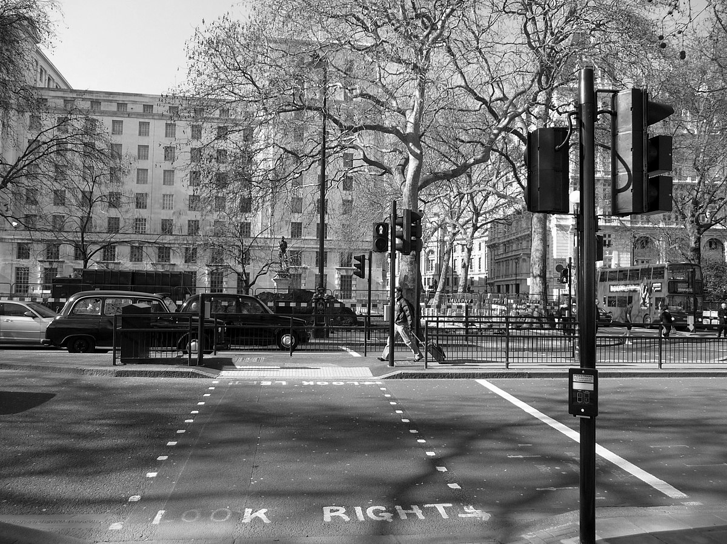
Road crossing quiz - cross or wait?
Notes:
Can the learner say if they should cross or wait?

Slide 18
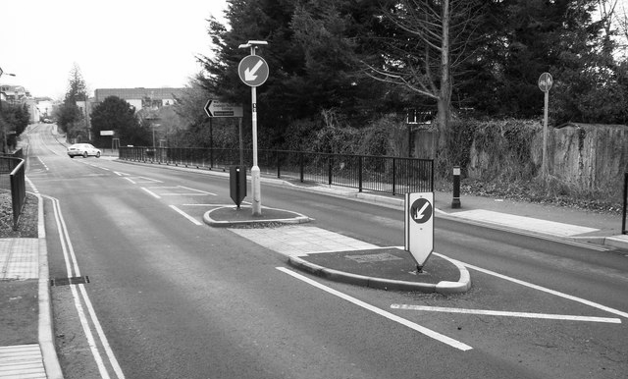
Road crossing quiz - where would you cross?
Notes:
-Ask where they would cross?
-Encourage learners to look at the traffic island if they don’t notice it.

Slide 19
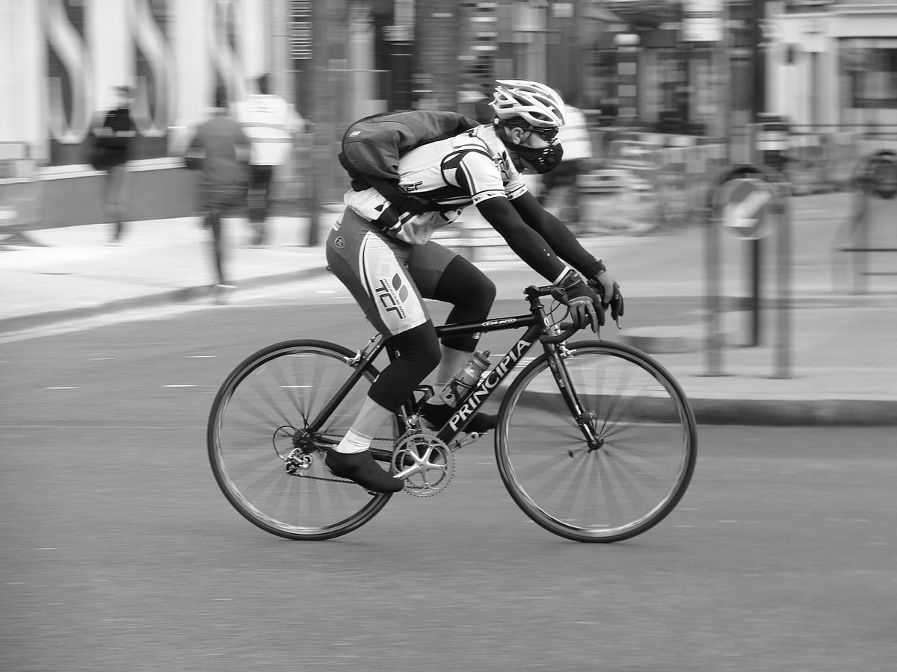
Look out for cyclists
Cyclists are quiet - so you must look carefully for them.
They are smaller than other traffic, so it can take longer to see them.
Notes:
-Explain that you can’t always hear cyclists, but that learners still need to look out for them.
-They are smaller than other traffic, so it can take longer to see them.

Slide 20
Road crossing checklist - Can you make your own?
Find a safe place to cross.
Stop a safe distance from the curb.
Look all around for traffic and even cyclists.
Listen for traffic and sirens.
Wait until it is safe before crossing.
Walk while crossing, don’t run, skip or play with anything.
Notes:
Read through the short checklist and encourage your learner to make their own using words or clear drawings if they would prefer - as long as it means something to them, and they can tell you what they need to do.

Slide 21
Independent Living
Safety
Road Safety
Make it easier
Make it harder
More ideas
With a trusted adult, can you take a walk around your local area and think about where the safest places are to cross the road?
Using a map, can you mark down safe places to cross roads in your local area?
Share your road crossing checklist with a friend. Do they have any different points that you could add?
Notes:
Final slide of the lesson. Suggest adaptations for teachers/parents.

Slide 22
Further Learning with Oak National
Independent Living:
Applying Learning- Safety on transport (Unit 6)
Applying Learning- Travel in the community/planning a journey (Unit 4)
Building Understanding- Transport (Unit 4)
Building Understanding- Travel in the community (Unit 4)
Notes:
Insert info for subject/lesson name/stage (if appropriate)

Slide 23
Referencing
Slide 8- Zebra crossing on a hump, Jaggery, Geograph
Slide 9- Don’t Walk-Red Man, Dominic Alves, Flickr Attribution 2.0 Generic (CC BY 2.0)/ Walk-Green Man, Dominic Alves, Flickr Attribution 2.0 Generic (CC BY 2.0)/
Slide 10- Toucan crossing, Oliver Dixon, Geograph / Clordir Road pelican crossing, Geograph, Jaggery / Green man panel, Secret London, Wikimedia commons / "PUFFIN" crossing, Albert Bridge, Geograph
Slide 12- Puffin crossing, Lord Belbury, Wikimedia Commons
Slide 13- TOUCAN crossing, Secret London, Wikimedia Commons
Slide 14- Toucan crossing, Jpennycook, Flickr Attribution-ShareAlike 2.0 Generic (CC BY-SA 2.0)
Slide 15- Zebra crossing, Rodhullandemu, Wikimedia Commons
Slide 16- Puffin Crossing, William Murphy, Flickr Attribution-ShareAlike 2.0 Generic (CC BY-SA 2.0)
Slide 17- Victoria Embankment Pedestrian Crossing, Geograph, Wikimedia Commons
Slide 18- Traffic island, Alex Mcgregor, Geograph
Slide 19- Cyclist, ProfDEH, Wikimedia Commons
Notes:
Insert info for subject/lesson name/stage (if appropriate)

