Slide 1
Angles
Downloadable Resource – Describing and comparing angles.
Mathematics
Mr. Thomas

Slide 2
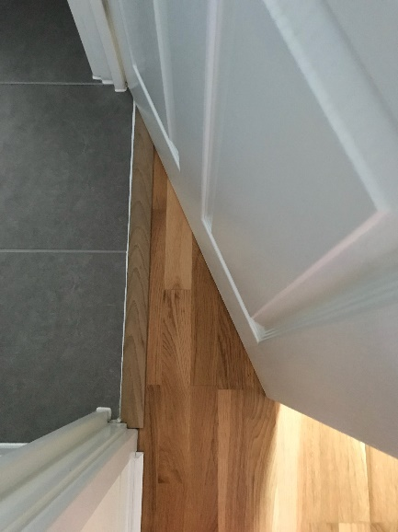
Try this
2
3
1
4
How would you describe what an angle is?
What do they measure?

Slide 3
Connect One way that we can interpret an angle is a measure of turn, measured in degrees.
: Start
: End

Slide 4
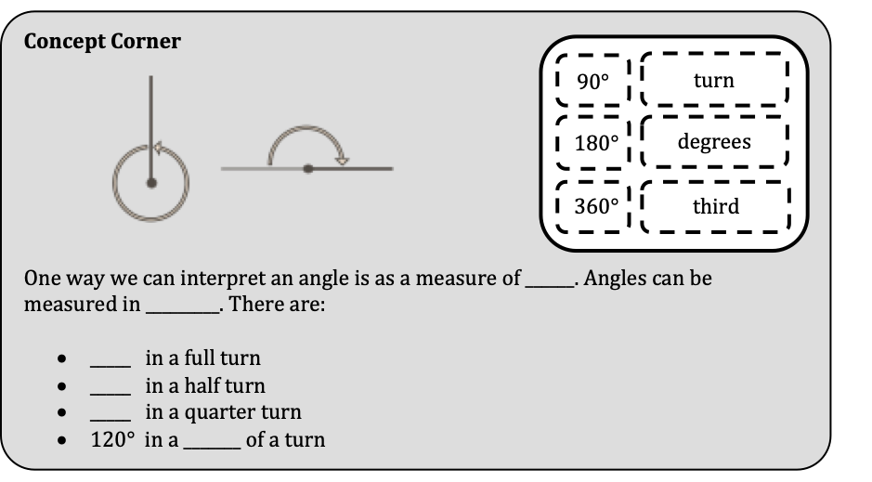
Fill in the blanks for the following exercise. You may want to go back in the video for some help.
Independent Task

Slide 5
Explore
Look at Zaki’s statement. Do you agree with her?
All the marked angles have different sizes!

