Slide 1
Lesson 3: School Lab Studios
Mobile App Development
Computing
Ben Garside
Materials from the Teach Computing Curriculum created by the National Centre for Computing Education

Slide 2
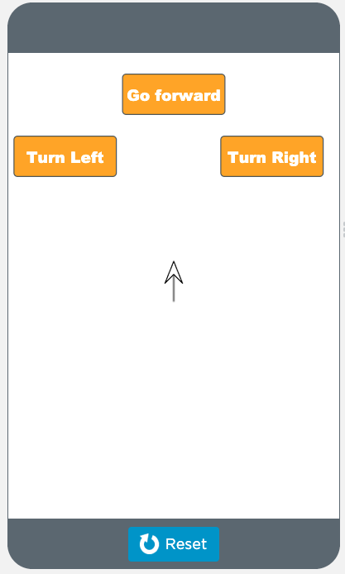
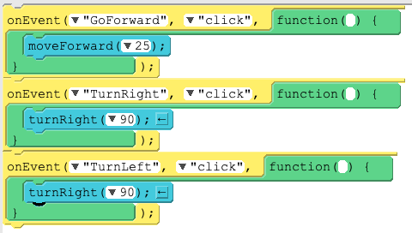
Task 1 - Spot the errors
Debug the app
There are three errors in this program.
Sign into your code.org account.
Follow this link: oaknat.uk/comp-AppLabL3S
Click View code and Remix.
See if you can find and fix all the errors.
Source: Code.org

Slide 3
Task 2 - User score
Instructions
Open the app that you developed in the previous lesson
If you don’t want to use your app, you can remix the following app:
oaknat.uk/comp-AppLabL3a1
We’re now going to apply the final touches to our Tappy Tap App by doing the following:
Designing the score screen
Adding code to pass the score to the score screen

Slide 4
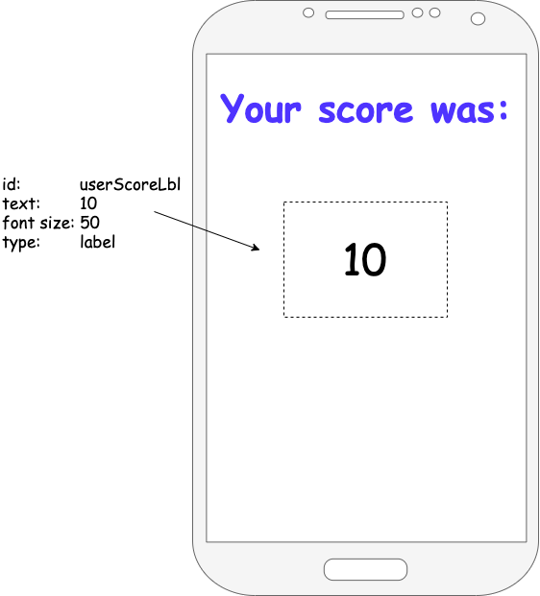
Task 2 - Score screen design
Enter design mode and select the score screen.
Add a label and place it where you would like the score to appear.
Change the id to user_score_label.
Format the font, size, and position (change the text property to an example score, such as 10).

Slide 5
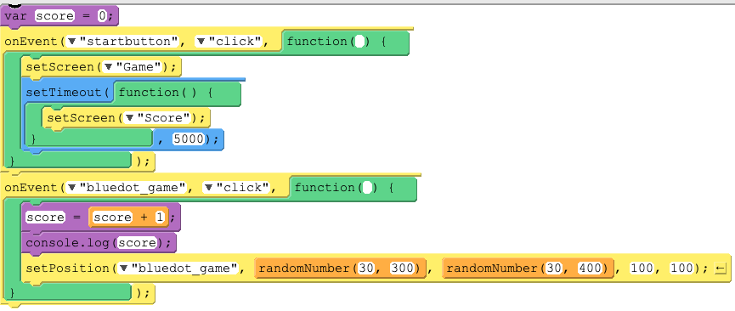
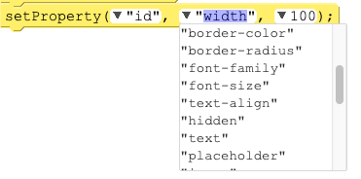
Task 3 - Passing the score into user_score_label
Add the following block of code into the correct position.
Customise the properties so that it changes the text to the value of the score variable.
Optional explorer task: Add and code a Play again button.
A
Source: code.org

Slide 6
Task 4 - Choose your project
You can now choose your project.
Open the project diaries for each project
Spend time reading the options and the requirements of each program
Download or make a copy of the project that you are going to work on
Source: Pixabay

Slide 7
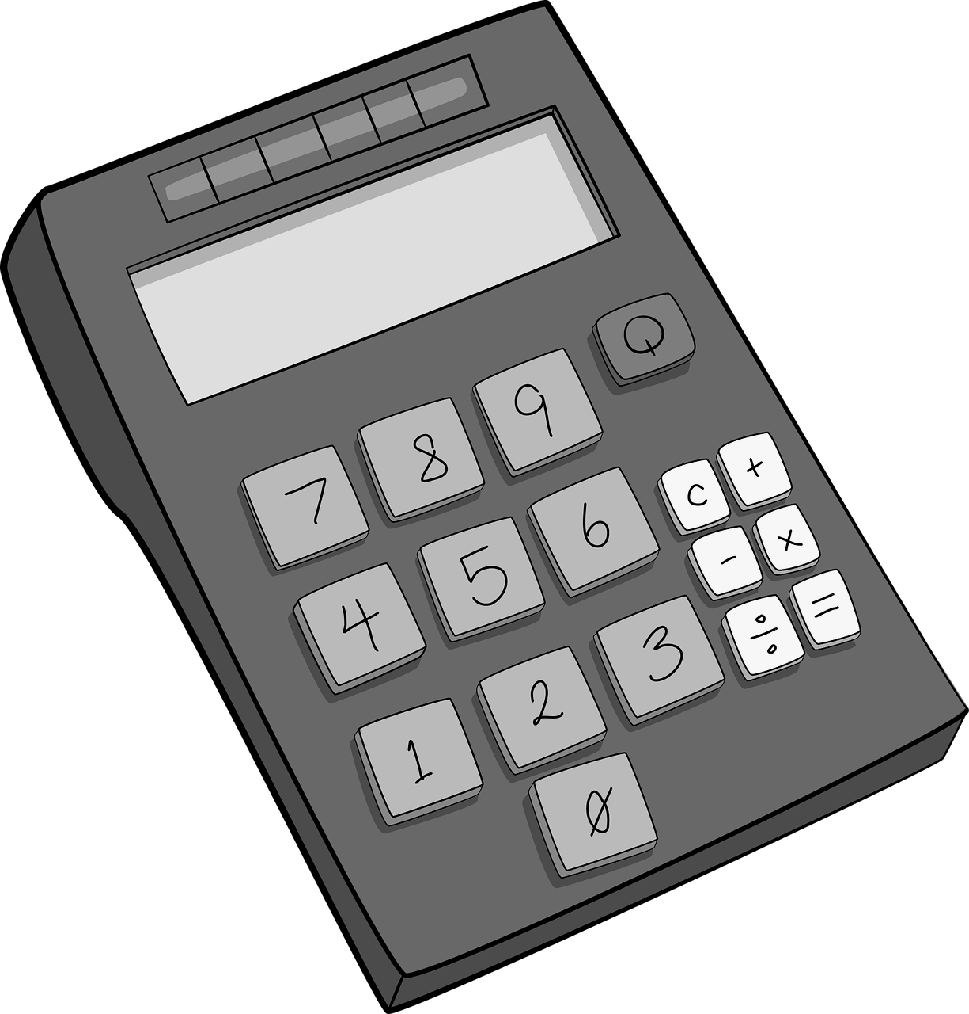
School Lab Studios: App Choices
KS2 Maths App
Clicky biscuits
oaknat.uk/comp-KS2MathsApp
oaknat.uk/comp-ClickyBiscuits
Your weight in space
Virtual pet
oaknat.uk/comp-YourWeightInSpace
oaknat.uk/comp-VirtualPet
Source: Pixabay

