Slide 1
To subtract fractions with the same denominator
Worksheet
Maths
Ms Brinkworth

Slide 2
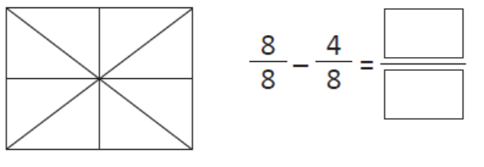
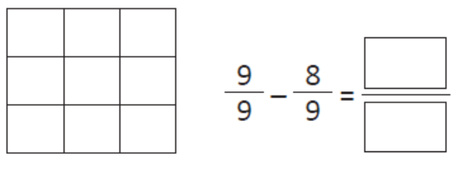
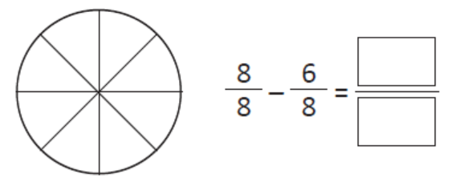
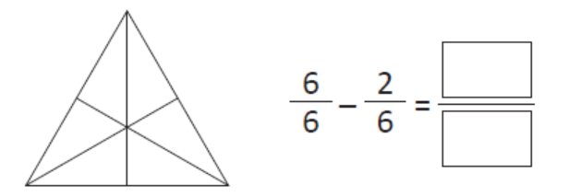
Part 1: Shade in the diagrams to subtract these fractions with the same denominator
A) B)
C) D)
Notes:
Remember

Slide 3
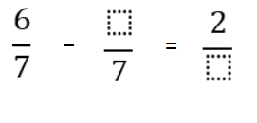
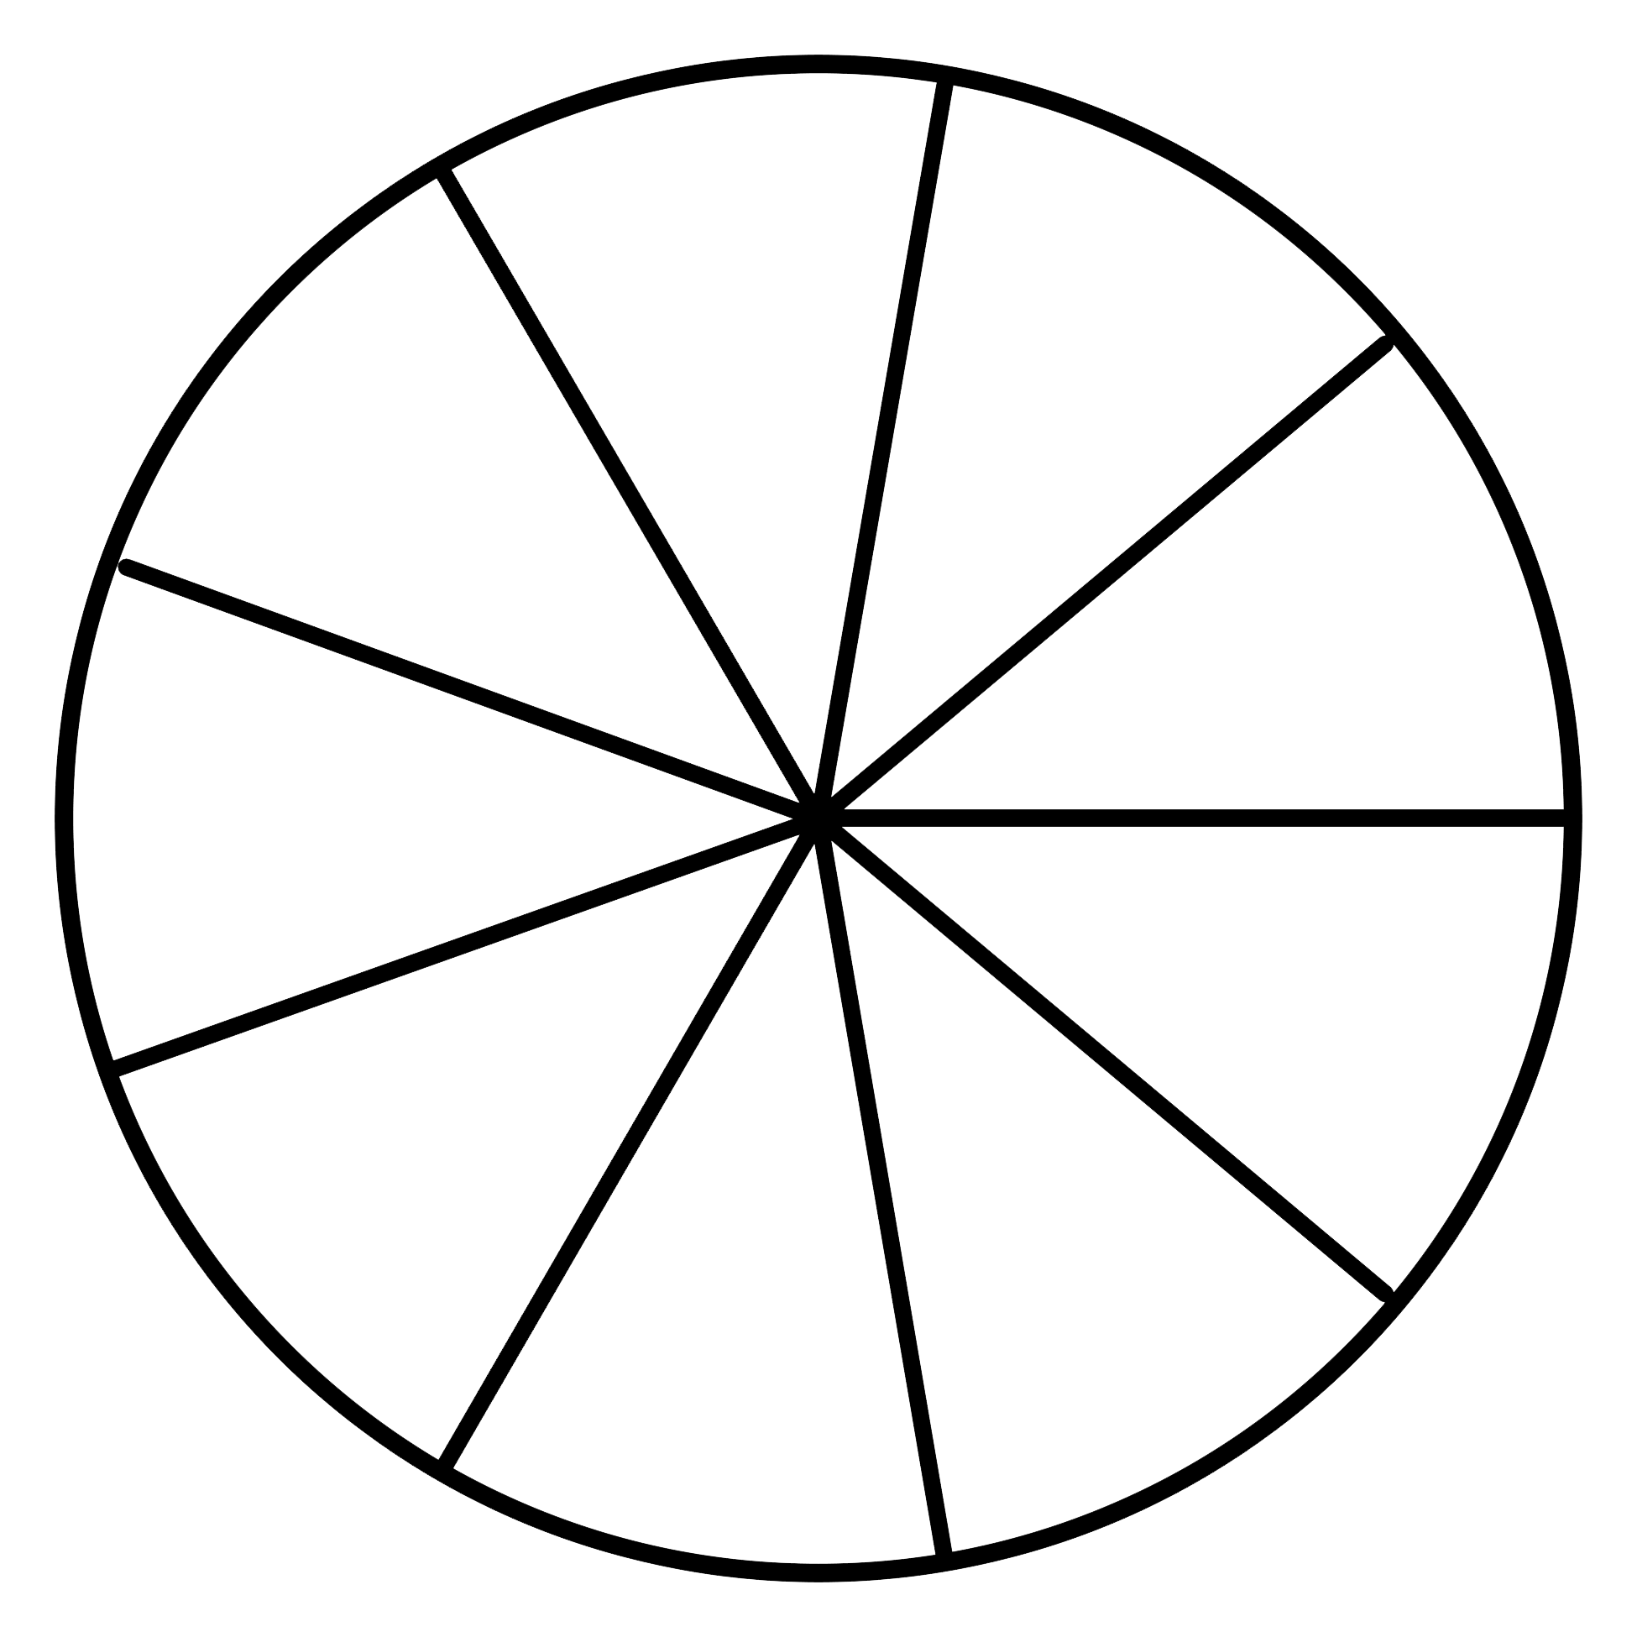
Part 2: Use the part whole model to subtract these fractions with the same denominator
4. _ _ = 5.
Challenge
If a shape is cut into 9 equal pieces and give 4 pieces to one friend 2 to another friend, how many pieces will I have left?
Notes:
Q5 - 7 because the denominator does not change, 6- ? = 2 must be 4

