Slide 1
Explore one fewer within six.
Mathematics
Mrs Harris

Slide 2
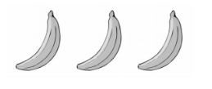
I

