Slide 1
Mathematics
Solving inequalities graphically 2
Independent Task
Ms Jones

Slide 2
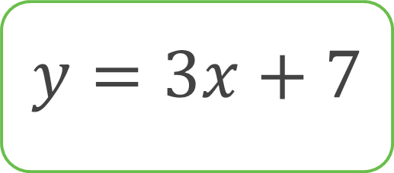
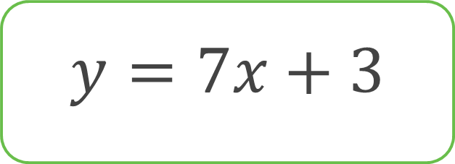
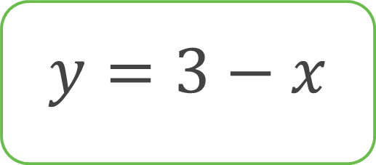
Find the points of intersection of the following lines

Slide 3
1. a) Draw y = -2x + 4 and y = x + 1 on a set of axes.
b) Find the point of intersection.
c) Use your graph to solve -2x + 4 > x + 1
2. a) Draw y = 3x + 4 and x + y = -4 on a set of axes.
b) Find the point of intersection.
c) Use your graph to solve 3x + 4 < -x – 4

Slide 4
