Slide 1
Practical application of Quantitative Chemistry
Triple - Chemistry - Key stage 4
Mrs Begum

Slide 2
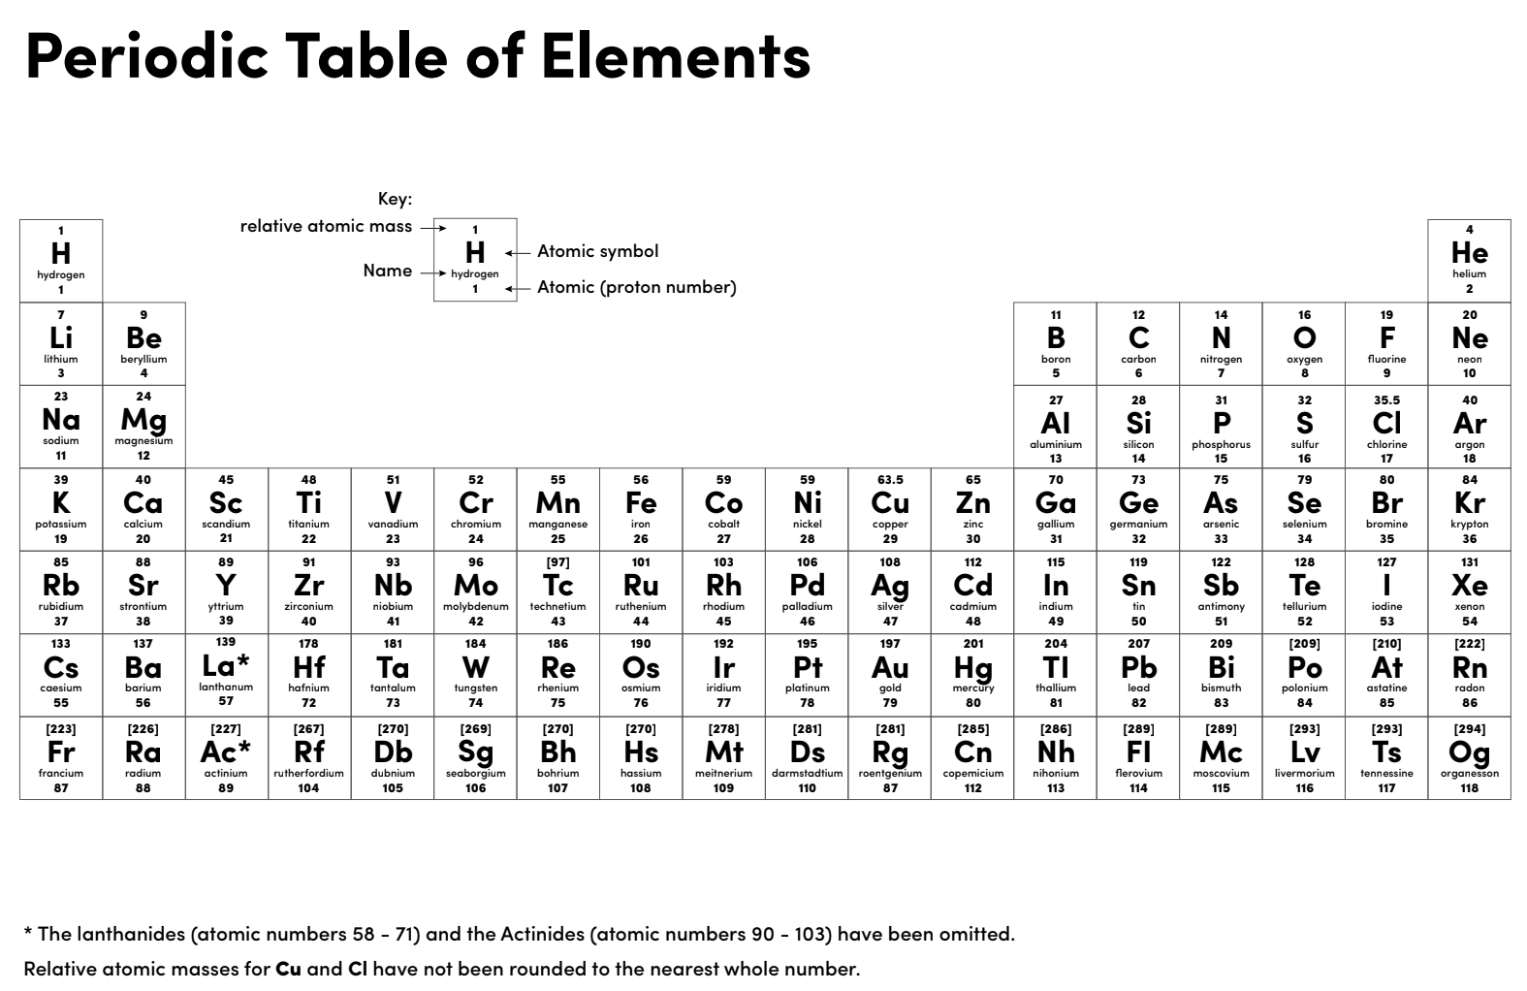

Slide 3
Warm up
Calculate the number of moles in 4.9 g of H₂SO₄.
Calculate the number of moles of potassium nitrate dissolved in 10 cm³ of a 0.2 mol/dm³ solution.
What mass of oxygen will react exactly with 6 g of magnesium? 2Mg + O₂ 2MgO
If you have 4.8 g of Mg reacting with 7.3 g of HCl, which reactant is the limiting reactant? Mg + 2HCl MgCl₂ + H₂
How do you calculate yield?
Calculate the atom economy of this reaction, PbO is the desired product. A_{r} Pb = 207; S = 32; O = 16 2PbS + 3O₂ 2PbO + 2SO₂

Slide 4
Independent practice 1
Your task is to produce 6.5g of copper sulfate. Using 1.5M H₂SO₄.
Work out the volume of acid you will need to make sure it is not the limiting reactant and write a method to produce the salts.
CuO + H₂SO₄ CuSO₄ + H₂O

Slide 5
Calculate your yield
Your task was to produce 6.5 g of copper sulfate.
You identified the volume of acid you would need.
A student carried out your experiment and produced 4.9 g of copper sulfate.
What is the percentage yield?
Suggest reasons why the yield is less than 100%.

Slide 6
Atom economy
Atom = relative formula mass of the desired product x 100% economy total formula mass of all the reactants
Calculate the atom economy of your reaction. Relative atomic mass of Cu = 63.5; O = 16; H = 1; S = 32
CuO + H₂SO₄ CuSO₄ + H₂O
M_{r} 79.5 98 159.5 18

Slide 7
Warm up
Calculate the number of moles in 4.9 g of H₂SO₄. 4.9/98 = 0.05 mol
Calculate the number of moles of potassium nitrate dissolved in 10 cm³ of a 0.2 mol/dm³ solution. Moles = 0.2 x (10/1000) = 0.002 mol
What mass of oxygen will react exactly with 6 g of magnesium? 4g of O₂ 2Mg + O₂ 2MgO
If you have 4.8 g of Mg reacting with 7.3 g of HCl, which reactant is the limiting reactant? Mg + 2HCl MgCl₂ + H₂ You need 2.4g of Mg to react with 7.3g of HCl and you added 4.8 g so Mg is in excess. HCl is the limiting reactant.
How do you calculate yield? (actual yield/theoretical yield) x 100
Calculate the atom economy of this reaction, PbO is the desired product. A_{r} Pb = 207; S = 32; O = 16 2PbS + 3O₂ 2PbO + 2SO₂ (2 x (207 +16) / 478 + 96) x 100% = 77.7%

Slide 8
Independent practice 1 answers
Your task is to produce 6.5g of copper sulfate, using 1.5M H₂SO₄.
Work out the volume of acid you will need and write a method to produce the salts.
CuO + H₂SO₄ CuSO₄ + H₂O
1.5 M H₂SO₄
How many moles in 6.5 g CuSO₄?
Moles = 6.5/159.5 = 0.041 moles
Balanced equation shows a ratio 1 : 1. So 0.041 moles is needed of H₂SO₄

Slide 9
Independent practice 1 answers
We need 0.041 moles of 1.5 M H₂SO₄.
Volume (dm³) = moles / concentration (mol/dm³)
= 0.041 / 1.5
= 0.027 dm³
Convert 0.027 dm³ into cm³ = 0.027 x 1000 = 27 cm³

Slide 10
Method
Measure 27 cm³ of 1.5M H₂SO₄ and pour it into the conical flask.
Gently heat the acid.
Add copper oxide, a spatula at a time, until no more will dissolve (excess).
Filter to get rid of the excess insoluble CuO.
Evaporate the water from the copper sulfate solution and you will be left with copper sulfate crystals.

Slide 11
Yield answers
What is the percentage yield? (4.9 / 6.5) x 100 = 75.4%
Suggest reasons why the yield is less than 100%.
Some copper sulphate remains on the filter paper.
Some of the copper sulphate may have been spilled or lost during the transfer from conical flask to evaporating dish.

Slide 12
Atom economy answer
Atom = relative formula mass of the desired product x 100% economy total formula mass of all the reactants
Calculate the atom economy of your reaction. Relative atomic mass of Cu = 63.5; O = 16; H = 1; S = 32
CuO + H₂SO₄ CuSO₄ + H₂O
M_{r} 79.5 98 159.5 18
Atom economy = (159.5 / 177.5) x 100% = 89.9%

