Slide 1
Lesson 2: Making a model with 3D shapes
Lesson 2 of 4
Numeracy: Shape and Sorting - Building Understanding
Simon

Slide 2
What are we going to learn today?
To explore 3D items.
To explore the properties of 3D shapes through play and exploration.
Key Vocabulary
3D 2D slide roll
stack flat curved tall

Slide 3
For this lesson, you will need:
Objects from your home and from your recycling bin. These could include boxes, crisps tubes, toilet roll tubes, plastic trays, straws etc.
A slope or ramp. This could be a hill outside, or a book leaning against the wall.

Slide 4
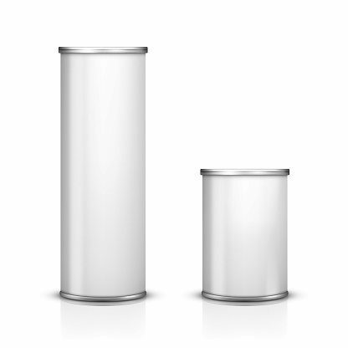
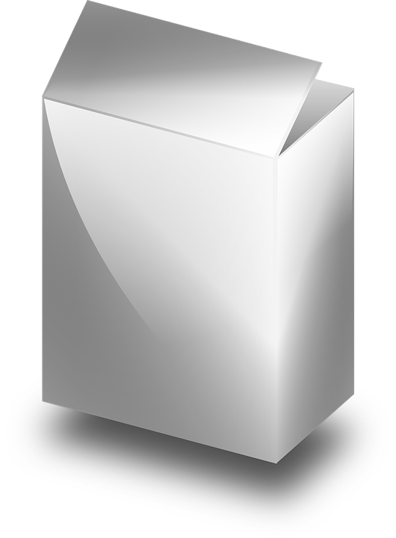
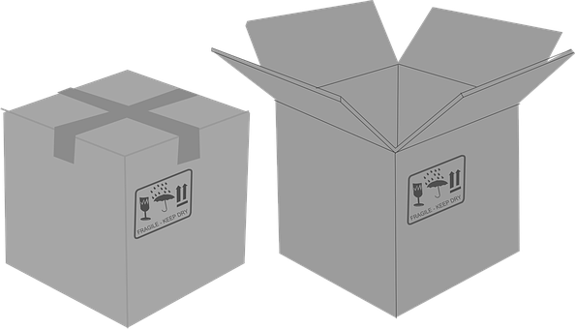
Explore the items you have gathered
Touch and feel the objects.
Touch the vertices (corners) and the surfaces.
Which are flat? Which are curved?
Do you know the names of shapes.
Images from Pixabay

Slide 5
Does it roll, slide or neither?
The shape of the object will change the way it behaves at the top of a slope.
Images from Pixabay

Slide 6
Task 1 - Observe what happens when each of the items is put at the top of a ramp.
Instruction
Make a slope or ramp. Put each item at the top of a ramp and then see what happens.
Questions to ask
What happened?
Did it move slow or fast?
Can you guess what this item will do?

Slide 7
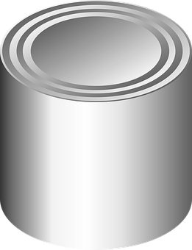
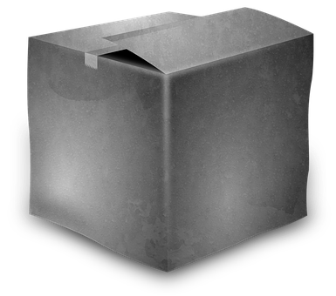
Making a tower
The objects can be stacked to make a tower.
You can stack your objects to make a tall tower.
Which items will work best to make a tower?
Images from Pixabay

Slide 8
Task 2- Stacking 3D objects
Instruction
Stack the items you have gathered. Try different combinations to make the tallest tower.
Questions to think about
Which items will you put at the bottom? Does size or shape make a difference?
Are you able to make your tower taller each time you try, as you learn which shapes work best?

Slide 9
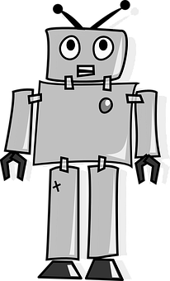
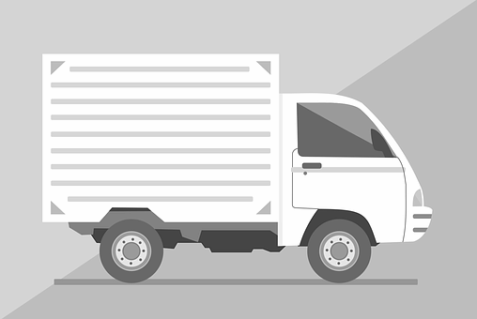
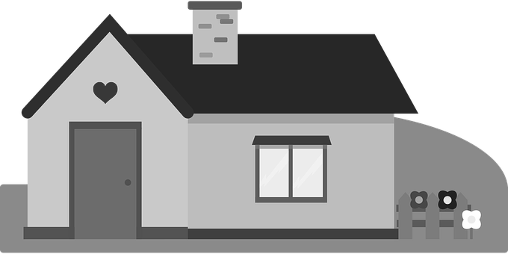
Making a model using 3D objects
What could you make using your recycled objects?
Here are some ideas for things you could make.
Images from Pixabay

Slide 10
Task 3- Modelling using 3D shapes
Instruction
Use your recycled materials to make a model of anything you like.
Questions to think about
Which items will work best for different parts of the model? For example, what will you use for the arms of a robot?
Which item matches the shape of the house (for example)?

Slide 11
Unit 2 Lesson 2: Making a model with 3D shapes
Make it easier
Make it harder
Other ideas
Make a tower using a single shape. For example, stack boxes of different sizes. This will give a chance to repeat actions and notice properties before moving on to the next shape.
Name the shapes and introduce vocabulary associated with 3D shapes. Can you identify any common features such as flat faces or curved faces?
Shape search around the home or local environment.
Can you find a shape that is the same as a box or a toilet roll tube?
What else can you build using 3D shapes?

