Slide 1
Reactivity
Lesson 7 - Making a Salt
Chemistry - Key Stage 3
Miss Fenner

Slide 2
Salt is made from oppositely charged ions. These ions ________ each other.
Option 1
Option 2
Attract
Repel

Slide 3
Which of the following is NOT a common salt type?
Option 1
Option 2
Sulfate
Chloride
Option 3
Option 4
Nitrate
Oxide

Slide 4
Independent Practice
True or false
Salts are always edible and tasty on chips.
2. The proper name for table salt is sodium chloride.
3. Salts are made of ions with the same charge.
4. Salts are made by reacting oxygen with a metal.
5. Common endings on the end of salt names are sulfate, chloride and nitrate.

Slide 5
Independent Practice
True or false
Salts are always edible and tasty on chips.
2. The proper name for table salt is sodium chloride.
3. Salts are made of ions with the same charge.
4. Salts are made by reacting oxygen with a metal.
5. Common endings on the end of salt names are sulfate, chloride and nitrate.

Slide 6
Filtration is a method used to separate a
__________ from a liquid.
solid

Slide 7
Filtration uses equipment including a
funnel, _____________ and a beaker.
filter paper

Slide 8
Crystallisation is a method used to
separate a _____________________ from
a solution.
dissolved solid

Slide 9
Crystallisation uses equipment including
a tripod, a bunsen burner and an
____________________.
evaporating basin

Slide 10
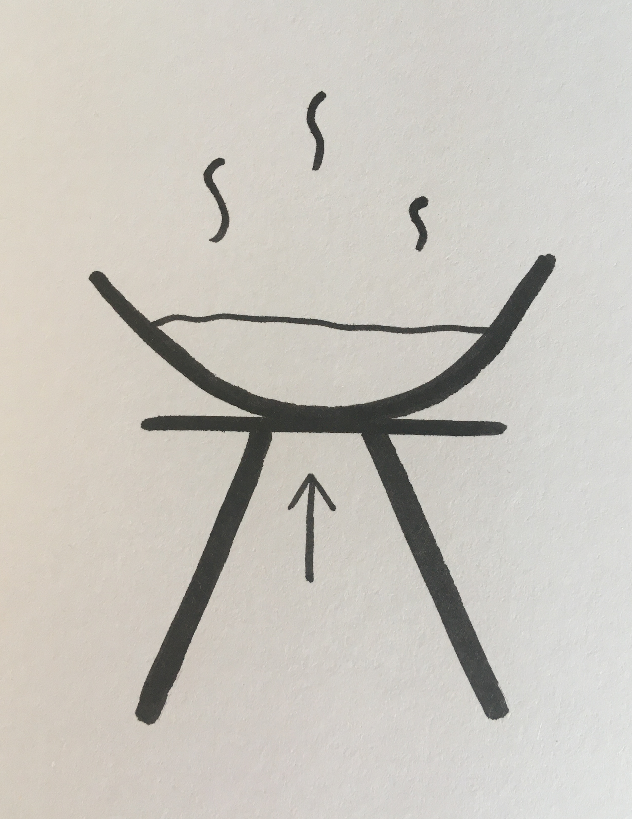
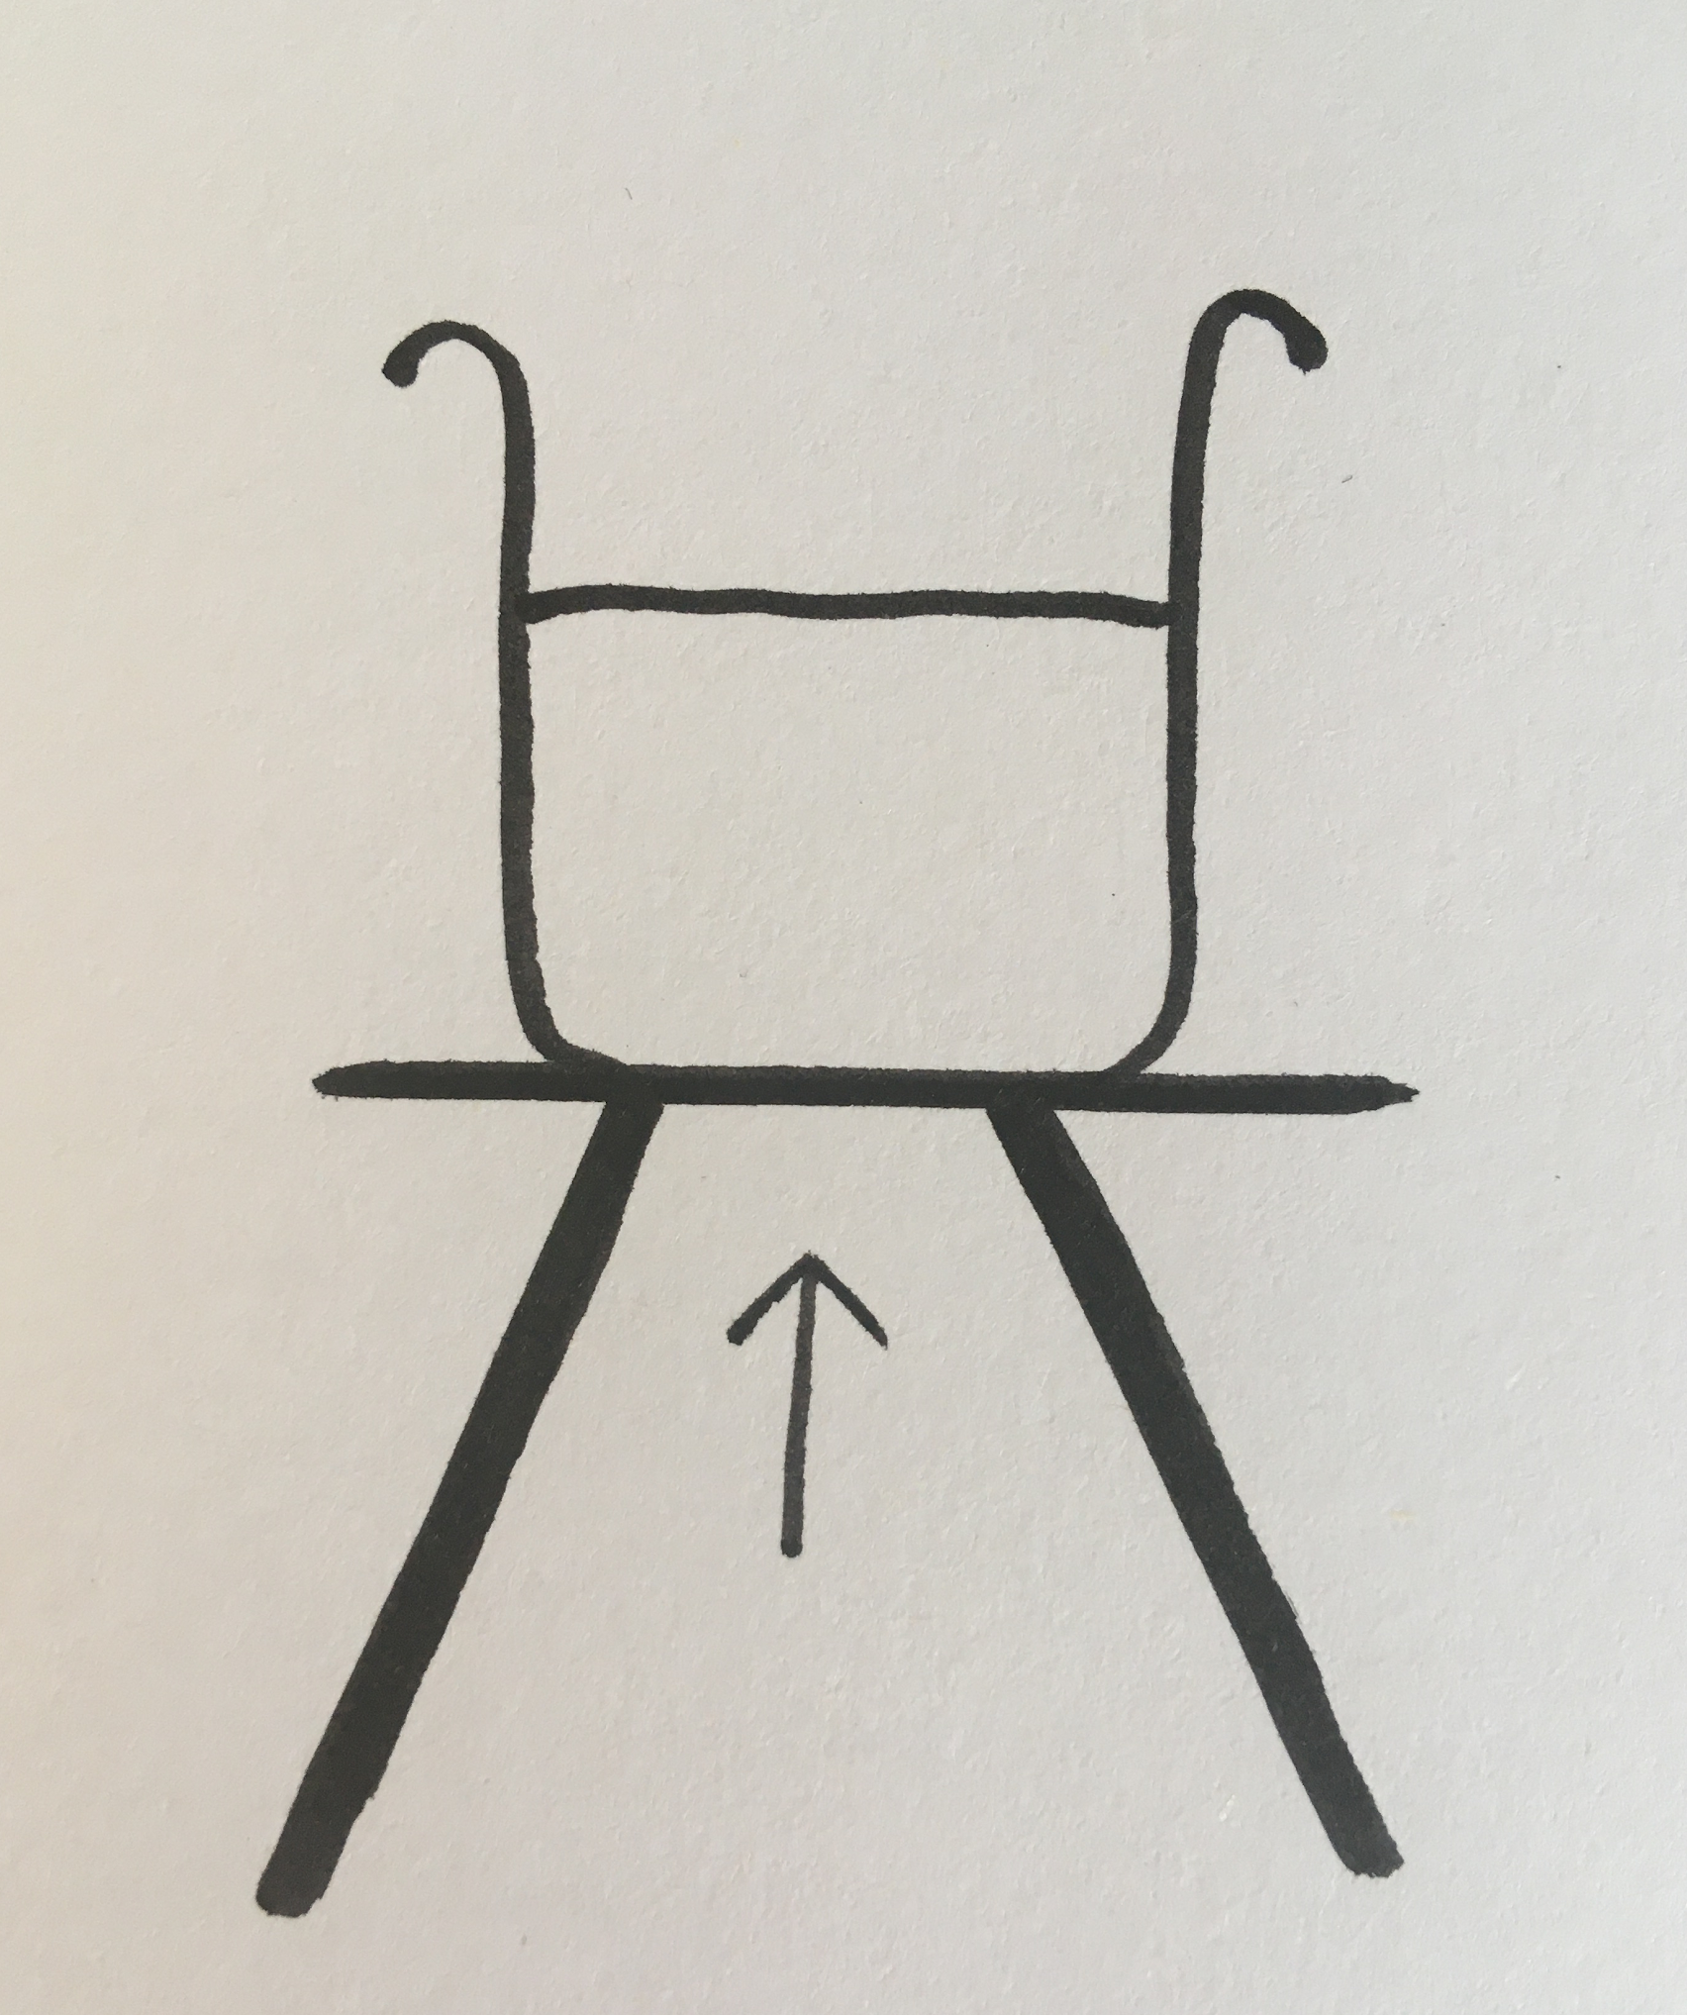
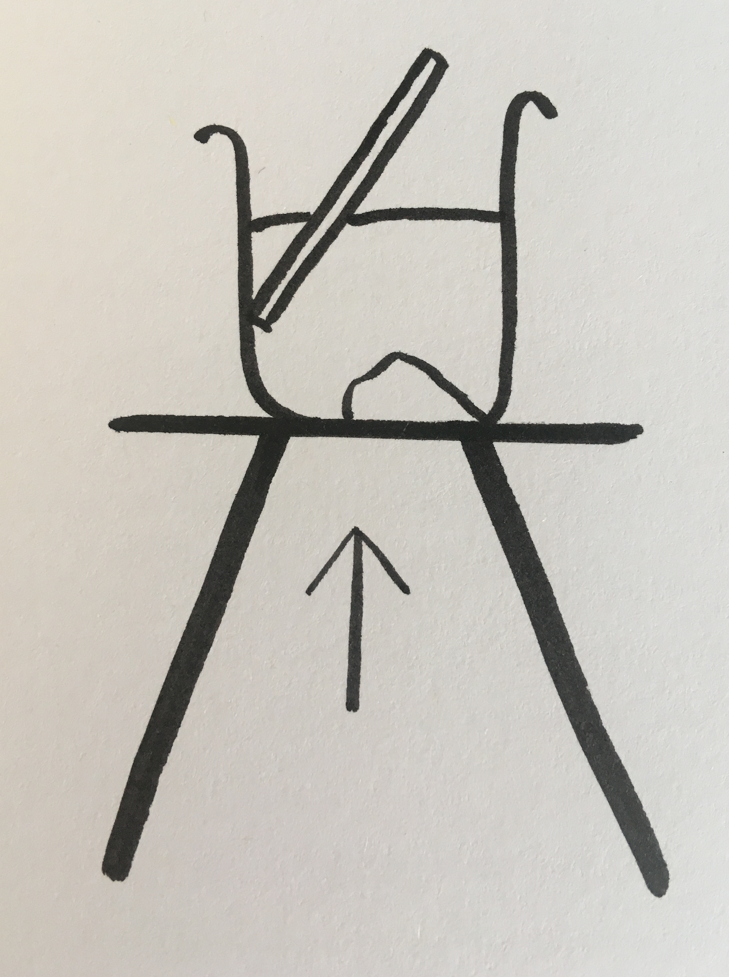
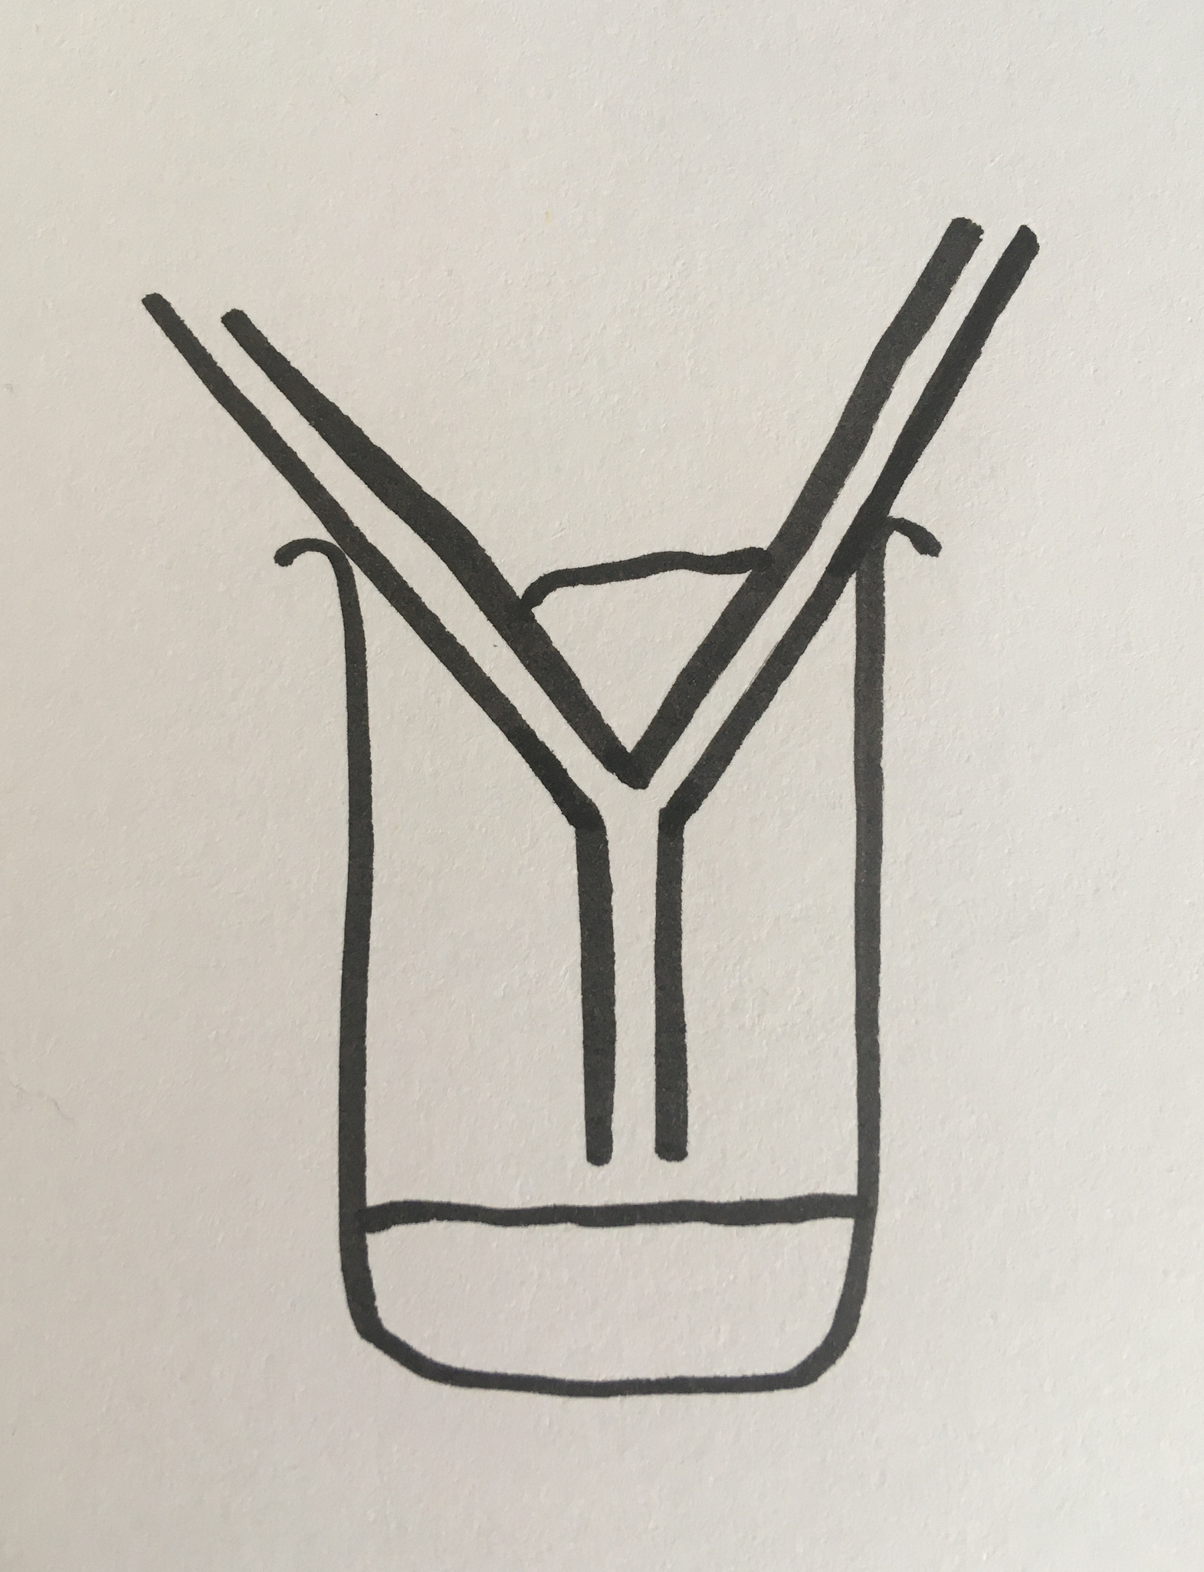
These pictures show each step of the method used to make a salt.
Put the pictures in the correct order.
A
B
C
D
E
Source: Miss Fenner

Slide 11
These pictures show each step of the method used to make a salt.
Put the pictures in the correct order.
B
C
E
A
D

Slide 12
Independent Practice
Write 1/2 sentence(s) to explain what is happening in each step. Use the diagram to help you.
Step 1
Step 2
Step 3
Step 4
Step 5

Slide 13
Independent Practice
Step 1
Add the sulfuric acid to a beaker and heat gently using a bunsen burner. Be careful to make sure the acid doesn’t boil and spit.
Step 2
Add the copper oxide and stir using a glass rod. Continue to gently heat (if needed) and keep adding copper oxide until there is excess.

Slide 14
Independent Practice
Step 3
Put some filter paper into a funnel and place in a beaker. Pour the solution into the filter paper.
Step 4
Pour the filtrate into an evaporating basin and place on a tripod. Heat gently to evaporate the water.

Slide 15
Independent Practice
Step 5
Once there is just a little bit of water left, leave on a windowsill to finish evaporating. Crystals of salt will remain.

