Slide 1
Calculate and measure perimeter
Mathematics
Mr Kelsall

Slide 2
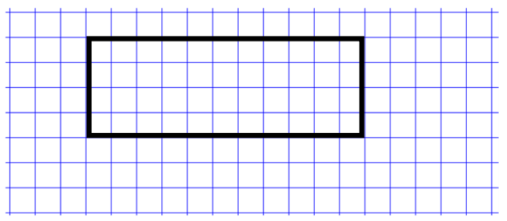
What does perimeter mean?
The perimeter is the distance around a boundary of a shape.
What is the perimeter of this shape?
11 units
4 units
4 units
11 units
Notes:
Pause and have a think about the definition of perimeter. Click for definition.
Model calculating perimeter of shape - click through for animations

Slide 3
Your turn. Calculate the perimeter of the shapes below
Look carefully at the units
* not drawn to scale
12 mm
23 cm
8 m
8 m
32 mm
2 m
Notes:
Give them time to work out then click through answers.

Slide 4
Your turn. Choose your strategy to find the perimeter of the shapes below
9 cm
11 cm 2 mm
2 cm 1 mm
41 mm
* not drawn to scale
Notes:
Give them time to work out then click through answers.

Slide 5
How would I calculate the perimeter of this compound rectilinear shape?
12 cm
4 cm
4 cm
4 cm
2 cm
7 cm
7 cm
6 cm
Notes:
Talk through, mention looking for bonds - 6 + 4 etc.

Slide 6
Question 1
Calculate the perimeter of the shapes below.
44 mm
12 cm
12 mm
19 cm
5 mm
2 cm
10 cm
Notes:
Lesson Agenda:

Slide 7
Question 2
Calculate the perimeter of the shapes below.
12 cm
9.8 cm
243 mm
8 cm
80 mm
5 cm 2mm
Notes:
Lesson Agenda:

Slide 8
Question 3
Calculate the perimeter of the compound shape.
5 cm
1 cm
4 cm
4 cm
2 cm
1 cm
1 cm
2 cm
Notes:
Lesson Agenda:

Slide 9
Question 4
Calculate the perimeter of the compound shape.
5 cm
3 cm
6 cm
6 cm
10 cm
Source of all images : Mr Kelsall or Oak National Academy
Notes:
Lesson Agenda:

