Slide 1
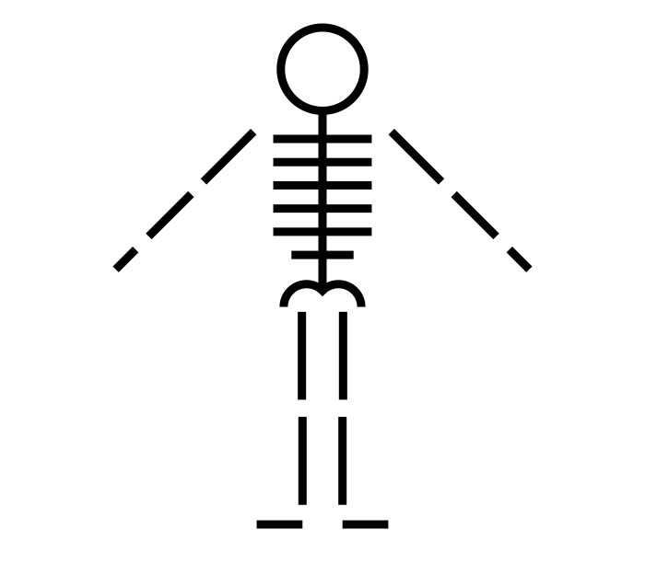
What are the major bones in the human body?
Science - Human Anatomy
Miss Hummel
Skeleton by Juan Pablo Bravo from the Noun Project
Notes:
Hi everyone! My name is Miss Hummel and together, we will be answering the question: What are the major bones in the human body?
In this lesson, we will discuss the differences between Astrology and Astronomy, particularly which one is considered scientific. We will then discover the works of famous astronomers and their contributions to society.

Slide 2
Answer this question:
What do you think an exoskeleton might mean?

Slide 3
Answer these questions:
What are the three functions of the skeleton?

Slide 4
Answer these questions:
How do our bodies move?
What set of bones helps keep our body upright?
What bone structure helps protect our brain?
What bone structure helps protect our lungs and heart?

Slide 5
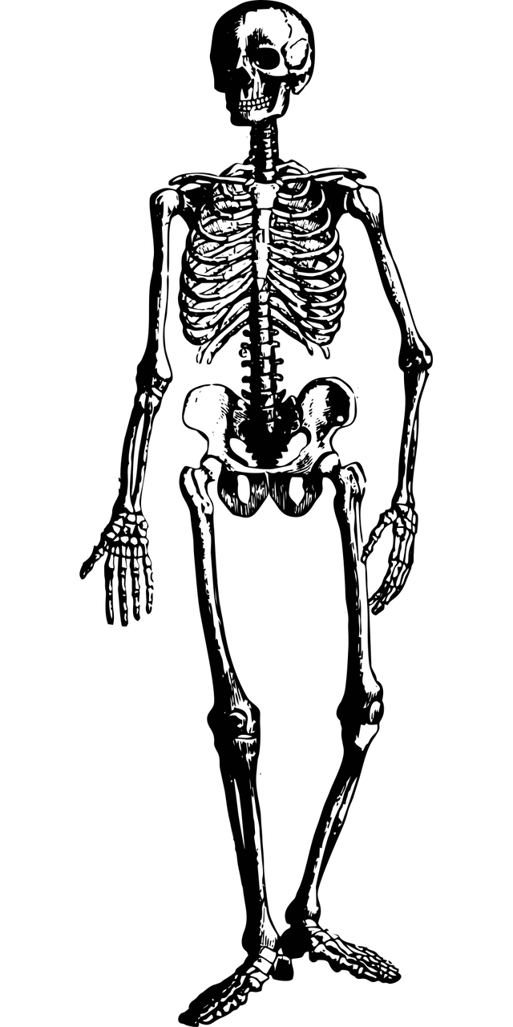
Can you label the bones we just discussed?

Slide 6
Answers:
Skull
Mandible
Ribs
Spine
Pelvis
Femur

Slide 7
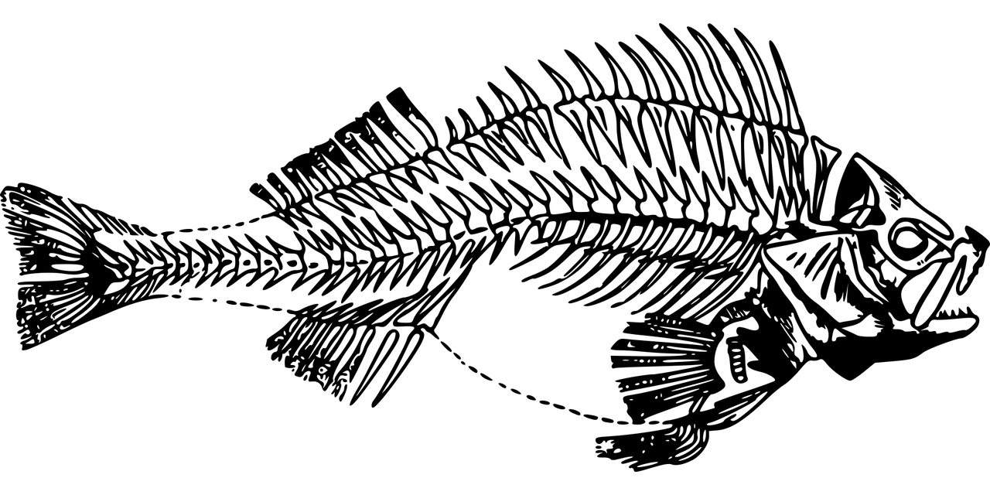
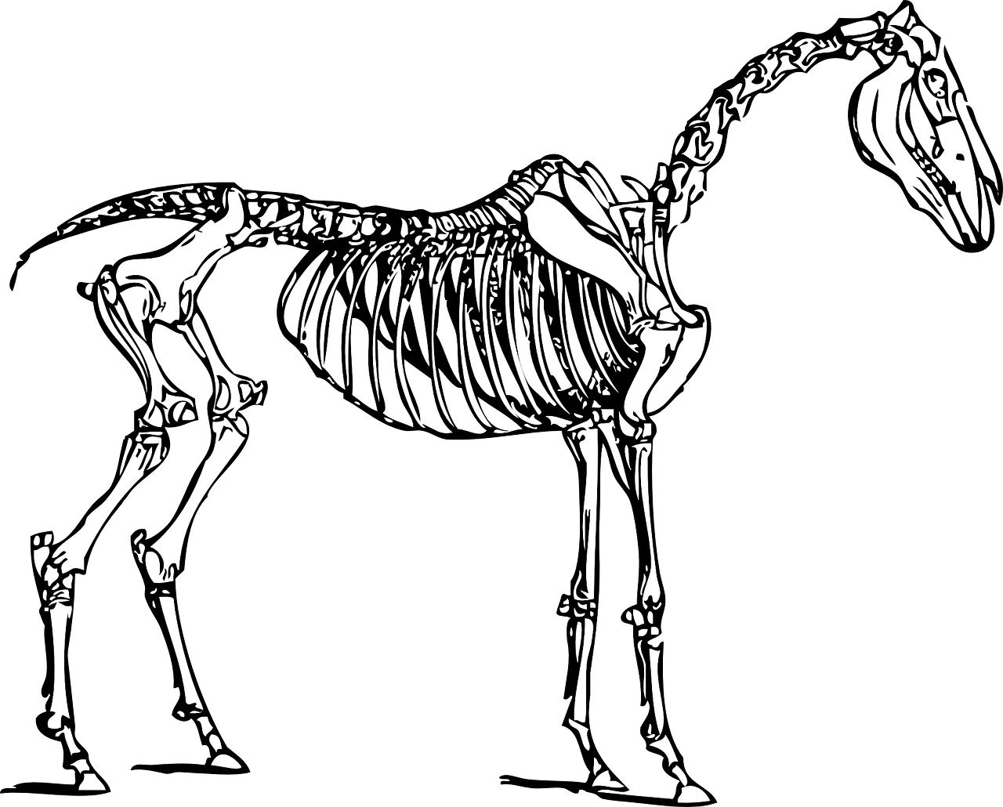
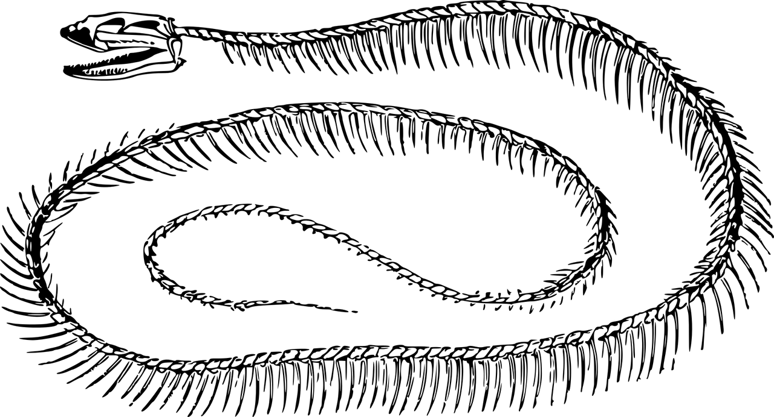
Name the animals that these endoskeletons belong to:

Slide 8
Answers:
Fish
Human
Snake
Horse

Slide 9
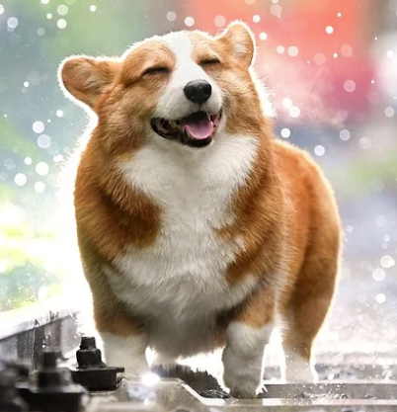
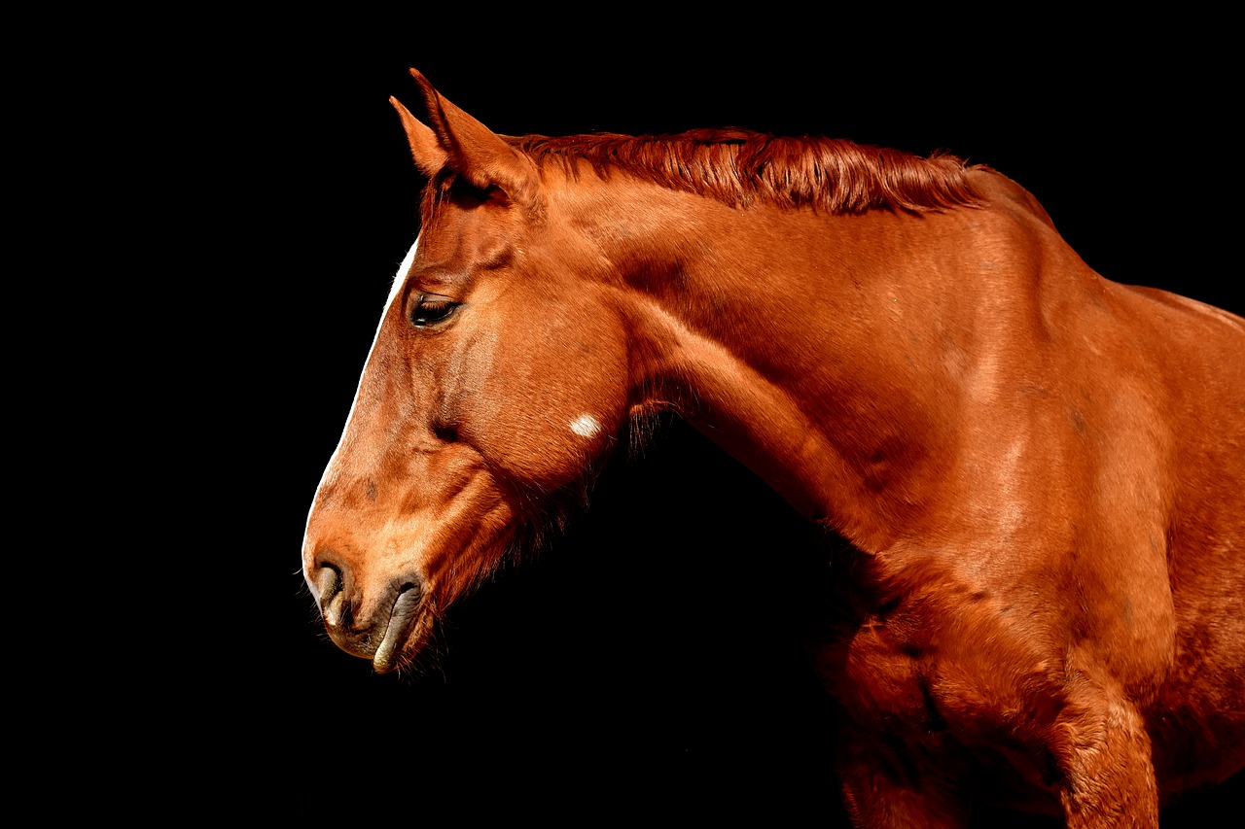
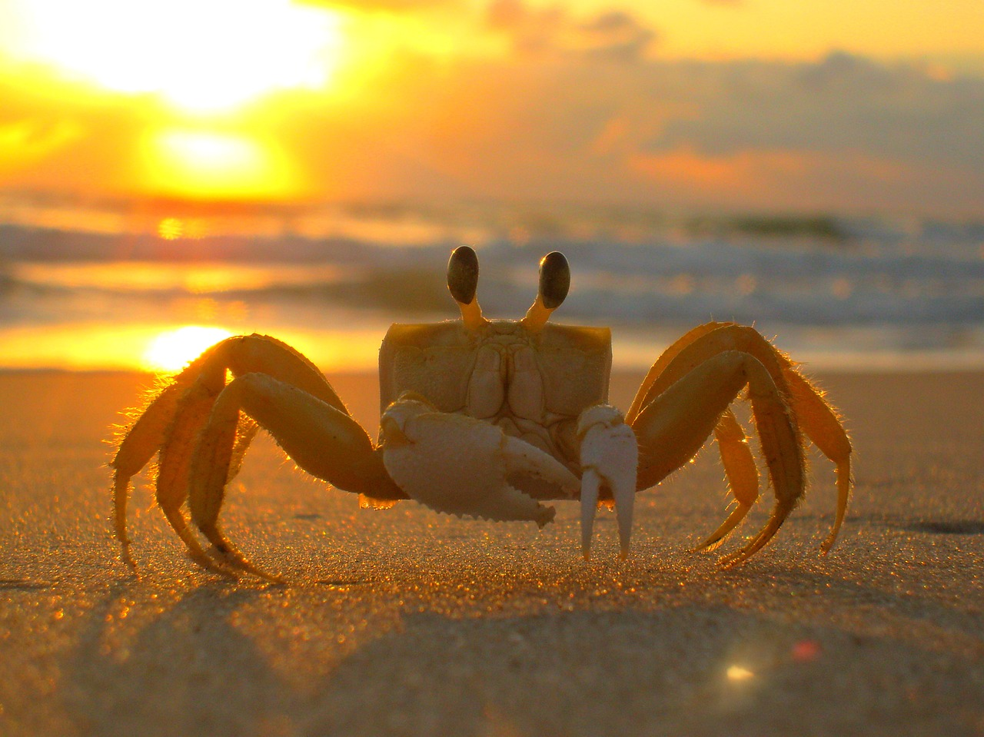
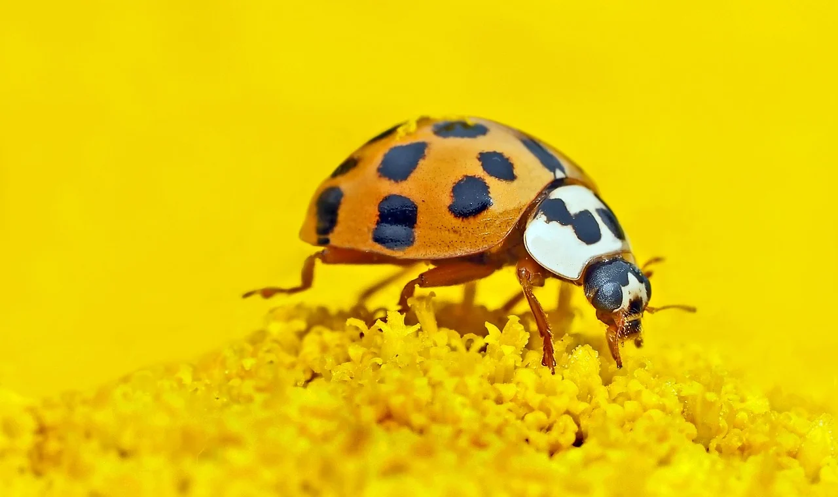
Label these animals as animals with exoskeletons or endoskeletons

