Slide 1
Mathematics
Calculating Probabilities
Downloadable Resource
Mr Langton

Slide 2
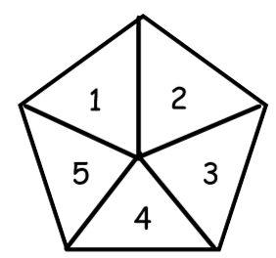
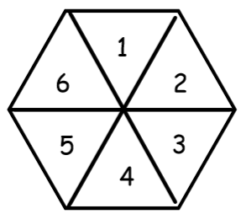
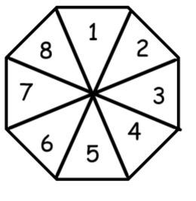
Calculating Probabilities
Here are three fair spinners.
1 2 3 4 5 6 7 8 9 10 11 12 13 14 15 16 17 18 19 20
A
B
C
Using the number cards above, calculate the probability of:
1. Selecting a prime number
2. Selecting a number that is not square.
3. Selecting a factor of 12.
4. Selecting a number less than 12.
5. Selecting a number greater than 20.
1. What is the probability of spinning a 4 on Spinner C?
2. What is the probability of spinning a 6 on each one?
3. Which one is most likely to land on an odd number?
4. Which one is most likely to land on a prime number?
5. Which one is most likely to land on a number less than 4?
6. Which one is most likely to land on a square number?

