Slide 1
Lesson 1 - Light waves
Science - Physics - Key Stage 3
Light and Space
Miss Wickham

Slide 2
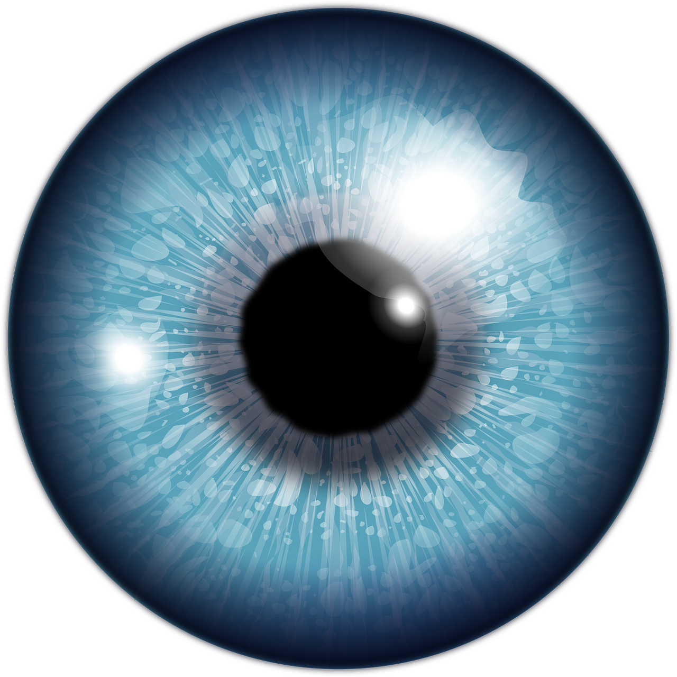
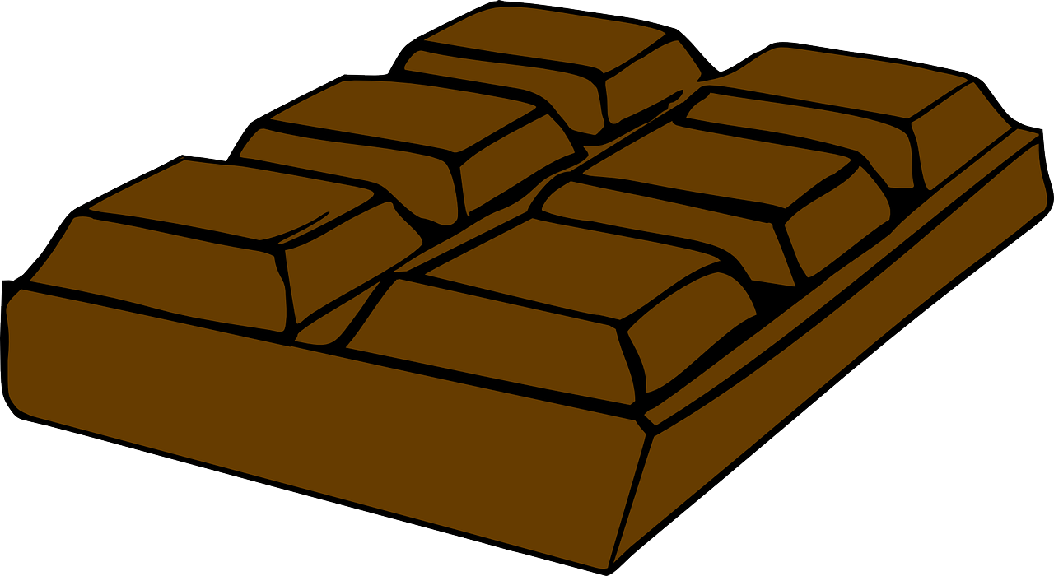
Spot the mistakes 1

Slide 3
Spot the mistakes 2

Slide 4
Spot the mistakes 3

Slide 5
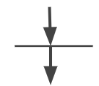
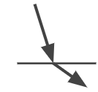
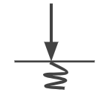
What happens when light meets a surface: Match up task
Reflection
Absorption
refraction
transmission

Slide 6
Draw a ray diagram to show:
How we can see our dinner.
Light travelling through a really clear car window
Light reflecting off a clean mirror
Sunlight being absorbed by a dark bench
Make sure:
Draw straight line using a ruler
Include direction light is travelling
Don’t worry too much about your drawing!

Slide 7
Complete the following gap fill:
Light is a ___________ wave, which means the vibrations are travelling ______________ to the direction of the wave. Light can travel at a maximum speed of _____________ m/s, when travelling through a ___________. We see objects as light _________ off the surface and into our eyes.
Key words: reflects, 300,000,000, transverse, vacuum, perpendicular,

Slide 8
References
Slide [2, 3, 4] - [lightbulb] - [Pixabay]
Slide [2, 3, 4] - [chocolate bar] - [Pixabay]
Slide [2, 3, 4] - [Eye] - [Pixabay]

