Slide 1
Viewing animal cells and applying the magnification equation
(Downloadable student document)
Combined Science - Biology - KS4
Cell Biology
Miss Wong

Slide 2
Recap: How do we view a plant cell under the microscope?

Slide 3
Viewing onion cells under the microscope
Collect a glass slide and an onion.
2. Carefully peel off a very thin layer of onion skin.
3. Place a small piece of the onion skin on a glass slide and add two drops of iodine solution.
4. Place the cover slip at an angle to avoid air bubbles. Blot off excess iodine solution if necessary.
5. Start observing using the objective lens with the lowest magnification. Use the coarse focus knob to manually focus the image. Switch to a higher magnification and use the fine focus knob to focus.

Slide 4
Quick recap:
Why is iodine solution added to the onion cells?
Why is the cover slip lowered at an angle?
Why must we use the fine focus at a high magnification when using the microscope?

Slide 5
Answers
Iodine solution is added to the cells to stain them. This makes the structures of the cells easier to observe.
2. The cover slip is lowered at an angle to avoid air bubbles forming under the cover slip.
3. The fine focus must be used because the objective lens and the specimen are very close together. Using the coarse focus will cause the two to come into contact.

Slide 6
Applying the magnification equation

Slide 7
What is the magnification?
The image of the worm is 80mm long while its actual size is 400μm. What is the magnification?
Notes:
We do

Slide 8
What is the magnification?
80mm
400μm
The image of the worm is 80mm long while its actual size is 400μm. What is the magnification?
8,000μm
=
400μm
= 20x
Notes:
We do

Slide 9
What is the magnification?
The width of the root is 30mm under the microscope while its actual size is 150μm. What is the magnification?

Slide 10
What is the magnification?
The width of the root is 30mm under the microscope while its actual size is 150μm. What is the magnification?
30mm
150μm
30,000μm
=
150μm
= 200x

Slide 11
Applying the magnification equation in an exam question

Slide 12
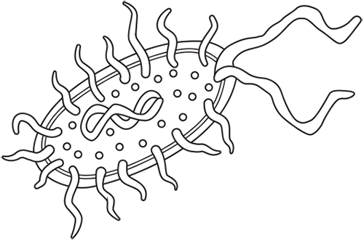
Exam questions
OCR, Jun2019 J250/01
A student draws this image of a prokaryotic cell. The cell image drawn by the student is 55 mm long. The actual length of the prokaryotic cell is 1 μm.
What is the magnification of the student’s drawing?

Slide 13
Exam questions
OCR, Jun2019 J250/01
A student draws this image of a prokaryotic cell. The cell image drawn by the student is 55 mm long. The actual length of the prokaryotic cell is 1 μm.
What is the magnification of the student’s drawing?
55 mm = 5 x 1000 = 55,000 μm
55,000
= 55,000x
1

Slide 14
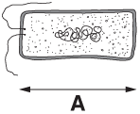
Exam questions
OCR, Jun2019 J250/02
A scientist observes some bacteria growing on agar plates using a microscope.The diagram shows a bacterium cell.
The length (A) of the bacterium on the right has been magnified 2500x.
What is the actual length of the bacterium? Give your answer in standard form.
The image size is 6.8 cm (on my screen).
The magnification is 2500x.

Slide 15
Exam questions
OCR, Jun2019 J250/02
A scientist observes some bacteria growing on agar plates using a microscope.The diagram shows a bacterium cell.
The length (A) of the bacterium on the right has been magnified 2500x.
What is the actual length of the bacterium? Give your answer in standard form.
The image size is 6.8 cm (on my screen).
The magnification is 2500x.
6.8
2500=
Actual size
= 2.72 x 10⁻³ cm

