Slide 1
Comparing Capacity
Mathematics
Lesson 1 of 10
Ms. Dobrowolski

Slide 2
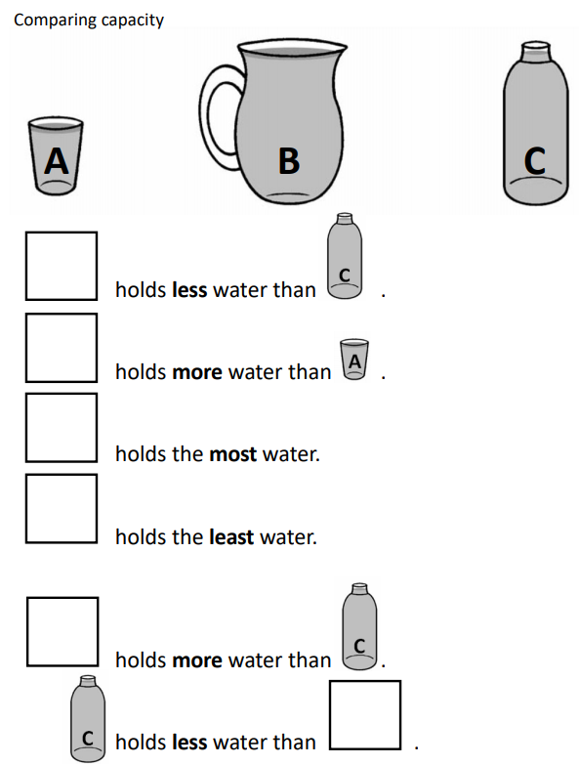
Independent Task

