Slide 1
Securing Multiplication Facts:
Consolidation and Review
Worksheet
Mr Ward

Slide 2
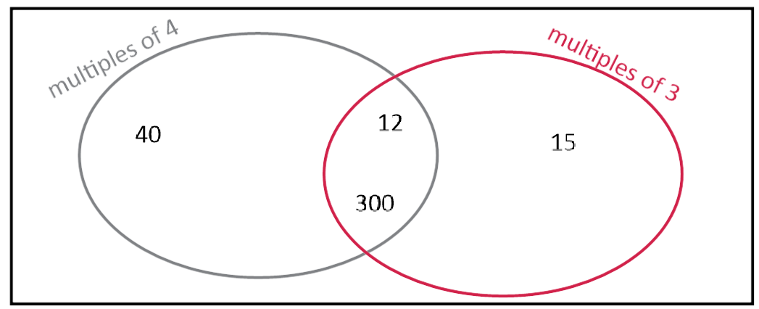
Warm up - Venn Diagram
How many multiples of 4 and 3 can you place correctly onto the venn diagram?

Slide 3
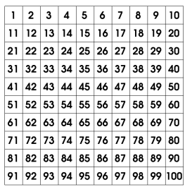
Blank 100 squares for lesson tasks

Slide 4
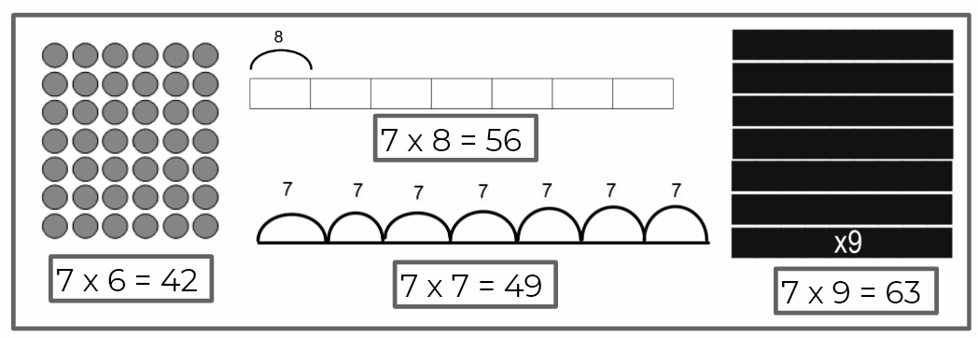
Representing multiplications
Can you identify the equation based on the representation?

Slide 5
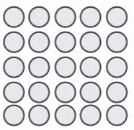
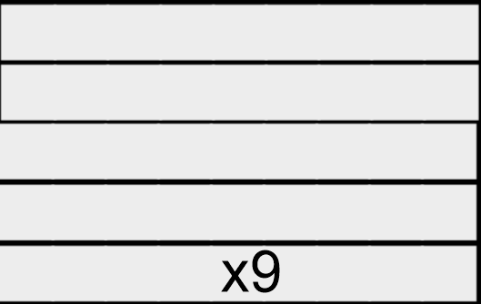
Representing multiplications
Can you identify the equation based on the representation?

Slide 6
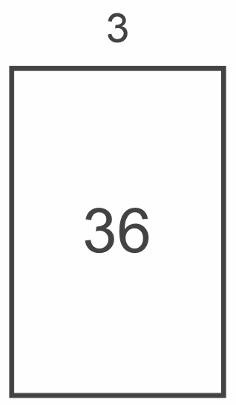
Representing multiplications
Can you identify the equation based on the representation?
10 x 3 + 10 x 3 + 2 x 3

Slide 7
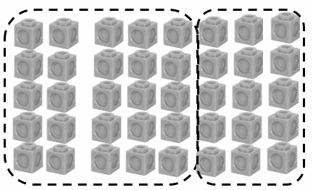
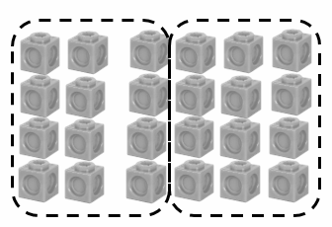
Representing multiplications
What is the multiplication shown?

Slide 8
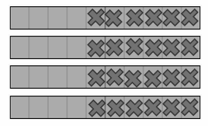
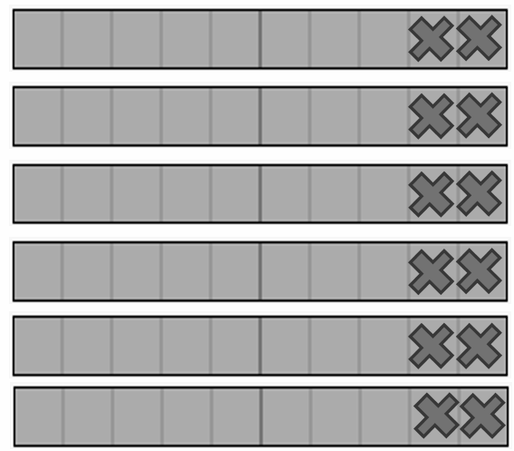
Representing multiplications
What is the multiplication shown?
?
?

Slide 9
True or False. Discuss your reasoning
Do you agree or disagree with the following statements made by Joe?
Can you explain your reasoning for why he is right or wrong?
You can use a 100 square to help if you would like!
There is only one number that is a multiple of seven and nine.
It’s 63
I know this because 7 x 9 = 63

Slide 10
True or False. Discuss your reasoning
Do you agree or disagree with the following statements made by Joe?
Can you explain your reasoning for why he is right or wrong?
You can use a 100 square to help if you would like!
All multiples of 8 and 4 are even

Slide 11
True or False. Discuss your reasoning
Do you agree or disagree with the following statements made by Joe?
Can you explain your reasoning for why he is right or wrong?
You can use a 100 square to help if you would like!
There is only one multiple of 9 on each row of a 10 x 10 grid?

Slide 12
True or False. Discuss your reasoning
Do you agree or disagree with the following statements made by Joe?
Can you explain your reasoning for why he is right or wrong?
You can use a 100 square to help if you would like!
The product 39 can only be created by the multiplication
1 x 39?

Slide 13
Moving Multiples
Mike the Machine is being cheeky and playing around with the multiples!
Read the numbers carefully and answer the questions you see.
Here are the first ten multiples of seven:
7, 14, 21, 28, 35, 42, 49, 56, 63, 70
Mike the Machine increases each multiple by
the same value:
11, 18, 25, 32, 39, 46, …
What do you notice about the digits in the ones place?
Will the number 73 and 88 be in this new pattern?
Can you name identify a 3-digit number in the new pattern?

Slide 14
Moving Multiples
Mike the Machine is being cheeky and playing around with the multiples!
Read the numbers carefully and answer the questions you see.
Here are the first ten multiples of nine:
9, 18, 27, 36, 45, 54, 63, 72, 81, 90
Mike the Machine increases each multiple by
the same value:
15, 24, 33, 42, 51, 60, …
What do you notice about the digits in the ones place?
Will the number 87 and 114 be in this new pattern?
Can you name identify a 3-digit number in the new pattern?

Slide 15
Mystery Number
Read the clues carefully.
Eliminate the possible answers until you are left with one.
Double check the clues again!
Use your 100 square to help.
I am thinking of a number
It is a multiple of 7
The number is greater than 30 but less than 100
It is not a multiple of 9 or 6
It is an even number where one digit has a value less than 6
The sum of the digits is 11
What is the number?

Slide 16
Mystery Number
Read the clues carefully.
Eliminate the possible answers until you are left with one.
Double check the clues again!
Use your 100 square to help.
I am thinking of a number
It is a multiple of 5
The number is greater than 5 but less than 50
It is not a multiple of 8, 4 or 3
It is an odd number where one digit has a value greater than 2
The sum of the digits is 8
What is the number?

Slide 17
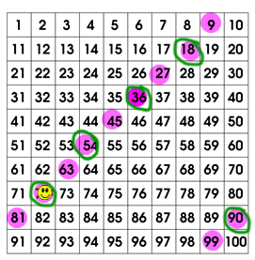
Challenge Slide
Can you work out what the clues would
be for 72 to be the mystery number?
I'm thinking of a number less than 100.

