Slide 1
Use Tangent to Find a Length
Maths
Miss Davies

Slide 2
Use Tangent to Find a Length
0.07 m
35°
30°
10cm

Slide 3
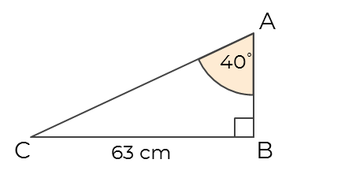
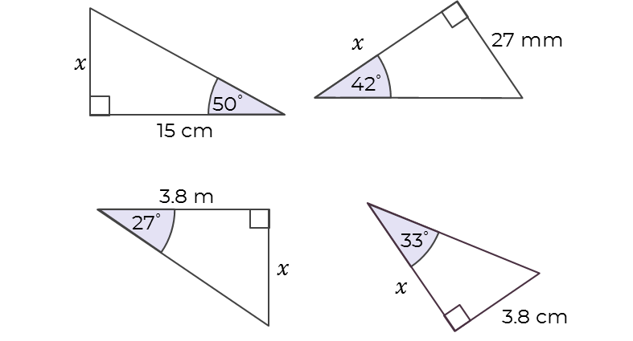
Use Tangent to Find a Length
4. Lycia is finding the length AB.
What mistake has she made?
5. A ladder is placed against a wall.
The base is 3 m from the bottom of the wall, at an angle of 60º with the floor.
How high up the wall does the ladder reach?

Slide 4
Answers

Slide 5
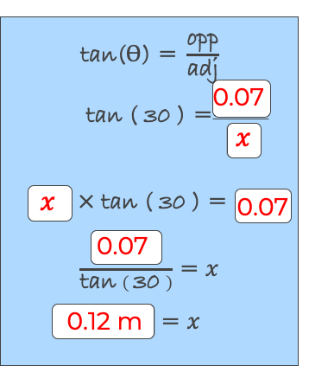
Use Tangent to Find a Length
0.07 m
35°
30°
10cm
35
10
10
35
7 cm

Slide 6
Use Tangent to Find a Length
4. Lycia is finding the length AB.
What mistake has she made?
5. A ladder is placed against a wall.
The base is 3 m from the bottom of the wall, at an angle of 60º with the floor.
How high up the wall does the ladder reach?
She has multiplied by 63. She should have multiplied by AB, then divide by tan(40).
5.2 m

