Slide 1
Forces and Elasticity 2
Combined Science - Physics - Key Stage 4 - Forces
Mr Saville
Miss Whittick

Slide 2
Warm up - Independent task
In our investigation into springs and stretching, what was independent variable?​ (the thing we change)
What was the dependent variable? ​ (the thing we measure)
What sort of relationship did we find?
​
What does this mean in terms of the spring’s behaviour every time the force is increased?
​​
What is the symbol for directly proportional?

Slide 3
You do - Independent Practice
A spring has a spring constant of 5 N/m and extends by 0.3 metres. Calculate the force needed to make this happen. (F = k x e)
A spring has a spring constant of 7.5 N/m and extends by 0.25 metres. Calculate the force needed to make this happen. Give your answer to 2 significant figures.
A spring has a spring constant of 13 N/m and compresses by 70 centimetres. Calculate the force needed to make this happen.
A spring has a force of 2.1 N applied to it and a spring constant of 0.3 N /cm. Calculate the extension.
A spring has a force of 4.6 N applied to it and a spring constant of 4.3 N / m. Calculate the extension. Give your answer to 3 significant figures.

Slide 4
Force​ (N) | Extension (cm)​
 | Test 1​ | Test 2​ | Test 3​ | Mean​
1​ | 0.5​ | 0.6​ | 0.4​ | (0.5+0.6+0.4) / 3 = 0.5
2​ | 1.0​ | 1.9​ | 1.0​ | (1.0+1.0) / 2 = 1.0
3​ | 1.6​ | 1.4​ | 1.5​ | ​
4​ | 2.1​ | 5.1​ | 1.9​ | ​
5​ | 2.4​ | 2.5​ | 2.5​ | ​
6​ | 3.0​ | 3.1​ | 4.7​ | ​
7​ | 3.5​ | 3.4​ | 3.6​ | ​
8​ | 5.6​ | 5.5 | 5.4 | ​

Slide 5
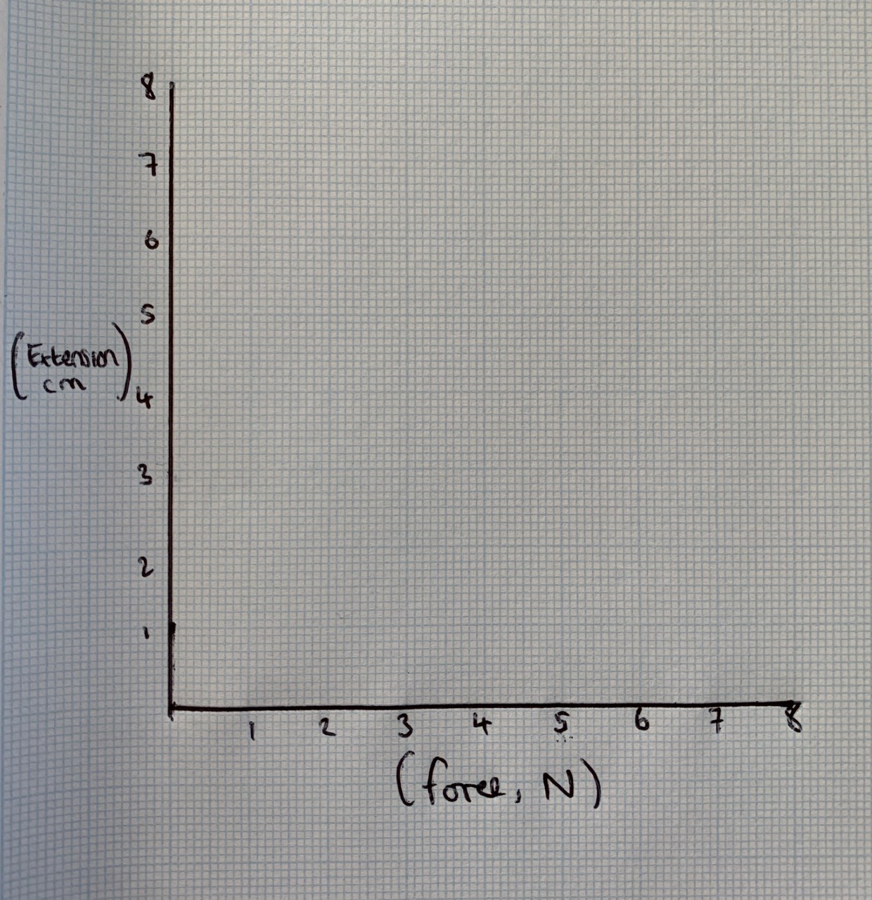
Independent Practice
Force​ (N) | Mean​ Extension (cm)
1​ | 0.5​
2​ | 1.0​
3​ | 1.5​
4​ | 2.0​
5​ | 2.5​
6​ | 3.0​
7​ | 3.5​
8​ | 5.5​
Use the results from our secondary data to plot a graph.

Slide 6
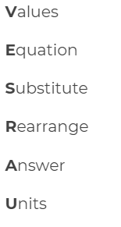
Calculating EPE - You do
A spring has a spring constant of 9.4 N/m and extends by 0.1 metres Calculate the elastic potential energy stored in the spring.
A spring has a spring constant of 15.5 N/m and extends by 0.5 metres. Calculate the elastic potential energy stored in the spring.
A 0.2m spring stretches to 0.6 m when a force is applied. The spring has a spring constant of 2 N/m. Calculate the elastic potential energy stored in the spring.

